Slide 1

PROPHYLAXIS D1110
Medical Necessity Questionnaire Training & Submission Process Overview

Slide 2


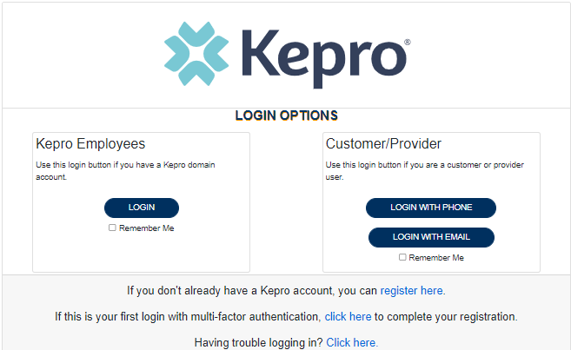
Atrezzo Provider Portal
Training Website:
For in-depth training on the new Atrezzo Platform, please visit:
mhcp.Kepro.com/training
> Atrezzo Provider Portal
Training Video Link:
MHCP Atrezzo Portal Create Case Wizard Training Video
Atrezzo Provider Portal allows for:
Secure access to Atrezzo Connect (Provider Portal)
Provider will be able to access letters by Case/Request, Respond/Send messages To/From KEPRO
Receipt of a Kepro Case ID# to confirm Kepro has successfully received your submission.
D1110 Questionnaire Training |

Slide 3


Prophylaxis D1110 Submissions
Enter Information & Upload Documentation:
All questions must be answered accurately based on the SOAP Notes and any additional clinical information uploaded to the Atrezzo Case.
Questionnaire Completed & Signed:
Upon completion, the Questionnaire is legally binding and may be used as evidence in an appeal and is also subject to routine audits.
Questions or Concerns?
Please stop and refer any concerns presented to the clinician who completed the procedure. (Refer to the MHCP Manual with questions regarding routine policies or procedures.

Slide 4
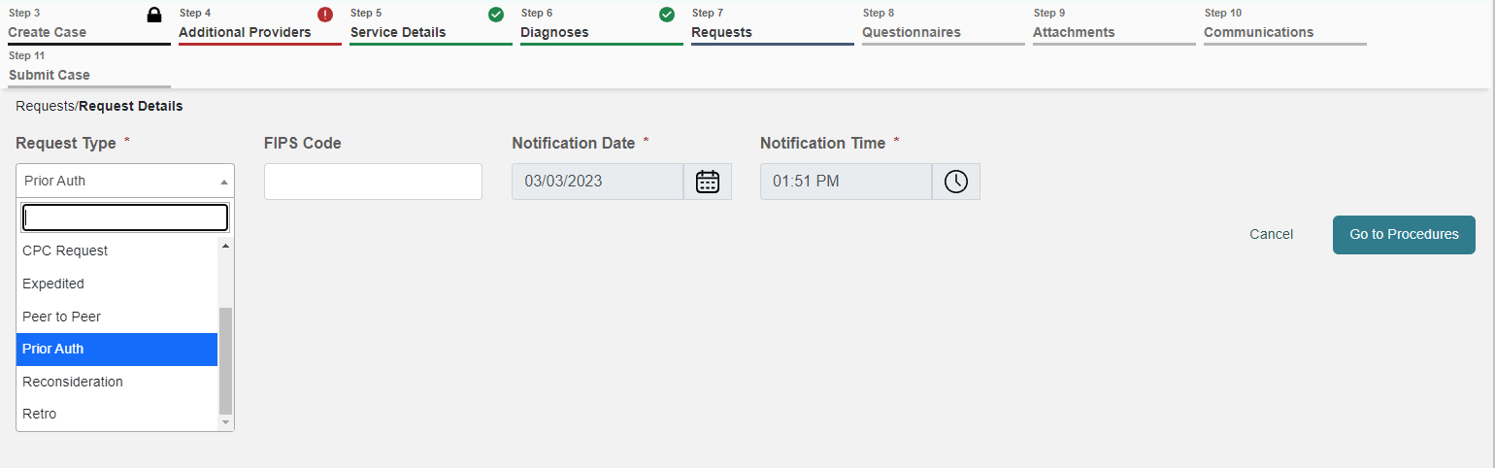
Authorization Submission Types
Prior & Retro Authorizations
Prior Auth: Prior authorization for additional prophy(s) for up to two years OR for completed prophy(s) within the current year.
Retro Auth: Prophy(s) completed in previous year ONLY

Slide 5
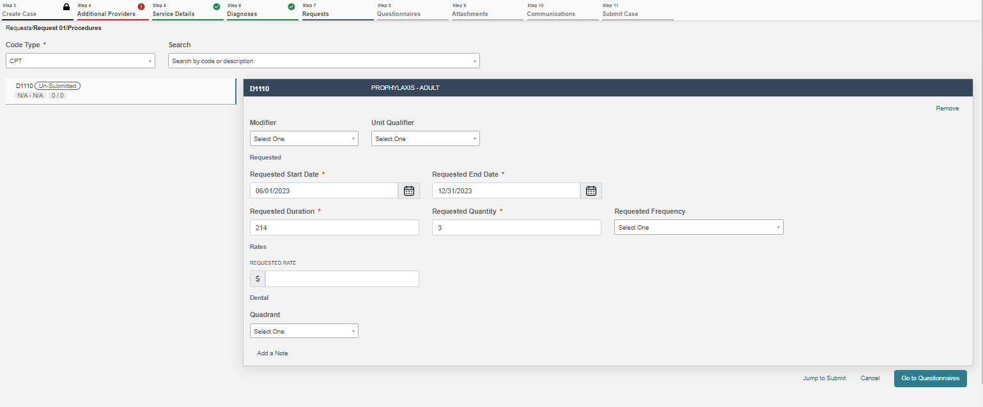
Atrezzo Case Creation
2. Start date should always be a future date.
1. Create only one request line for code D1110
3. Enter “End Date” as the last day of the calendar year (ex: 12/31/23 | 12/31/24)
*For Retro Requests, (If completed in previous year), start date & end date should be identical to reflect the date of service completed
Impacted Teeth Questionnaire Training |
Page 5

Slide 6


Questionnaire
Prophylaxis D1110:
***CLINICAL DOCUMENTATION MUST SUPPORT THE ANSWERS GIVEN IN THE QUESIONNAIRE
The D1110 Questionnaire has been created in collaboration with DHS specific to D1110 Criteria
As of April 1, 2023, this Questionnaire MUST BE submitted.
  If not utilizing the Provider Portal, please print this document here:
  Dental (D1110) Questionnaire
Questionnaire DOES NOT replace clinical notes

Slide 7

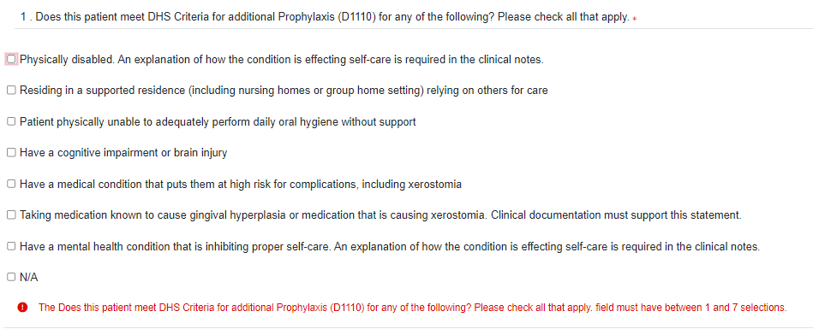
Question #1
1. Please check ONLY the options that are supported by the clinical documentation SUBMITTED that apply to
this recipient.
D1110 Questionnaire Training |

Slide 8

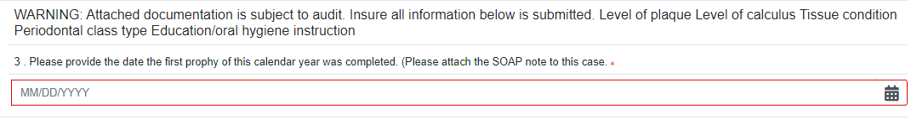
Question #2 - #3
Indicate the correct
answer to Question #2.
WARNING: Documentation is required and subject to audit.
D1110 Questionnaire Training |

Slide 9

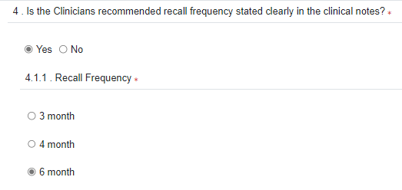
Question #4
If is selected, please indicate the frequency.
D1110 Questionnaire Training |

Slide 10

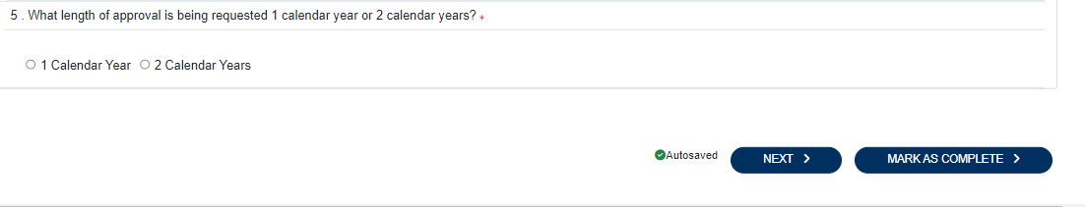
Question #5
Indicate the correct answer to question number 5.
Click “Next to move to Attestation
D1110 Questionnaire Training |

Slide 11
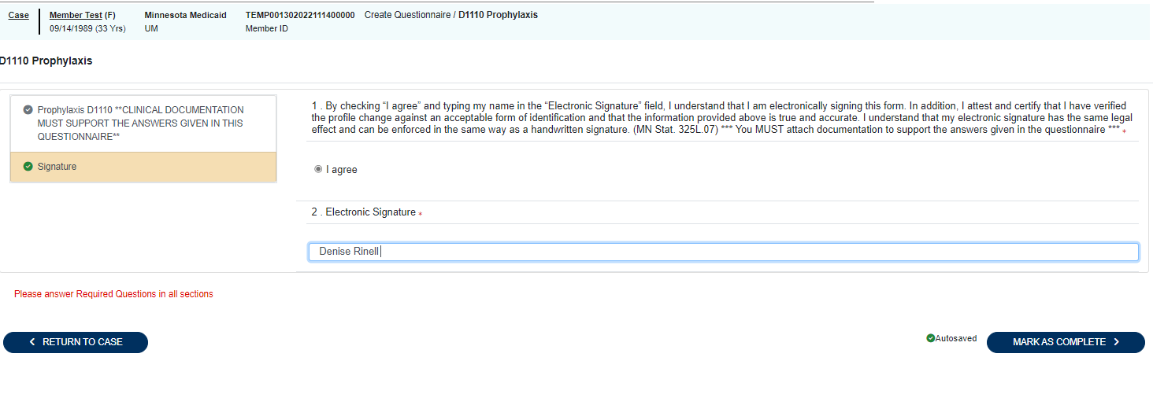
Attestation
Please choose and type in your name.
Attest and certify that the information provided is true and accurate!
*Review all answers to ensure complete and accurate information and click “Mark as Complete” to finish the questionnaire step.
D1110 Questionnaire Training |

Slide 12
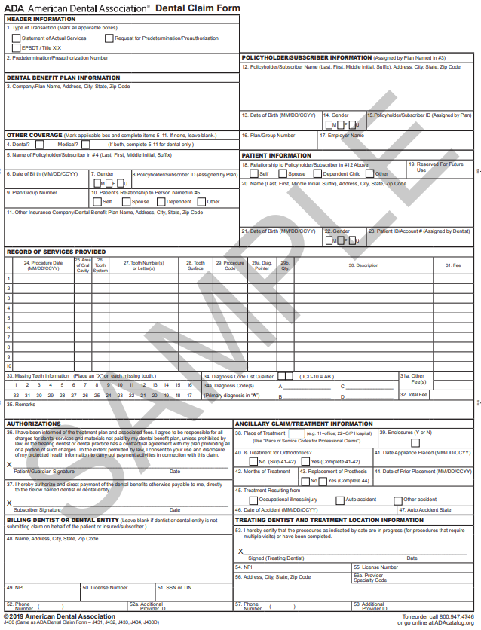
Documentation Notes
*Per DHS, the ADA Form is NOT considered clinical documentation
Please remember:
Providers must follow federal and state regulations and MN Board of Dentistry requirements for documentation, infection control, and patient care.
All documentation must have patient identifiers and treatment/exam date.
Clinical notes must be signed by clinician.
ADA form, non-clinical handwritten notes or case note entries in Atrezzo are not considered clinical documentation.
Questionnaire does not replace clinical notes.
For D1110, radiographs and periodontal charting are not required documentation for submission
D1110 Questionnaire Training |

Slide 13
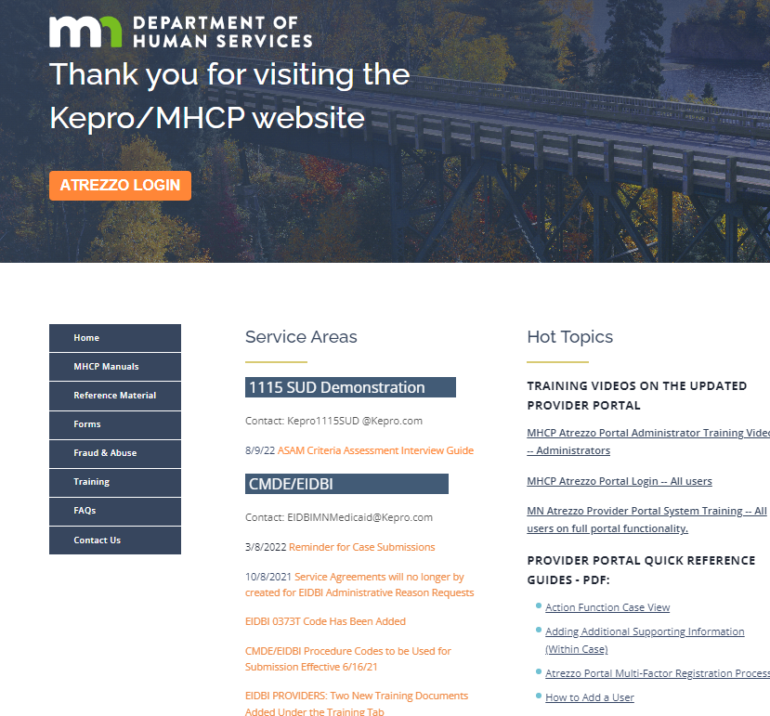
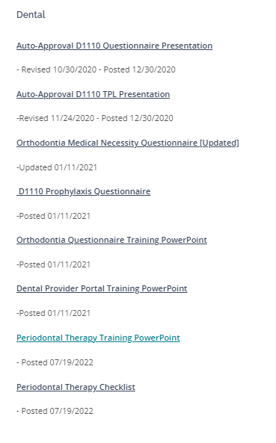
MHCP.KEPRO.COM
To access all available trainings, please follow the action steps below:
Please visit MHCP.Kepro.com
Click on the “Training” Tab
Expand the “Dental” Section
Access all available trainings
D1110 Questionnaire Training |

Slide 14

Question & Answer

Slide 15

Thank you for attending!
Please reach out with any questions you may have.
Contact Info
1 (866) 433-3658
DentalMNMedicaid@Kepro.com
https://mhcp.kepro.com/

