Slide 1
Periodontal therapy training
D4341 & D4342
Checklist Introduction and DHS Criteria Review

Slide 2
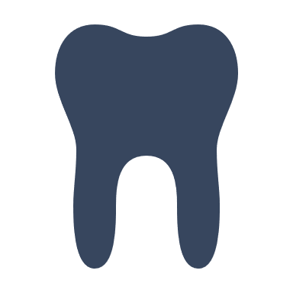
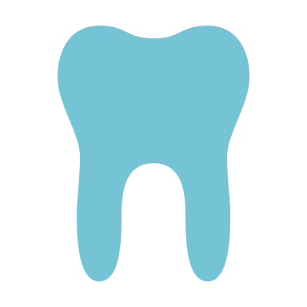
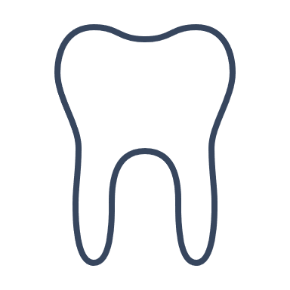
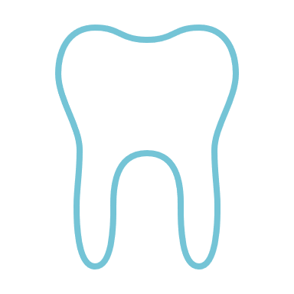
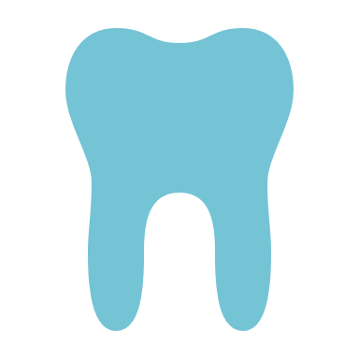
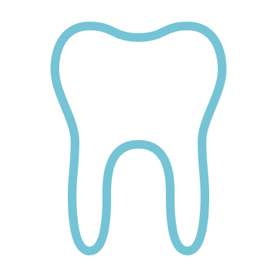

DEFINITIONS
D4341
Four or more teeth per quadrant
Per DHS, quadrant designation is to be:
  10, 20, 30, 40
D4342
One to three teeth per quadrant
Teeth to be treated must be specified

Slide 3
DHS Criteria
Scaling and Root Planing
Evidence of bone loss present in current, diagnostic radiographs to support the diagnosis of periodontitis
  full mouth series
  PA’s
  Bitewings
Presence of pathology including:
  bleeding,
  deposit levels
  tissue conditions
Pocket depth of greater than 4 mm
  To meet American Academy of Periodontology (AAP) criteria for periodontal scaling and root planing

Slide 4
Checklist: Periodontal Therapy
Submit requests for authorization with the following dental history, case information, and documentation:
  Copies of current diagnostic imaging (BWX, PA’s, FMX)
  Panoramic Radiograph is not used to diagnose bone loss per industry standard
  Patient’s name and date of exposure must be on each radiograph submitted (Preferably mounted as a set)
MEDICAL NECESSITY DOCUMENTATION REQUIREMENTS PER DHS POLICY (Must be uploaded to the case)
Please confirm by checking the box that all required documentation has been included

Slide 5
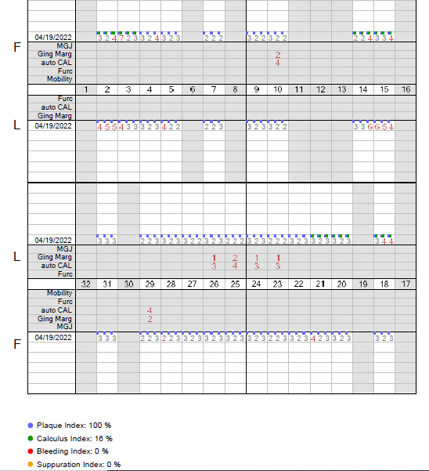

Checklist:
Periodontal Therapy
  Six-point periodontal charting including attachment loss and mobility
  Must be current
  Bleeding per requested site
  Please notate on Perio Charting
  If Perio charting is color coded, please submit a colored copy

Slide 6
Checklist: Periodontal Therapy
Clinical Information –
Must be in attached clinical notes
  Periodontal Prognosis for all requested teeth
  Classification of the periodontology case type which must be in accordance with documentation established by the AAP
    (Documentation must be included in attached clinical notes and signed by treating clinician including credentials)
MEDICAL NECESSITY DOCUMENTATION REQUIREMENTS PER DHS POLICY (Must be uploaded to the case)
Please confirm by checking the box that all required documentation has been included

Slide 7
Checklist: Periodontal Therapy
    Presence of Pathology in requested sites including:
    Bleeding per requested site
    Please notate on Perio Charting
    If Perio charting is color coded, please submit a colored copy
    Deposit levels (plaque and calculus) per requested site
    Tissue conditions per requested site
    (Ex: Color, texture, shape)
    DHS Approved 06/14/2022
MEDICAL NECESSITY DOCUMENTATION REQUIREMENTS PER DHS POLICY (Must be uploaded to the case)
Please confirm by checking the box that all required documentation has been included

Slide 8

SCALING & ROOT PLANING
Frequency, Limitations of Service
Allowed once per two years
Cannot be performed on the same day as D1110 or D⁴³⁵⁵

Slide 9


Periodontal Maintenance
PRIOR AUTHORIZATION
SERVICE FREQUENCY
Prior authorization IS NOT REQUIRED
Do not submit to review agent
Allowed once every 91 days for 730 days following the completion of srp

Slide 10

Questions & Answer
Thank you for attending.

Slide 11

Conclusion
We are happy to answer any questions or work with any issues that arise. Please email us at:
DentalMNMedicaid@Kepro.com
Please do not include any PHI in your correspondences.
Contact Info
DentalMNMedicaid@Kepro.com
https://MHCP.Kepro.com

