Slide 1
MN PHP Prior Authorization Submission Requirements

Slide 2
Kepro is now Acentra Health….
……which can be a little confusing as technology and access merge to a single name.
Contact numbers, email addresses and web sites will eventually show full name change but your current access points remain the same

Slide 3
Partial Hospitalization program
Review Submission Process
Turn around times –
Prior authorization requests are completed within 10 business days
Retrospective authorization requests are completed within 20 business days

Slide 4
When to request an authorization?
If the patient remains in PHP treatment past 21 days
If the patient is entering treatment within 45 days of discharge from PHP (*please indicate this information with your authorization request)
When to submit the DHS-4695-ENG MHCP Authorization Form
Because everyone wants to know ☺
    ONLY if submitting a FAXED submission OR when requesting a change to a previously approved authorization
    NOT required when submitting via the Provider Portal or when generating your own PA

Slide 5
How to submit:
Portal Submissions
Fax Submissions
  We encourage all Minnesota Providers to use this process as it allows the greatest amount of control of your review submission
  Pick the time you submit
  Select NPI, service location, providers, dates of service, CPT codes, units
  Access to message system to communicate questions and information directly to the review team
  Easily monitor status throughout the review process
  *If you are interested in learning more about the portal benefits, please contact us at MH.SUD.ProviderQuestions@Kepro.com
The medical review agent creates the review case file and generates a prior authorization in the MMIS (MNit’s) system.
When electing this process, please submit documents in the following order to ensure your case is created accurately:
Ensure the initial fax cover sheet clearly identifies the type of service AND if this is a readmission
Completed DHS required forms
Present DHS required documentation in the order of completion, i.e., diagnostic assessment, treatment plan, progress notes, reviews, etc.
This process unfortunately does not allow for direct messaging

Slide 6


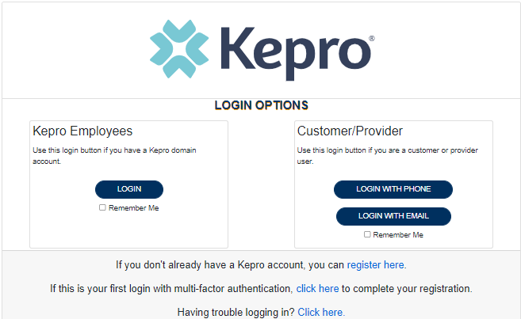

ANG Provider Portal
Training Website:
For in-depth training on the new ANG Platform, please visit:
mhcp.Kepro.com/training
> ANG Provider Portal
Training Video Link:
MHCP ANG Provider Portal Create Case Wizard Training Video
ANG Provider Portal allows for:
Secure access to ANG Connect (Provider Portal)
Provider will be able to access letters by Case/Request, Respond/Send messages To/From KEPRO/Acentra
Receipt of an ANG Case ID# to confirm Acentra has successfully received your submission.
Notes:
Might want to doublecheck that the letters access DOES use the word “Kepro”.. And address “Kepro Case ID#”… or is it an ANG Case ID#?

Slide 7


Clinical Review Outcome
Acentra clinically evaluates all submitted documentation to determine medical necessity using DHS criteria
Types of Determination
Approval – Submission meets all DHS criteria
Pended – Additional information is required to determine if DHS criteria met – provider required to submit within 15 calendar days
Adverse Determinations
Rejected – Documentation not presented as required by DHS, i.e., no progress notes
Denied – Medical Director has determined the quality of the documentation does not meet DHS standards and requirements, i.e., treatment plan does not demonstrate measurable goals/objectives
Denied – Provider did not comply with DHS requirement to verify existing Third-Party Liability (TPL) payor (Medicaid is the payor of last resort) at time of submission

Slide 8

Tips and Tricks
Read the MHCP Provider Manual on a regular basis
Check for updates and revisions /Sign up for DHS email updates
Use the most current DHS form (most come with instructions)
Clearly identify the initial PHP treatment start date
When possible, label your documents to correspond with DHS requirements
If experiencing challenges with printing from your ERH/EMR, reach out to DHS provider services or speak with your DHS policy lead
When faxing, clearly identify your service request …. Load documents in clinical order
Advise when you are requesting authorization for a readmission
Only send the DHS required documentation, be easy on yourself
For pended requests, NEW information is being requested
AND ….consider using the Kepro-Acentra provider portal for your review submission
QUESTIONS?

Slide 9



Questions
Feel free to reach out to the below contacts with any concerns or questions.
Additional Contact Information
Kepro Provider Services: (866) 433-3658
DHS Provider Services: (651) 431-2700
MH.SUD.ProviderQuestions@kepro.com
For clinical review assistance
MNProviderIssues@kepro.com
For assistance with Portal Access or Training
Notes:
25

Slide 10
Documentation Standards
Please see DHS presentation for more information

