Slide 1
ORAL SURGERY - IMPACTED TEETH questionnaire training
Medical Necessity Questionnaire Training

Slide 2
DHS Criteria for Extraction of Impacted Teeth
IMPACTED TEETH
Requests for authorization must include documentation of evidence of pathology and documentation of one or more of the following criteria:
Presence of severe pain or swelling
Documented recurrent episodes of pericoronitis
An episode of cellulitis
An episode of abscess formation or untreatable pulpal or periapical pathology
Active current periodontal disease due to the position of the third molar and its association with the second molar
External resorption of the third molar or of the second molar where this would reasonably appear to be caused by the third molar
A non-restorable carious lesion on a partially erupted third molar or a carious lesion on the distal of the second molar due to the position of the third molar
A pathological condition such as a dentigerous cyst or other related pathology
Systems per tooth MUST BE charted per DHS requirements
Systems per tooth MUST BE charted per DHS requirements
Pain level per tooth MUST BE charted per DHS requirements

Slide 3
Documentation Requirements
Submit authorization requests with the following dental history and case information:
Objective documentation of significant infections and symptoms for each tooth to be extracted
  This must be documented in the clinical documentation by a clinician
Pain level must be included for each tooth
  On a pain scale from 1-10.
  See pain scale on next slide
Any prescriptions given to treat pain or infection should be included

Slide 4
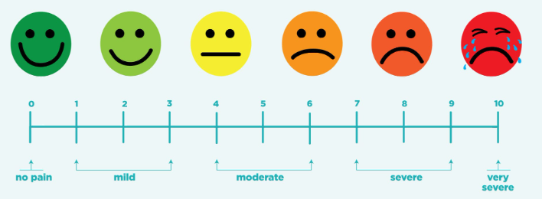
Universal Pain Scale
Impacted Teeth Questionnaire Training |

Slide 5
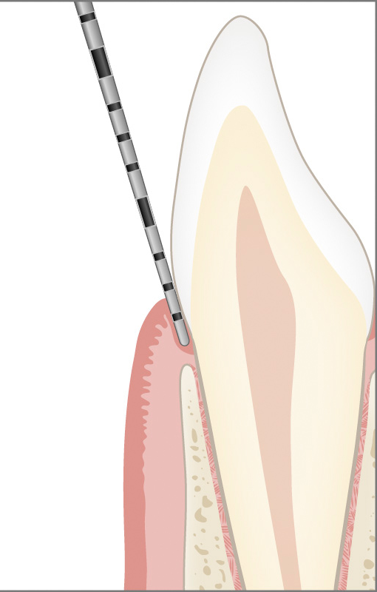
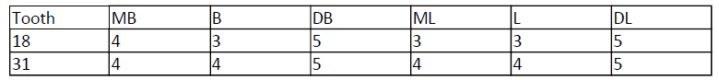
Documentation Requirements
Submit authorization requests with the following dental history and case information:
6 Point Periodontal charting of teeth involved if periodontal disease or periodontal defect is the rationale for extraction
Examples of ways to chart periodontal pockets:
#31: DB - MB 323
DL - ML 333
Periodontal Probing Depths (MB-B-DB) (ML-L-DL):
#2 - (444) (455)
#15 - (445) (345)
#18 - (455) (446)
#31 - (455) (345)
Periodontal Probing Depths:

Slide 6

Documentation Requirements
Submit authorization requests with the following dental history and case information:
Copies of current radiographs with diagnostic value and chart documentation for each tooth to be extracted.
X-rays must be mounted.
Indicate the date of exposure on all X-rays
Patient Identifiers must appear on all X-rays
Do not submit original X-rays; they could be lost and compromise the member’s care.

Slide 7

Documentation Requirements
Submit authorization requests with the following dental history and case information:
For episode of abscess formation or untreatable pulpal or periapical pathology, current radiograph must be submitted showing PAP
External resorption of the third molar or of the second molar (where this would reasonably appear to be caused by the third molar) must be visible on radiograph
A pathological condition such as a dentigerous cyst or other related pathology must be visible on radiograph

Slide 8
Questionnaire
A Questionnaire has been created in collaboration with DHS specific to Oral Surgery Authorization Requests
For all Oral Surgery Requests, this Questionnaire MUST BE submitted.
  If not utilizing the Provider Portal, please print this document here: Kepro Oral Surgery Questionnaire

Slide 9
video
Questionnaire Completion Steps
Impacted Teeth Questionnaire Training |

Slide 10
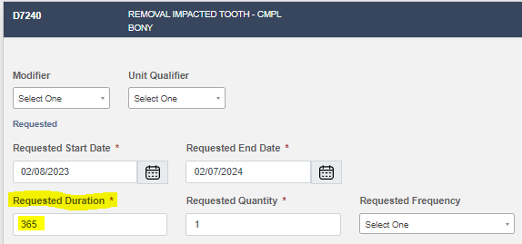
Requested Duration
When creating a case in the Provider Portal:
1. Enter the START DATE being requested,
2. Move to the REQUESTED DURATION,
3. Enter 365 if a full year approval is necessary.
Impacted Teeth Questionnaire Training |
Page 10

Slide 11
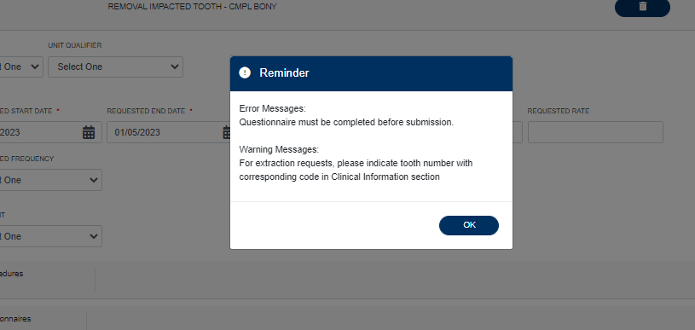
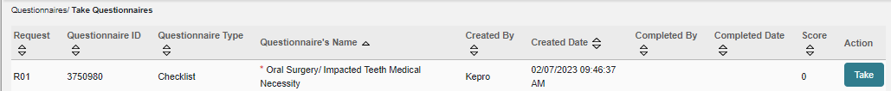
Atrezzo Portal Error Message
An error prompt will appear when you enter Oral Surgery Codes
Click “ok” to continue to the Questionnaire Section
Click “Go to Questionnaire” to expand for Questionnaire Link
Click on the blue button titled Action: “Take”

Slide 12

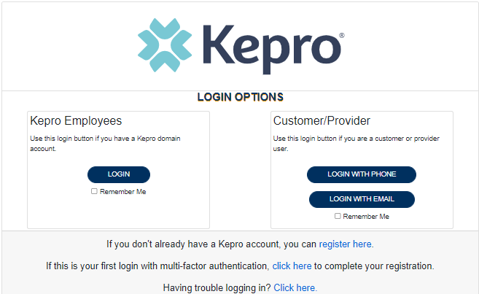

Atrezzo Provider Portal
Training Website:
For in-depth training on the new Atrezzo Platform, please visit:
mhcp.Kepro.com/training
> Atrezzo Provider Portal
Training Video Link:
MHCP Atrezzo Portal Create Case Wizard Training Video
Atrezzo Provider Portal allows for:
Secure access to Atrezzo Connect (Provider Portal)
Provider will be able to access letters by Case/Request, Respond/Send messages To/From KEPRO
Impacted Teeth Questionnaire Training |

Slide 13
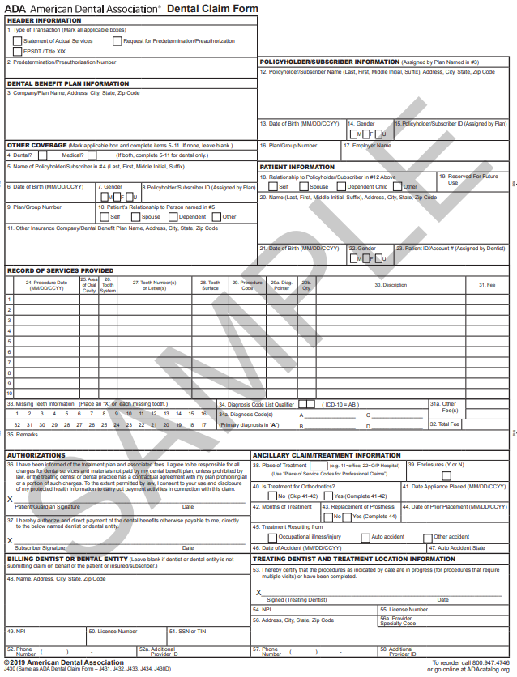
Documentation Notes
*Per DHS, the ADA Form is NOT considered clinical documentation
Please remember:
Providers must follow federal and state regulations and MN Board of Dentistry requirements for documentation, infection control, and patient care.
All documentation must have patient identifiers and treatment/exam date.
Clinical notes must be signed by clinician.
  Administrative staff taking phone calls from patient regarding symptoms may submit their entry. Please ensure signature and job title are included.
ADA form, non-clinical handwritten notes or case note entries in Atrezzo are not considered clinical documentation.
Questionnaire does not replace clinical notes.
Impacted Teeth Questionnaire Training |

Slide 14
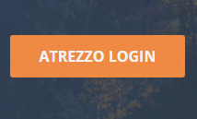
Accessing Atrezzo
Provider Portal
Select “Atrezzo Login”
To Register for Atrezzo Provider Portal :
Enter your 10 digit National Provider Identifier (NPI) number and Provider Registration Code (Provider to call Kepro Customer Service (866) 433-3658 to obtain registration code)
Website: https://mhcp.kepro.com
Registered Provider:
Enter your unique username and password

Slide 15
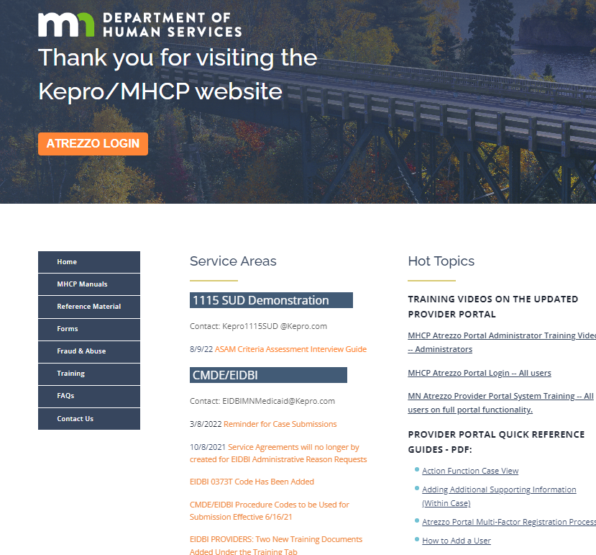
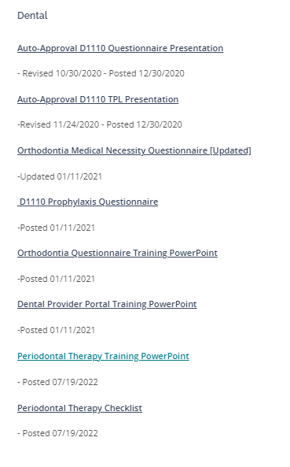
MHCP.KEPRO.COM
To access all available trainings, please follow the action steps below:
Please visit MHCP.Kepro.com
Click on the “Training” Tab
Expand the “Dental” Section
Access all available trainings
Impacted Teeth Questionnaire Training |

Slide 16

Question & Answer
Impacted Teeth Questionnaire Training |

Slide 17

Thank you for attending!
Please reach out with any questions you may have.
Contact Info
1 (866) 433-3658
DentalMNMedicaid@Kepro.com
https://mhcp.kepro.com/

