Slide 1
Retrospective Post-Payment Reviews
AtrezzoTM Provider Portal
Submission Requirements
KEPRO

Slide 2
Review Process
Minnesota Health Care Programs Retrospective Post-Payment Reviews will be conducted by KEPRO beginning in the Fourth Quarter of 2017
Each quarter the STATE will focus on select outpatient and inpatient review objectives. Claims will be pulled from 2016
If your claim is selected, you will receive a Request for Medical Records via fax notification

Slide 3
Retrospective Review Process
Key components of the review include:
  Coverage Policy
  Medical Necessity
  Level of Care
  Coding
  Quality of Care

Slide 4
Retrospective Review Process
Requested medical records must be submitted to KEPRO within 15 business days following the date of the request
If Medical records are NOT received within 15 business days, a second notice requiring immediate attention will be sent via fax requesting medical records submittal within 10 business days
If the required documentation is NOT received within 10 business days of the final notification , KEPRO will close the case and will notify DHS for further action

Slide 5
Retrospective Review Required Submission Method
Requested Medical records must be submitted directly to KEPRO via Atrezzo Provider Portal web based system
  Non-registered providers must utilize the login credentials listed on the Request for Medical Records notification letter
  Registered providers that currently utilize the Atrezzo Provider Portal system for Minnesota Medicaid prior authorization request must continue to utilize existing login credentials
Once registration is completed, the provider will conduct a search using the patient’s Minnesota Medicaid ID or the Case ID listed on the Request for Medical records notification letter

Slide 6
Retrospective Review Requested Medical Records
  Required information to submit includes the following:
Inpatient Claim | Outpatient Claim
Emergency department records History and physical examination Discharge summary Consultation reports Physician orders Physician, nurse and other progress notes Surgery, anesthesia and other procedure records Laboratory results Diagnostic and imaging reports Dialysis, chemotherapy, radiation and transfusion records Transplantation reports Ventilator and other flow sheets Medical equipment records Medication administration and dispensing records | Certified plan (s) of care Signed physician order (s) Initial evaluation and treatment notes Ongoing progress reports Daily or treatment notes Discharge plan Discharge summary Note: Providers must submit the signed doctor’s order and initial evaluation regardless of the dates of service under review. Without these documents, KEPRO will deny the case.

Slide 7
Retrospective Review
  The Minnesota Department of Human Services (DHS) will review the results of the reviews.
  DHS will contact the provider only if follow up is indicated.

Slide 8

Accessing Atrezzo Provider Portal
Website Address: mhcp.kepro.com
Select “Atrezzo Login”

Slide 9
Atrezzo Provider Portal
Atrezzo Provider Portal allows for:
– Secure access to Atrezzo Connect (Provider Portal)
– Provider will be able to access letters by Case/Request, Respond/Send messages To/From KEPRO

Slide 10
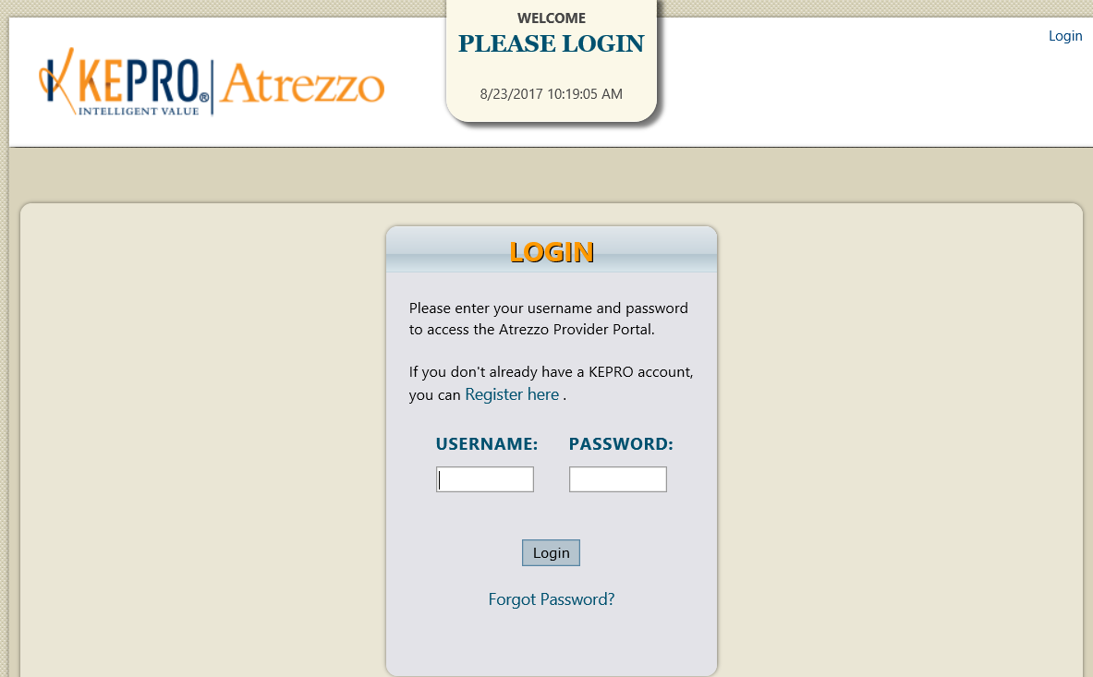
Atrezzo Provider Portal
Login Page
Click “Register here” to begin registration. Once registration has been completed, you will gain immediate access to KEPRO’s Atrezzo Provider Portal System.

Slide 11
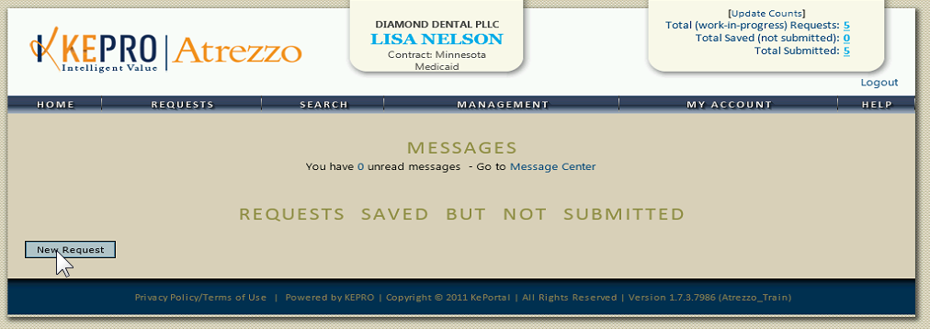
Atrezzo Provider Portal
Home Page
Successful completion of setup/login, takes you to the Home Page
Hoover over the “Search” tab and select “Request/Case or Member” to access your KEPRO case
Your organization
Your Name
Minnesota

Slide 12
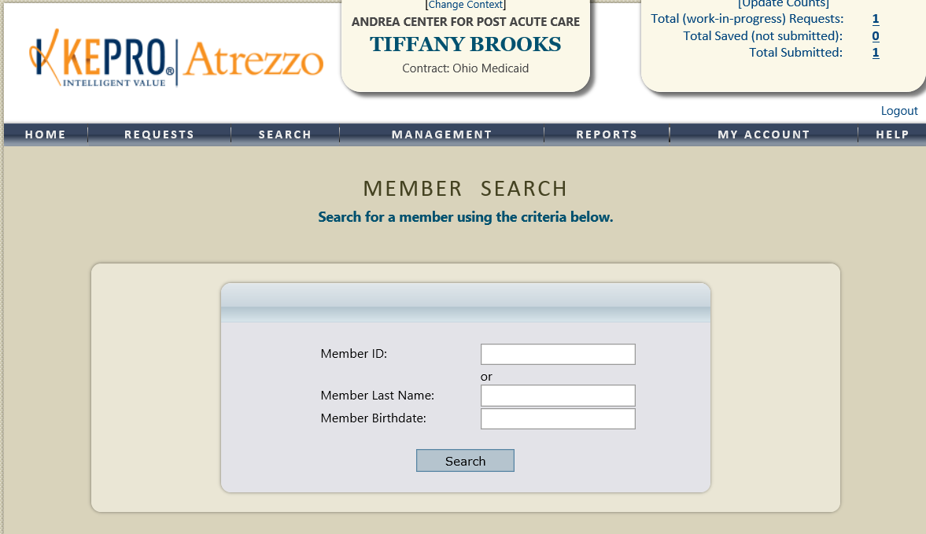

Atrezzo Provider Portal
Locating Request via Member Search
Complete member search utilizing the Member’s Minnesota Medicaid ID # or Last name and Birthdate

Slide 13
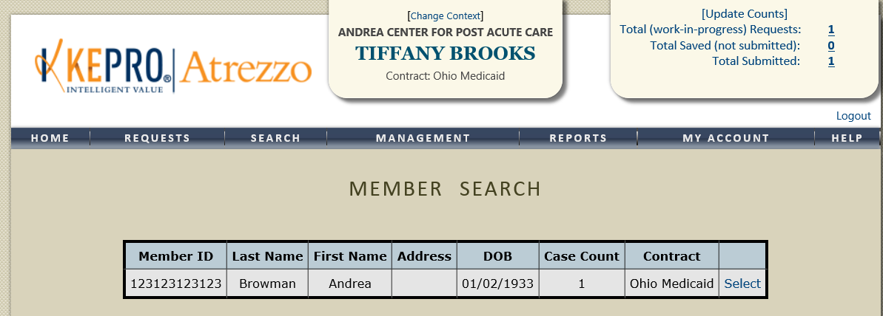
Atrezzo Provider Portal
Locating request via Member Search
Upon verification of the Member’s First Name, Last Name, and Date of Birth, Click “ Select” under the actions column

Slide 14
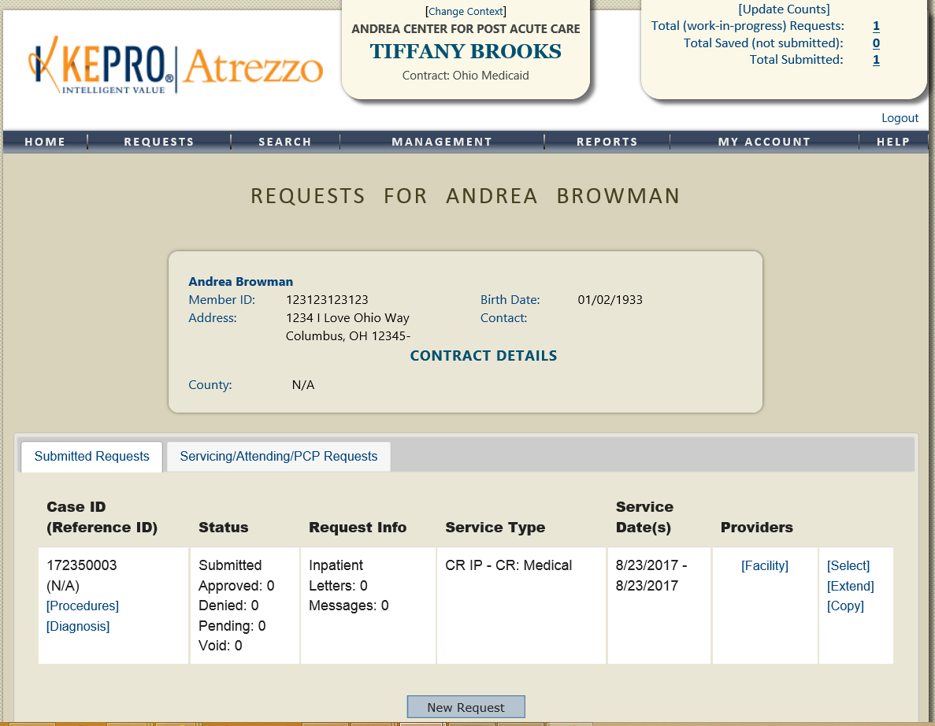
Atrezzo Provider Portal
Locating request via Member Search
Locate the case identified on the Request for Records Notification letter. Click ‘Select” to access the case

Slide 15
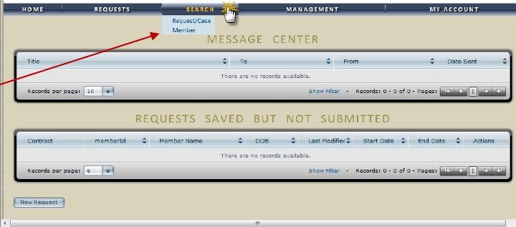
Atrezzo Provider Portal
Locating request utilizing KEPRO’s Case ID
Hoover over “Search” tab and Click Request/ Case option

Slide 16
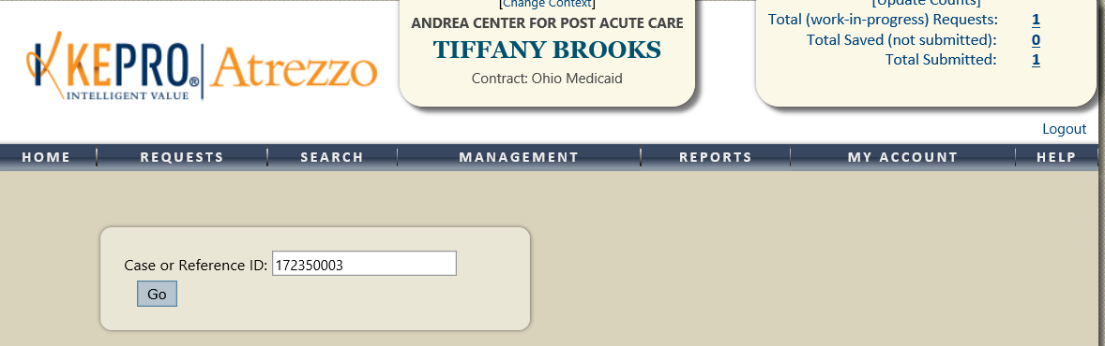
Atrezzo Provider Portal
Locating request utilizing KEPRO’s Case ID
Enter the Case ID listed on your “Request for Medical Records” Letter/Notification . Select “Go”

Slide 17
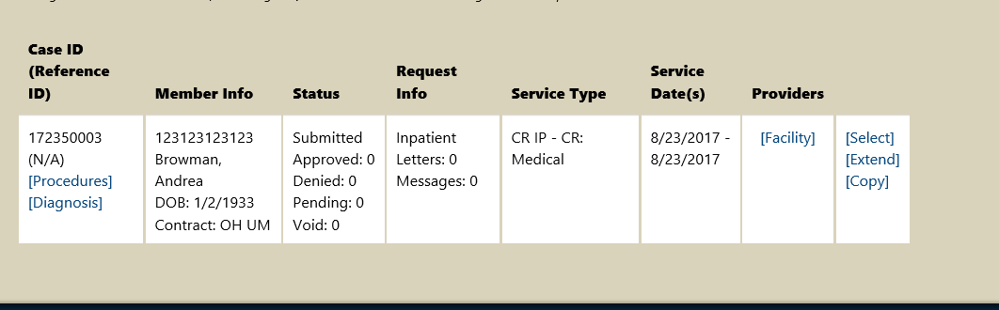
Atrezzo Provider Portal
Locating request utilizing KEPRO’s Case ID
Search Results will Display at the bottom of your page.
Click “Select” to access the case

Slide 18
Atrezzo Provider Portal
Understanding the Request Overview Page
Request Overview page will displays all case information
Member Information
Requested and Certified CPT codes
Requested and Certified Quantity
Current Status (Pending- Add information, Submitted, Approved or Denied)
All Case Messages
  Ability to send a new messages
Attached Documents ( All clinical information previously attached for KEPRO Review )
  Ability to attach additional documentation
Clinical Information- View all Clinical notes submitted by KEPRO internal staff members and Providers via the Atrezzo Provider Portal System
  Ability to add Additional Clinical Information

Slide 19
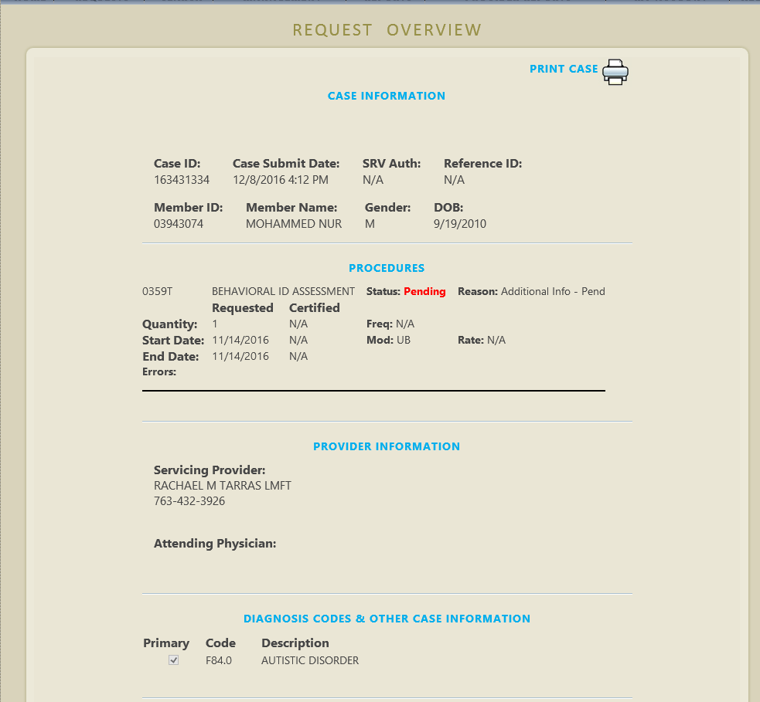
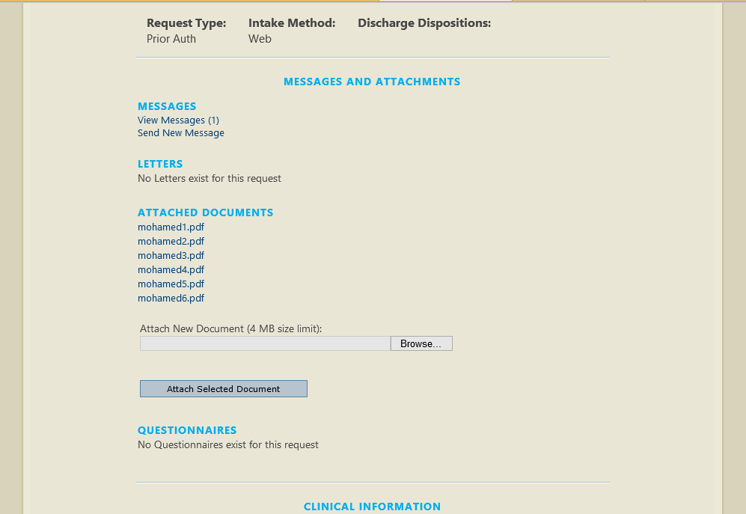
Atrezzo Provider Portal
Understanding the Request Overview Page

Slide 20
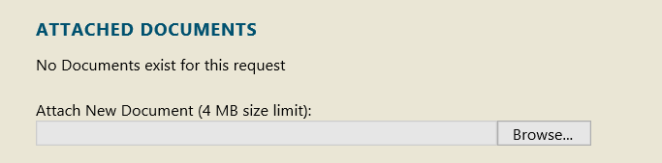
Atrezzo Provider Portal
Uploading Requested Medical Records
Uploading Medical Records
Under Attached Documents section, click “Browse” to select the document from your my computers/ my documents section. To attach documents, the intended documents must be saved on your computer

Slide 21
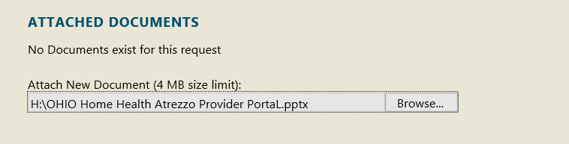
Atrezzo Provider Portal
Uploading Requested Medical Records
Once the document has been selected. The file name will display in the Browse Window

Slide 22
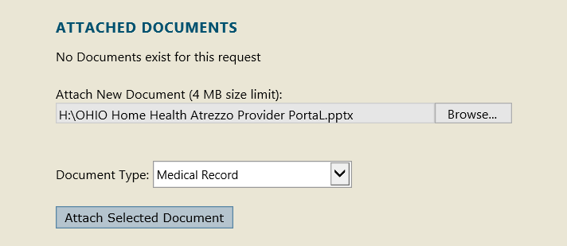
Atrezzo Provider Portal
Uploading Requested Medical Records
Document Type- Select Medical Record from the drop down listing
Click “Attach Selected Document”

Slide 23

Atrezzo Provider Portal
Uploading Requested Medical Records
The document name will reappear as a hyperlink

Slide 24
Atrezzo Provider Portal
Uploading Requested Medical Records
Provider Pointers:
Any one document must be less than 50 MB. There is no limit to the total size of all the documents, so long as each individual document is less than 4 MB.
If the document size is more than 50 MB compress the file to reduce the size.
  Instructional information regarding file compression depends on your individual computer settings. Consult with your IT representative within your facility for assistance.
  OR
  Split your document into two separate files to meet the maximum size limit.
Atrezzo accepts files with the following extensions:
    PDF DOCX XLS GIF TIF TXT
    XLSX JPG DOC RTF BMP JPEG

Slide 25
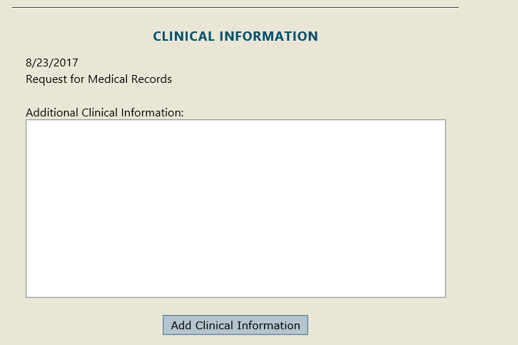

Atrezzo Provider Portal
Clinical Information Section
In the “Clinical Information” text box, data enter the submitter’s Name and Contact Information
Click “Add Clinical Information”

Slide 26
KEPRO’s Contact Information
If you have any questions about registration for Atrezzo Provider Portal, please contact KEPRO at mnatrezzoregistration@kepro.com
OR
Refer to the Atrezzo Provider Portal User Guide located under the Help tab on the Home page in the Atrezzo Provider Portal

