Slide 1
EIDBI Atrezzo Provider Portal training
Utilizing the Create a Case Wizard
Portal Submission Requirements

Slide 2
Objectives
Registration & Submissions
Kepro’s role as the MRA
Certification Outcomes/FAQs
MHCP’s current medical review agent is Keystone Peer Review Organization (KEPRO). MHCP contracts with KEPRO to process EIDBI service authorization requests.
to increase efficiency and certification outcomes for these requests.
review the registration and submission process for EIDBI and CMDE requests via the Atrezzo Provider Portal
Notes:
As the MRA Kepro is an impartial party and uses the MHCP policies and statutes that are in place for EIDBI services to conduct reviews.
Kepro does not handle any billing/claims concerns and we ask those questions be directed the DHS provider call center who can further assist with connecting you to an EIDBI billing trainer.
General overview of the submission process. For more detailed instructions on the submission process please visit our website at https://mhcp.kepro.com/training for user guides and system navigation materials.
Following the review and information presented during the call today we hope to increase the certification outcomes for providers by addressing common reasons for rejections or requesting additional information.

Slide 3
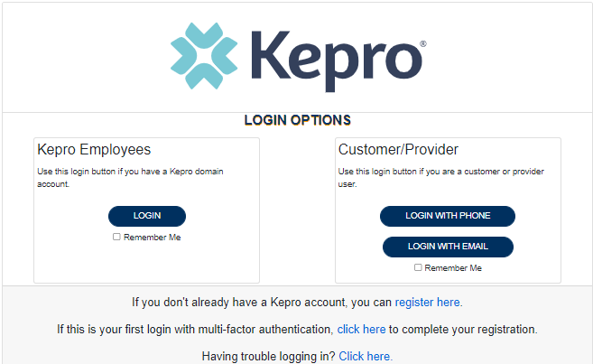
Atrezzo Provider Portal
Training Website:
For in-depth training on the new Atrezzo Platform, please visit:
mhcp.Kepro.com/training
> Atrezzo Provider Portal
Training Video Link:
MHCP Atrezzo Portal Create Case Wizard Training Video
Atrezzo Provider Portal allows for:
Secure access to Atrezzo Connect (Provider Portal)
Provider will be able to access letters by Case/Request, Respond/Send messages To/From KEPRO
Receipt of a Kepro Case ID# to confirm Kepro has successfully received your submission.

Slide 4
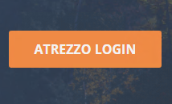
Accessing Atrezzo Provider Portal
Select “Atrezzo Login”
To Register for Atrezzo Provider Portal :
Enter your 10 digit National Provider Identifier (NPI) number and Provider Registration Code (Provider to call Kepro Customer Service (866) 433-3658 to obtain registration code)
Website: https://mhcp.kepro.com
Registered Provider:
Enter your unique username and password

Slide 5
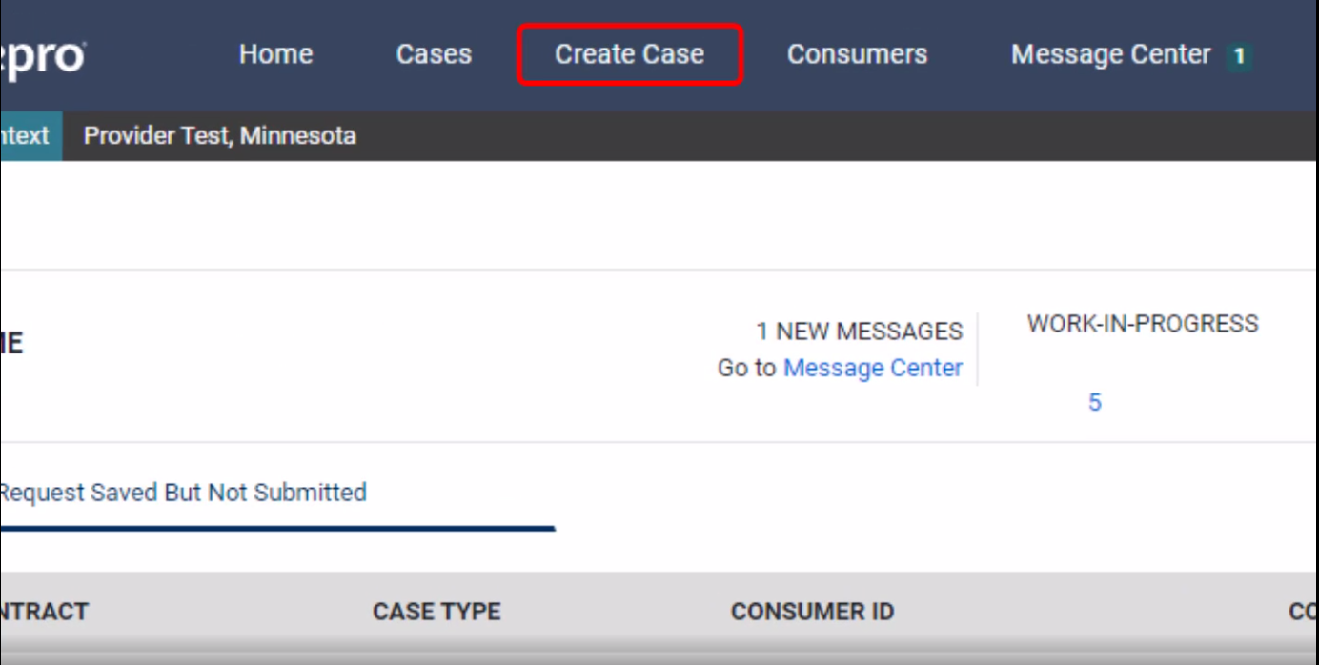
Atrezzo Provider Portal
Successful Completion of setup/login directs user to the Home Page
After logging in from the home screen, click on “Create Case”.

Slide 6
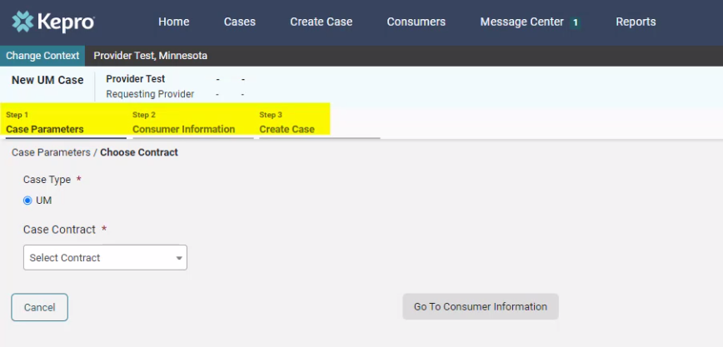
Atrezzo Provider Portal
The Create a Case Wizard shows each section as a Step. The required information will be indicated by a red asterisk (*).
Create Case Wizard

Slide 7
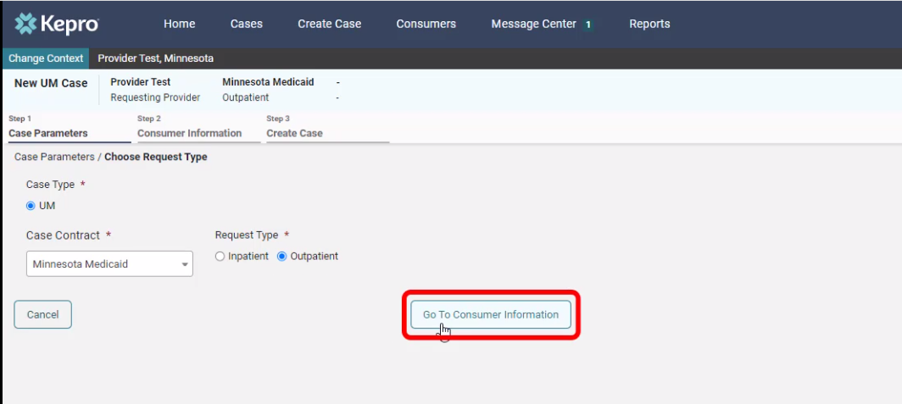
Atrezzo Provider Portal
Case Parameters
Choose:
Case Type: “UM”
Case Contract: “Minnesota Medicaid”
Request Type: “Outpatient”.
Click “Go To Consumer Information” to continue.

Slide 8
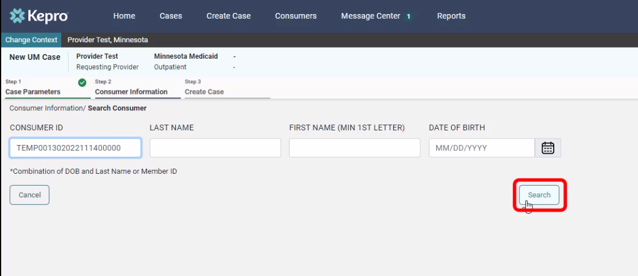
Atrezzo Provider Portal
Consumer information
Search members by:
MN Member ID
Last Name & DOB
Click “Search to continue”

Slide 9
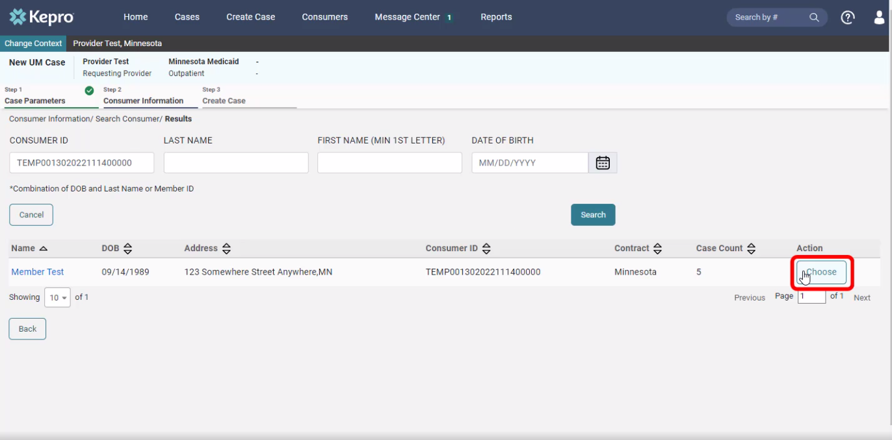
Atrezzo Provider Portal
The members demographic information will display.
Consumer information
Verify member information.
Click “Choose” to continue.

Slide 10
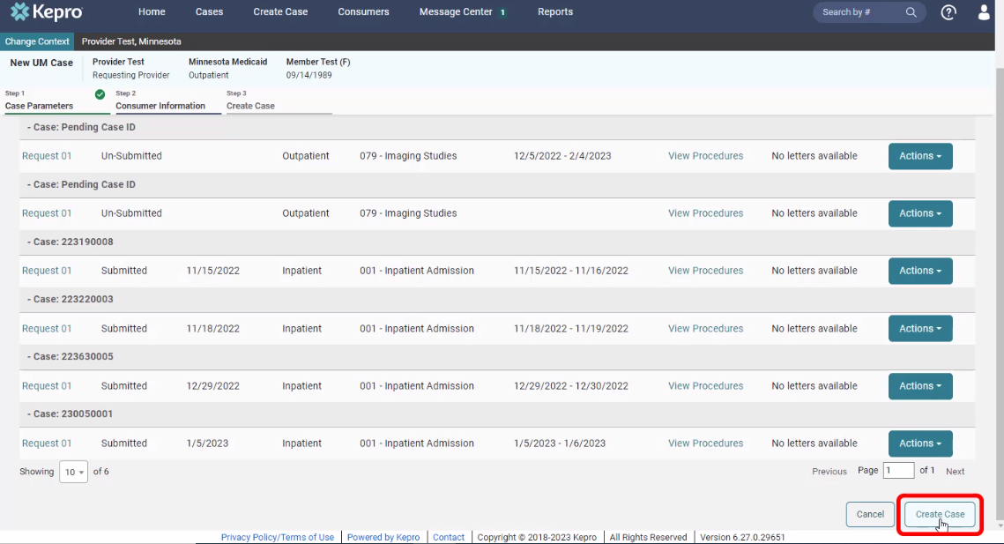
Atrezzo Provider Portal
Consumer information
Previous cases submitted for this member will be displayed.
Click on “Create Case” to continue.

Slide 11
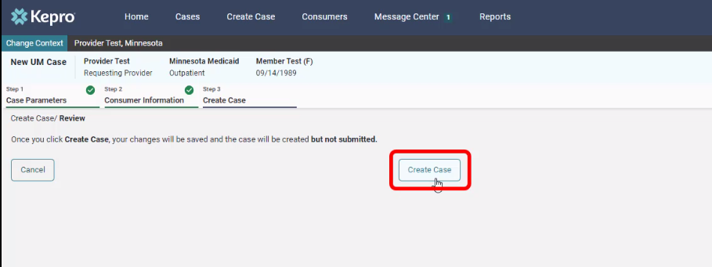
Atrezzo Provider Portal
Disclaimer
CREATE CASE
Notification prompt displays:
“Once you click Create Case, your changes will be saved and the case will be created; BUT
Case WILL NOT be submitted”

Slide 12
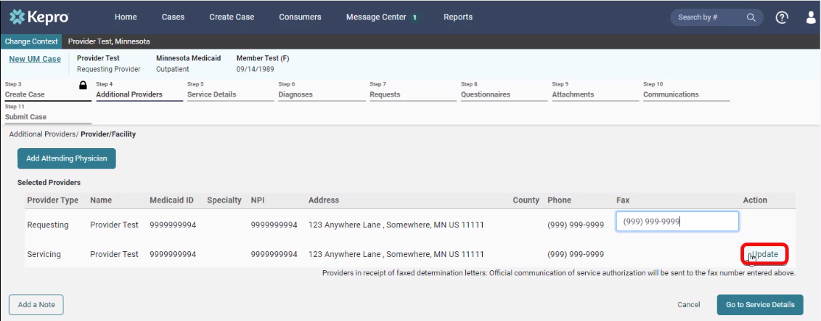
Atrezzo Provider Portal
Additional providers
Entering the attending physician is not necessary for EIDBI
Update the Servicing Provider by clicking on “Update”

Slide 13
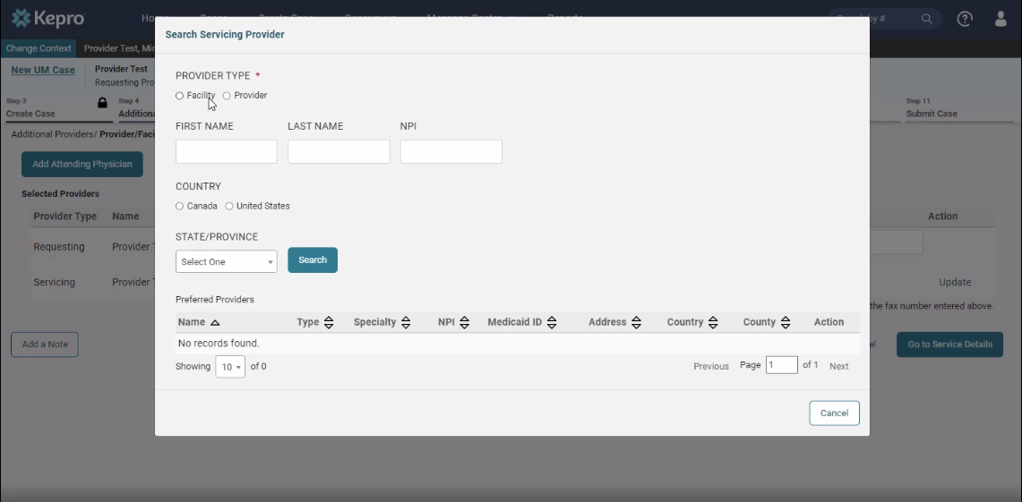
Atrezzo Provider Portal
ADDITIONAL PROVIDERS
If registered as a facility, search using “Facility”.
If registered as a provider, search using “Provider”.
*Reminder: NPI entered under Servicing Provider will be the NPI used to create a SA for DHS.

Slide 14
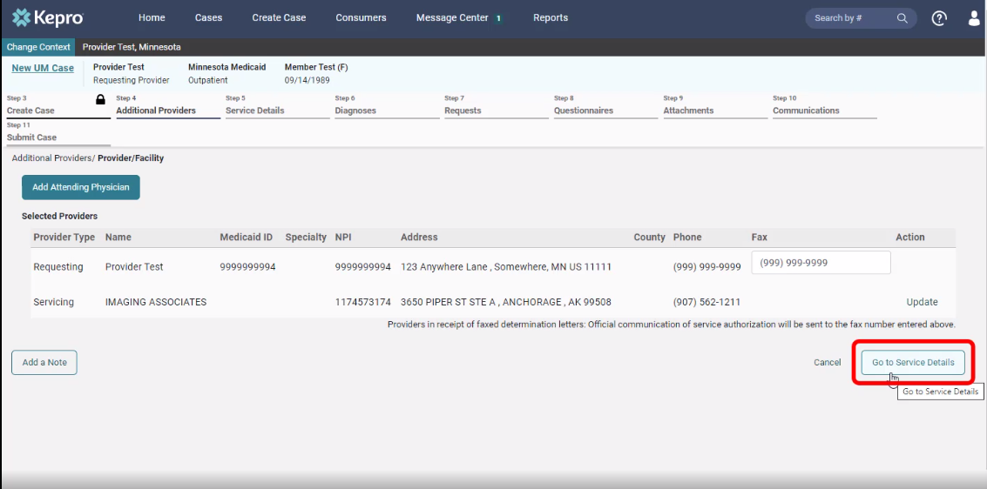
Atrezzo Provider Portal
Fips code
Verify provider information
Click on “Go to service details” to continue.

Slide 15
Atrezzo Provider Portal
11
Service details
Choose:
Place of Service: Optional
Service Type: 048-EIDBI or 048a-CMDE
Click on “Go to Diagnosis” to continue
048-EIDBI

Slide 16
Atrezzo Provider Portal
12
diagnosis
Choose:
Code Type: “ICD 10” from the drop down,
Enter the diagnosis code to search. *Please note that F84.0 is listed as Autistic Disorder.
Select the correct code from the drop down,
Click “Go to Requests” to continue
F84.0
F84.0 Autistic Disorder

Slide 17
Atrezzo Provider Portal
13
requests
Choose Request Type: Prior Auth
The notification date and time will display.
Click on “Go to Procedures” to continue.
FIPS Code field is not required for EIDBI submissions, leave blank and continue.

Slide 18
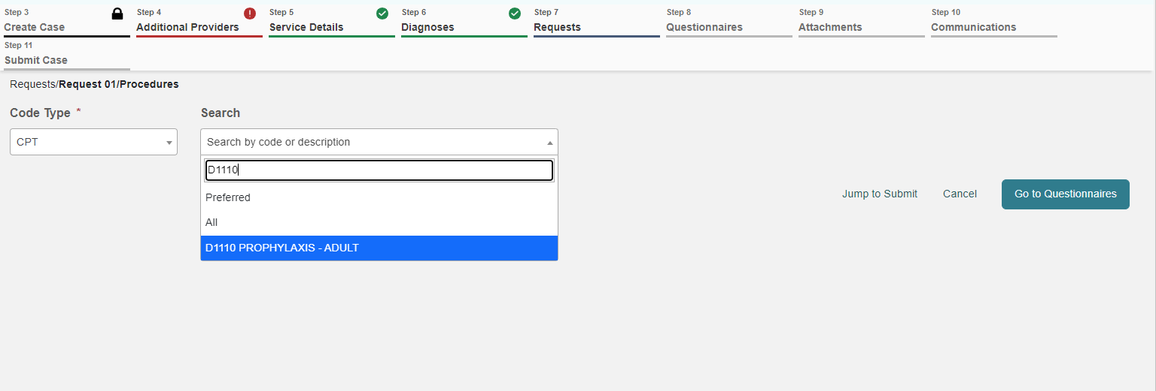
Atrezzo Provider Portal
14
requests
Enter the procedure code in search bar:
CMDE: 97151 UB
EIDBI: 97153, 97154, 97155, 97156, 97157, 0373T, H0046 (all codes require UB modifier)
Select the correct code from the drop-down.
97153
ADAPTIVE BEHAVIOR TX BY TECH

Slide 19
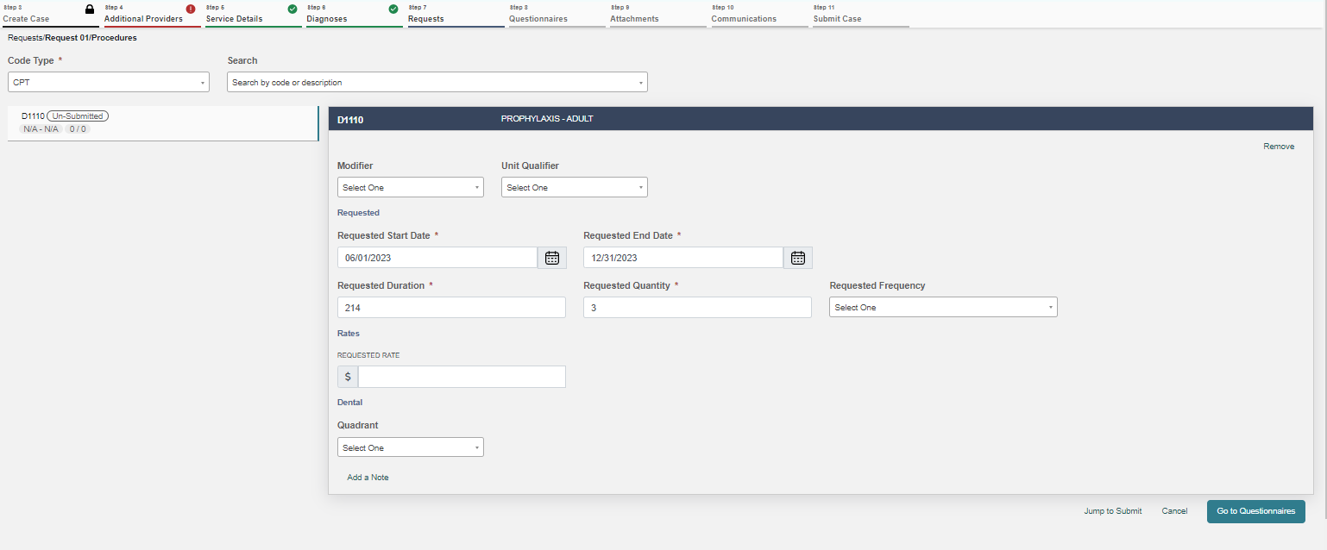
Atrezzo Provider Portal
15
Requests
REQUEST 01 WILL DISPLAY
Enter Requested Start Date.
Enter the Requested Duration (this will populate the correct Requested End date).
For a CMDE-please enter the start date as the date the CMDE was signed and completed. The end date can remain the same date as the start date.
Enter the Requested quantity.
Repeat the process for additional procedure codes by entering an additional code in the search field.
Please note that the total units for H0046 cannot exceed 9999. However, the SA will reflect the requested amount.
97153 ADAPTIVE BEHAVIOR TX BY TECH |  | Submitted |  | Units 5760 / 5760 | 01/01/2023 - 06/30/2023
01/01/23
06/30/23
180
5760
Units
Leave Rate Blank, Use Modifier UB and the requested frequency should indicate the total units for the requested duration of service.
*Providers are not permitted to submit cases as “insufficient information” status (warning message will pop-up that will prompt you to correct the error).

Slide 20
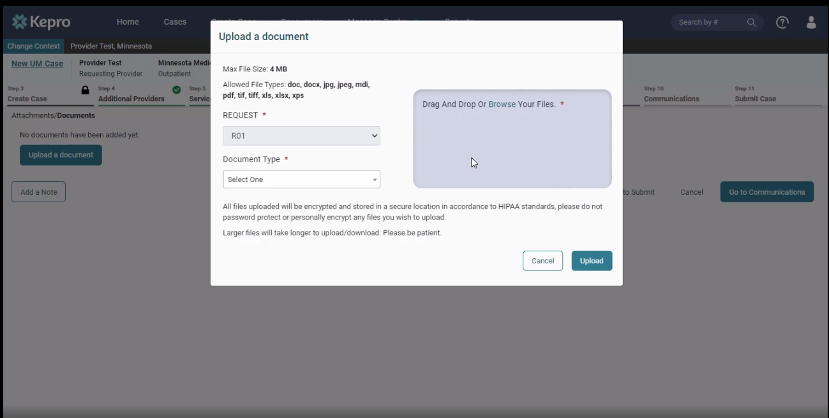
Atrezzo Provider Portal
16
attachments
Click on “Upload documents.”
*You can drag and drop your documents, or you can browse your files.
Once the documents are chosen, click on “Upload.”
To attach a CMDE-select CMDE w/signature page or if the documents are separate files select CMDE and signature page. To attach an ITP-select EIDBI ITP w/signature page or if the documents are separate files select EIDBI ITP and signature page

Slide 21
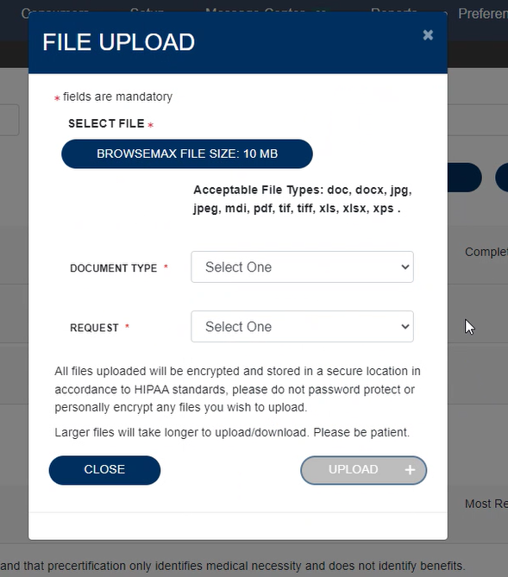
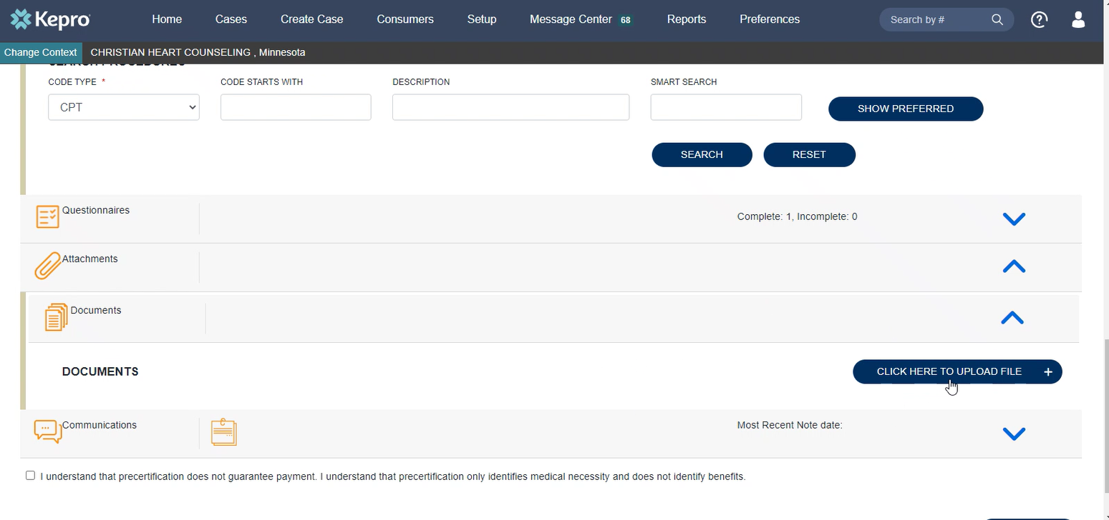
Atrezzo Provider Portal Attaching documents continued (*same steps for attaching documents to a pended case*)
Step
ADDING ADDITIONAL INFORMATION TO A PENDED CASE
Expand the “Attachments” Folder by pressing on the arrow.
Expand the “Documents” Folder by pressing on the arrow.
Click the “Click Here to Upload” Button.
Upload documents in the same manner as the initial case creation.

Slide 22
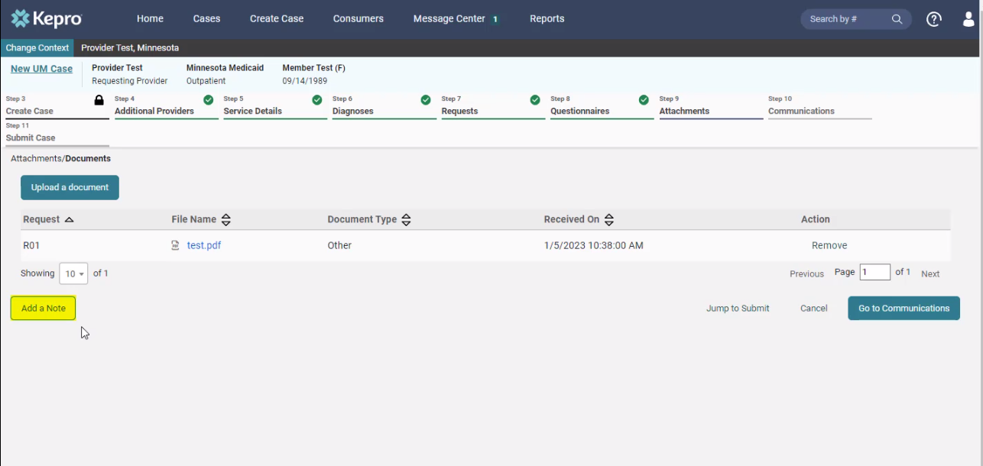
Atrezzo Provider Portal
17
Case note
Each step has a “Add a note” button displayed on the bottom left.
*A note can be added any time throughout the creation of the request; however, it is not necessary.
*Please be advised when responding to this request, clinical rationale/medical necessity information must be captured within the physical record (written documentation) and not solely entered as a case note.

Slide 23
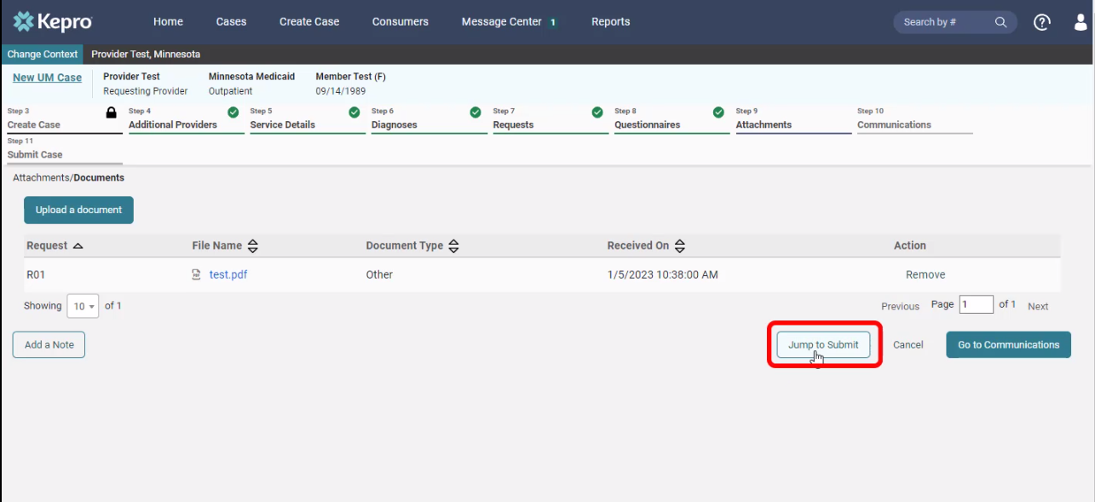
Atrezzo Provider Portal
18
attachments
Click on “Jump to Submit” when all the steps are completed, and a case note has been entered (if necessary).

Slide 24
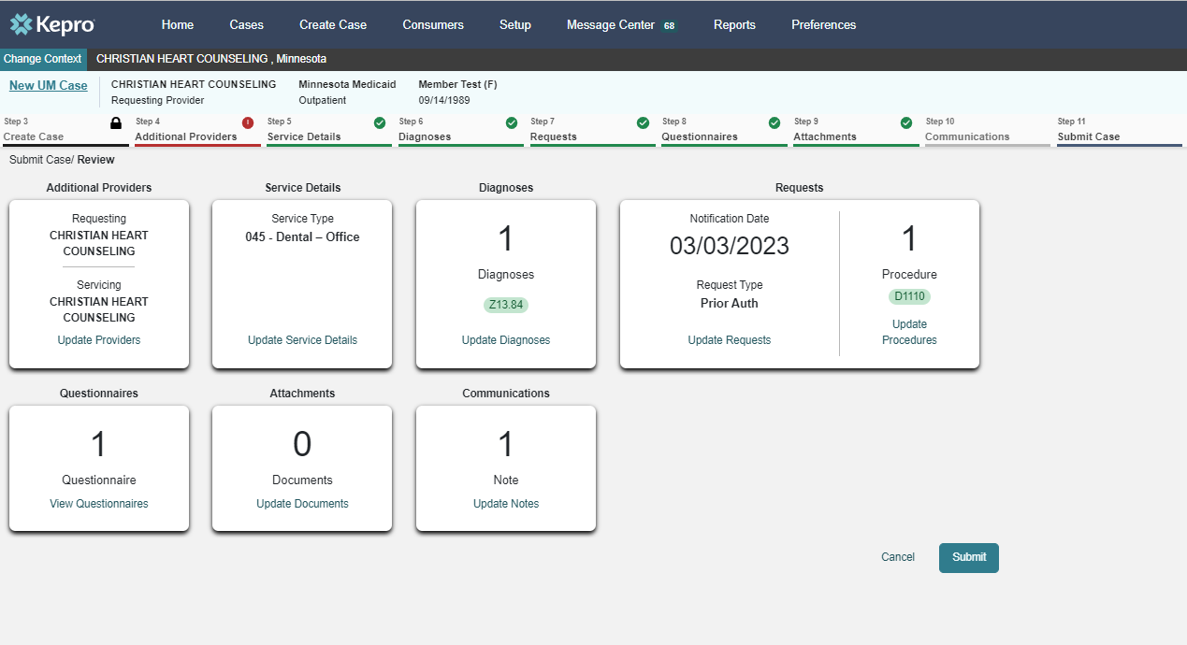
Atrezzo Provider Portal
19
communications
Review the request.
If any changes need to be made, click on “Update” in any section.
If everything is correct, click on “Submit”.
048 -EIDBI
F84.0
97153

Slide 25
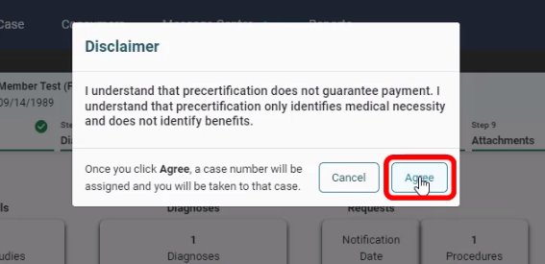
Atrezzo Provider Portal
20
disclaimer
Click “Agree” on the disclaimer.

Slide 26
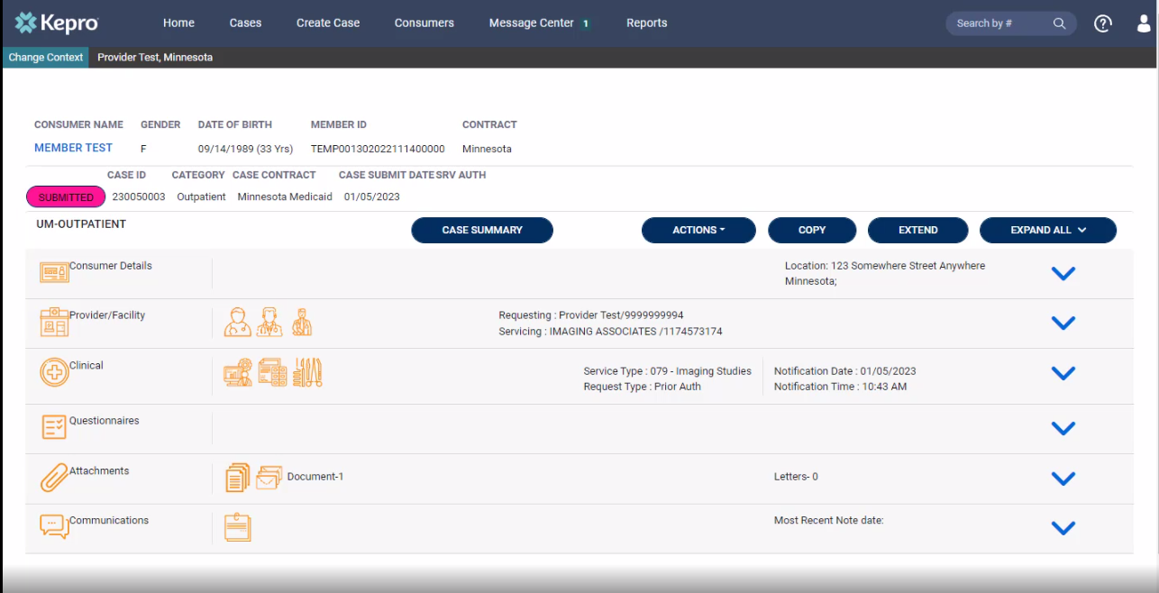
Atrezzo Provider Portal
21
completion
Completed request that is now ready for review by Kepro staff.
Please print or record case number. This will allow for tracking case status, checking for pended information requests or to enter questions into the messaging system.

Slide 27
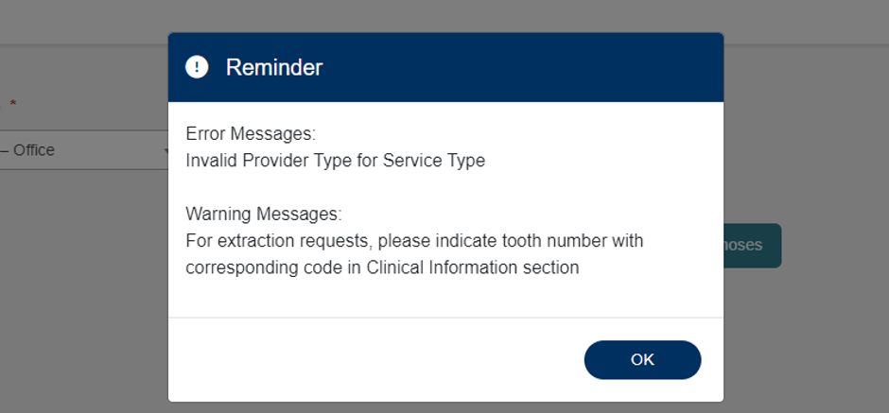
Atrezzo Provider Portal
22
Error messages
If applicable, error messages will appear, prohibiting request submission.
Errors will disappear as information is added or corrected.
If “Invalid Provider Type” error message appears, an incorrect provider type was selected.

Slide 28
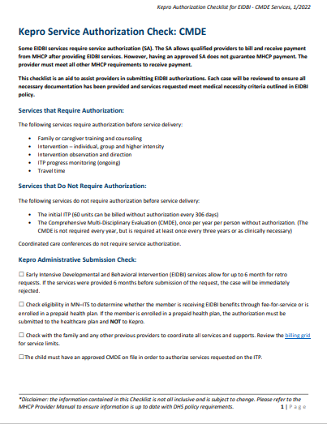
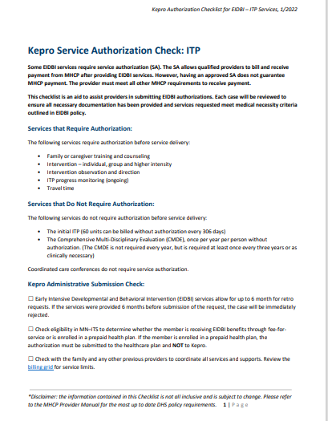
Atrezzo Provider Portal
23
22
Authorization Checklist
CMDE:
Kepro Service Authorization Checklist
ITP:
Kepro Service Authorization Checklist

Slide 29
CASE DENIAL REASONS
MOST COMMON REASONS FOR A REJECTED CASE/ADMINISTRATIVE DENIAL
Active PPHP
PHI
Incomplete/inaccurate signature page
Multiple data entry discrepancies in the case submission
Multiple missing pages in the document
Ineligible recipients or providers
*This list is not exclusive to these listed items*

Slide 30
Frequently Asked Questions
1. How do I request additional units for service codes to an already approved ITP?
Update Section D of the ITP indicating the increase in units for the needed service code (s).
Provide rationale for the need for additional units in Section E of the ITP under the rationale paragraph.
Obtain QSP and guardian approval through a revised signature page.
Locate the already approved case in Atrezzo portal for the time frame needed and attach the updated documents.
Leave a note for the reviewer regarding what the attachments include and generally what is being requested.

Slide 31
Frequently Asked Questions
2. When and how should the provider contact the Kepro reviewer for a pended case?
When to contact a clinical reviewer:
Questions about a pended case (clinical questions should be asked by QSP, not admin)
Error on case submission or attachments
How to contact a clinical reviewer:
Leave a written message or clinical note within the specific case being referenced in the Atrezzo portal
Call Kepro Provider Call Center at (866) 433-3658 and reference the case in question
To inquire about the status of a pended case, please call the Kepro Provider Call Center
Most questions can generally be answered via the Atrezzo portal.
Please call DHS with billing questions.

Slide 32
Frequently Asked Questions
3. When does a provider submit a CMDE for medical necessity review only?
Active PPHP during the CMDE completion timeframe (including the signature date)
Another provider completed a CMDE but was not submitted to Kepro for review
Indicate in notes
Leave a note for reviewer indicating that this review is for medical necessity only.

Slide 33
Frequently Asked Questions
4. When and how does a provider submit a discharge summary?
A discharge summary should be completed when:
A recipient has been discharged from your agency and is no longer receiving EIDBI services
A recipient discharges to another EIDBI provider to continue services with the new provider
Providers are strongly encouraged to complete the DHS Discharge/Transition Form (7109A) to avoid billing discrepancies between providers
Attach discharge summary or 7109A form to the approved/applicable Atrezzo case (please ensure QSP at minimum has signed the summary)

Slide 34
Frequently Asked Questions
5. What should a provider do when the recipient switches in the middle of an authorization period from an MCO to Fee For Service (MA)?
Verify recipient’s MA eligibility to determine start date
Ensure that there is an approved CMDE on file for that recipient (may need to be approved for medical necessity)
Create a case for review in the Kepro portal and select the dates of service in which MA became primary coverage
May also require prorating total units needed for each service code (i.e. if the authorization timeframe is 90 days then the service codes should be adjusted to reflect 90 days of service)
Please Note: submitting the prior authorization information does not guarantee an automatic approval through Kepro

Slide 35
DHS MHCP MANUAL
To access the MHCP Manual, please visit:
Early Intensive Developmental and Behavioral Intervention (EIDBI) Benefit (state.mn.us)

Slide 36
Question & Answer

Slide 37
Thank you for attending!
Please reach out with any questions you may have.
Contact Info
1 (866) 433-3658
EIDBIMNMedicaid@kepro.com
https://mhcp.kepro.com/

