Slide 1
Dental orthodontic questionnaire training
Provider training for new DHS Orthodontic Criteria

Slide 2

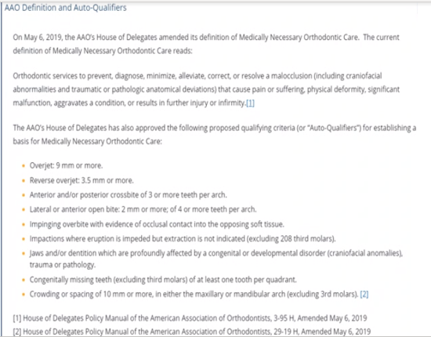
QUESTIONNAIRE
“Effective Jan. 1, 2022, MHCP is following the American Association of Orthodontists (AAO) 2019 medically necessary orthodontics parameters for coverage of orthodontic treatment for birth through 20-year-olds.
New criteria is listed to the right:

Slide 3
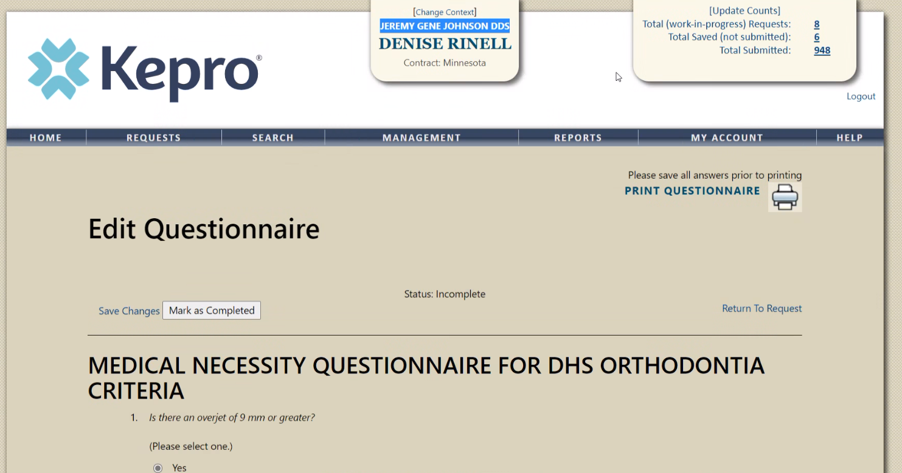
QUESTIONNAIRE
Provider name is listed here
*Please save changes but mark “completed” only upon finalization
“Save changes” should be used throughout the process
When Marked as Completed, the questionnaire cannot be edited or altered

Slide 4
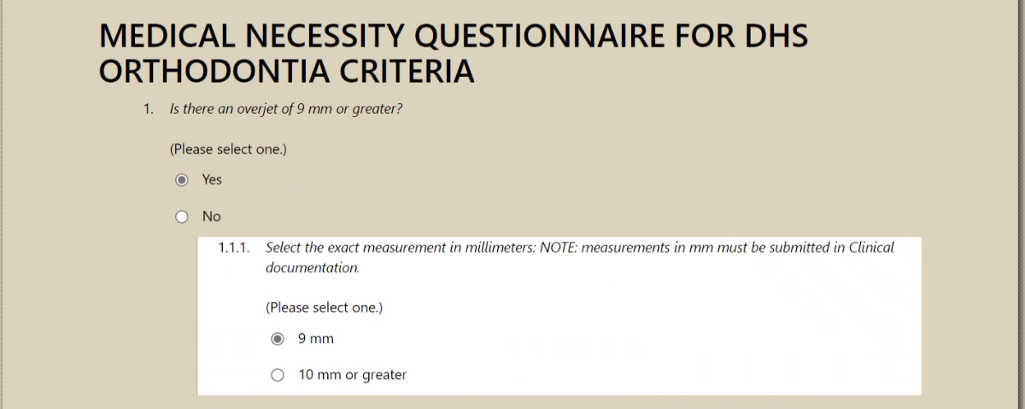


Question 1
Choose “Yes” or “No”
If “Yes”, choose appropriate measurement.

Slide 5
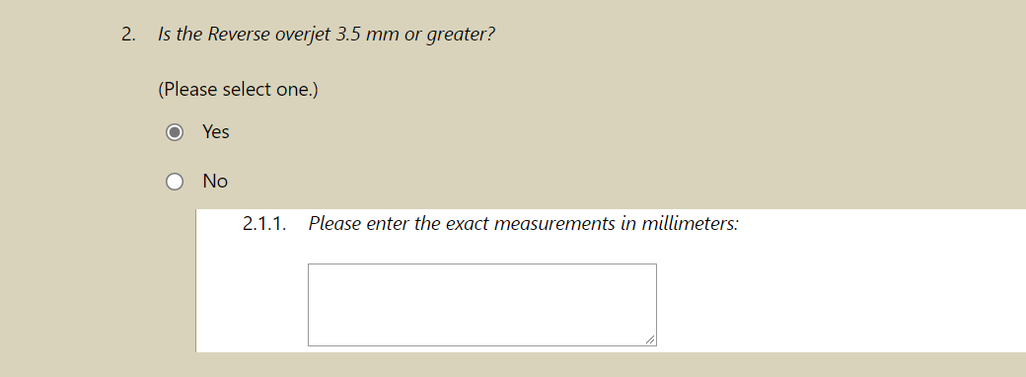
Question 2
Choose “Yes” or “No”
If “Yes”, enter the appropriate measurement in mm.

Slide 6
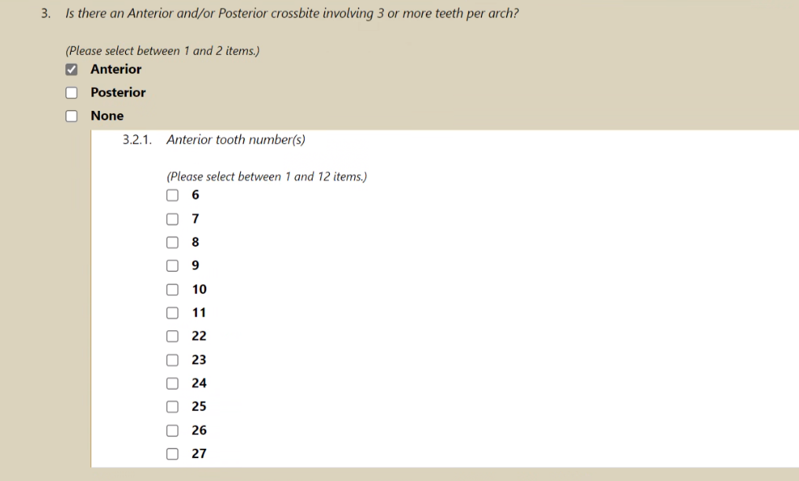
Question 3
Choose “Yes” or “No”
If “Yes”, choose appropriate tooth numbers.

Slide 7
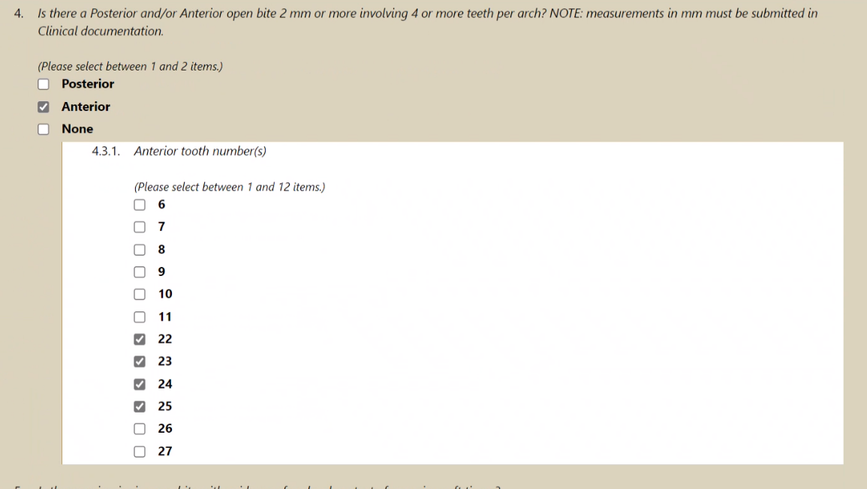
Question 4
Choose “Yes” or “No”
If “Yes”, choose appropriate tooth numbers

Slide 8
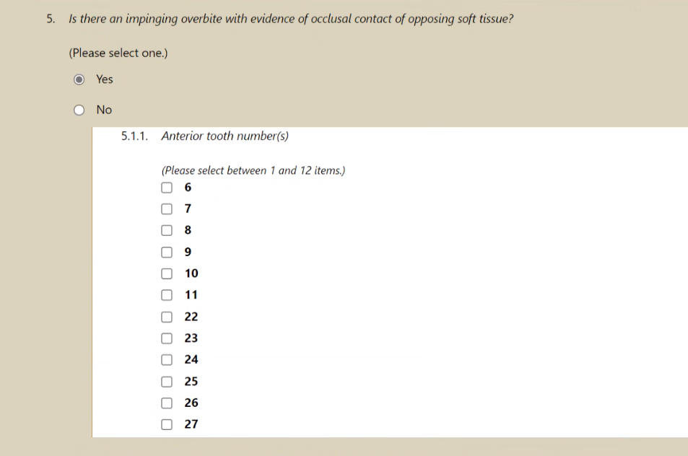
Question 5
Choose “Yes” or “No”
If “Yes”, choose appropriate tooth numbers causing impingement

Slide 9
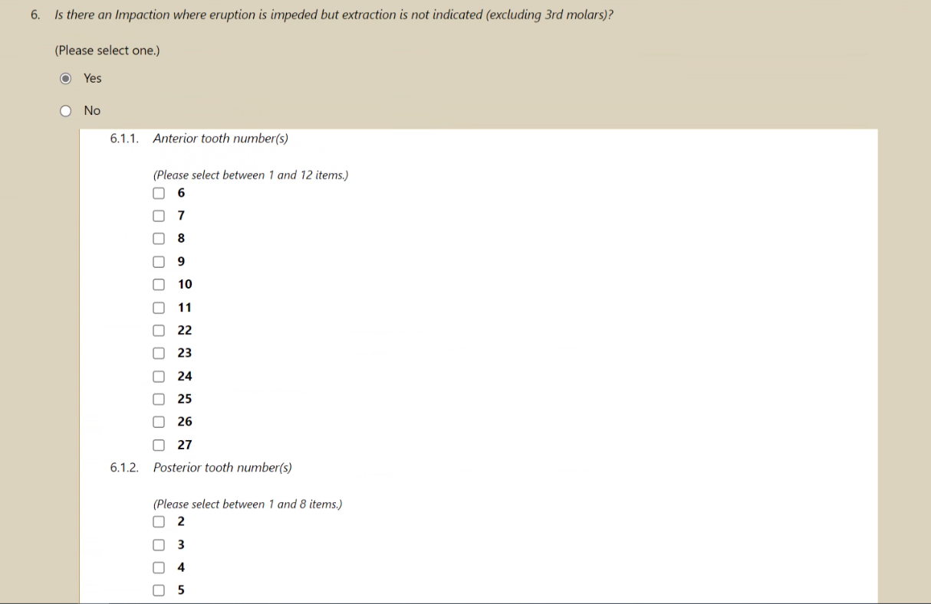
Question 6
Choose “Yes” or “No”
If “Yes”, choose appropriate tooth number

Slide 10
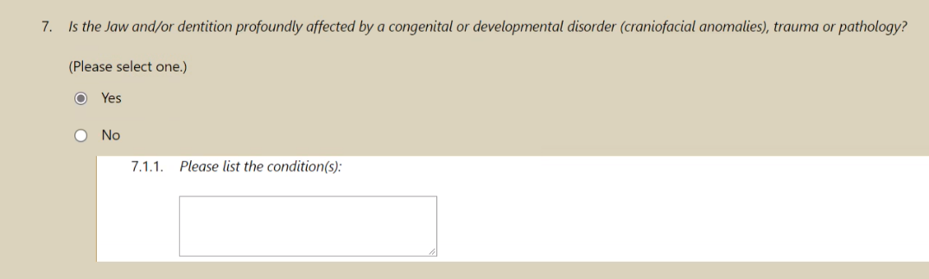
Question 7
Choose “Yes” or “No”
If “Yes”, list the congenital or developmental disorder trauma or pathology.

Slide 11
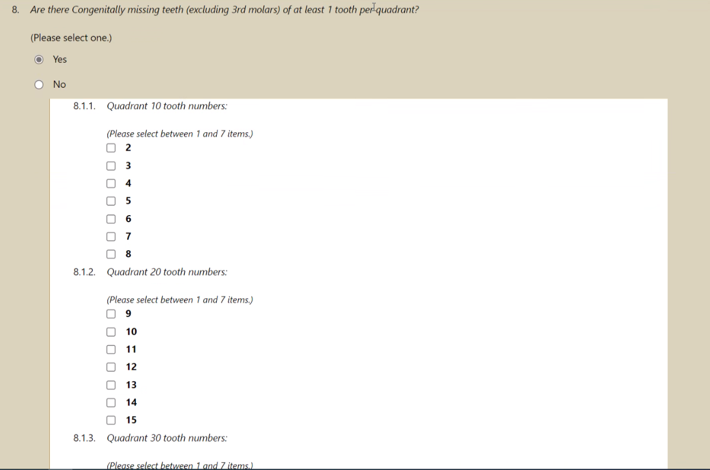
Question 8
Choose “Yes” or “No”
If “Yes”, choose appropriate tooth number per quadrant.

Slide 12
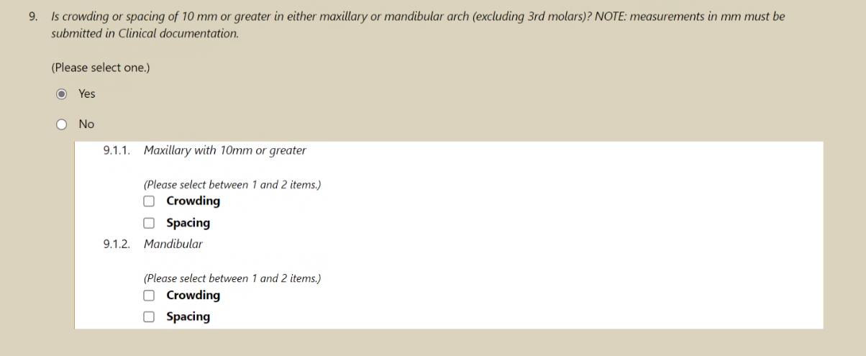
Question 9
Choose “Yes” or “No”
If “Yes”, choose crowding or spacing per arch involved.

Slide 13
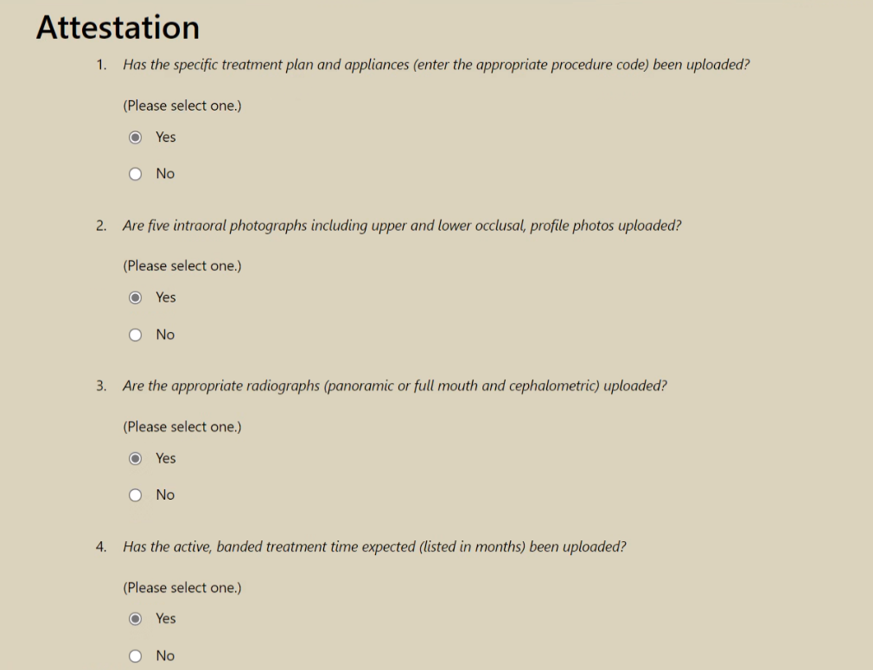
Attestation
Choose “Yes” or “No”
Please note ALL questions and attestations must be answered or questionnaire will not submit

Slide 14
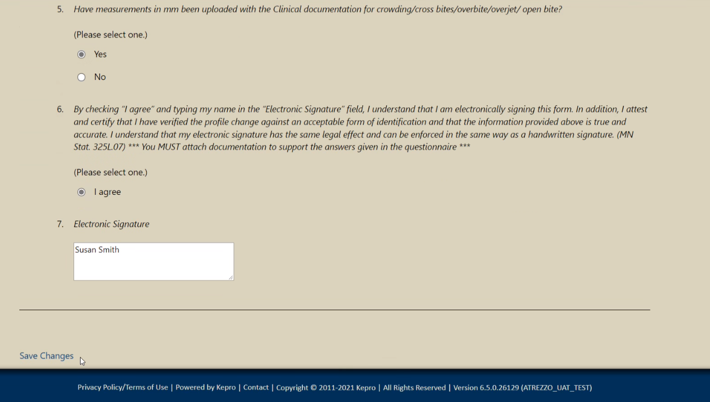


Attestation
Choose “Yes” or “No”
6: Read and Choose “I agree”
The electronic signature is of the person completing the questionnaire
Click “Save Changes” upon completion.

Slide 15

Question & Answer

Slide 16

Thank you for attending!
Please reach out with any questions you may have.
Contact Info
1 (866) 433-3658
DentalMNMedicaid@Kepro.com
https://mhcp.kepro.com/

