Slide 1
Early Intensive Developmental and Behavioral Intervention (EIDBI) Benefit
Atrezzo Provider Portal Submission Training and Requirements
Notes:
Introductions. There will be time for questions and answers at the end of the training.
Poll the room for submission process review or specific questions related to criteria.
Intros: Please provide your full name, agency name, best means of contact (email/ phone), and how long the agency been providing services

Slide 2
Objectives
Registration & Submissions
Kepro’s role as the MRA
Certification Outcomes
MHCP’s current medical review agent is Keystone Peer Review Organization (KEPRO). MHCP contracts with KEPRO to process EIDBI service authorization requests.
to increase efficiency and certification outcomes for these requests.
review the registration and submission process for EIDBI and CMDE requests via the Atrezzo Provider Portal
Notes:
As the MRA Kepro is an impartial party and uses the MHCP policies and statutes that are in place for EIDBI services to conduct reviews.
Kepro does not handle any billing/claims concerns and we ask those questions be directed the DHS provider call center who can further assist with connecting you to an EIDBI billing trainer.
General overview of the submission process. For more detailed instructions on the submission process please visit our website at Training (kepro.com) for user guides and system navigation materials.
Following the review and information presented during the call today we hope to increase the certification outcomes for providers by addressing common reasons for rejections or requesting additional information – additional information may be needed for the reviewers to have a better clinical picture of the member or treatment plan

Slide 3
EIDBI BENEFIT PROCESS Information in this section pertains to fee-for-service MHCP members only.**
Note the following timelines in the EIDBI service authorization process:
Each EIDBI service authorization request cannot exceed a 180-day time span.
Complete and submit a person’s CMDE at least 30 days, but no more than 60 calendar days, before the end date of the current service authorization period. (The CMDE is not required every year, but is required at least once every three years or as clinically necessary).
The ITP and CMDE may be signed on the same day, but the ITP must not be signed prior to the CMDE being completed.
KEPRO may retroactively approve up to 180 days for services that require authorization. The qualified providers and legal representative must sign the ITP and CMDE prior to delivering any of these services.
Notes:
If the person is enrolled in a prepaid health plan, contact the appropriate managed care organization for authorization requirements. When people have private insurance, follow the primary insurance’s authorization procedures and other applicable rules.
Please ensure the start date of the request matches the last signature date. Some EIDBI services require service authorization (SA). The authorization requirement safeguards against inappropriate and unnecessary use of health care services under state and federal law.
It’s important to submit initial review and change requests timely
The SA allows qualified providers to bill and receive payment from MHCP after providing EIDBI services. However, having an approved SA does not guarantee MHCP payment. The provider must meet all other MHCP requirements to receive payment.
For information on transferring agencies or coordinating EIDBI with other services, see EIDBI Benefit Policy Manual-Services.

Slide 4
EIDBI BENEFIT - PROVIDER RESPONSIBILITIES
The comprehensive multi-disciplinary evaluation (CMDE) provider is responsible to:
Check eligibility in MN–ITS to determine whether the member is receiving EIDBI benefits through fee-for-service or is enrolled in a prepaid health plan
Submit the completed CMDE Medical Necessity Summary Information (DHS-7108) (PDF), including the CMDE signature page, to the web-based KEPRO Atrezzo portal.
Ensure that all documentation in the CMDE is complete and accurate prior to submission.
The Qualified Supervising Professional (QSP) is responsible to:
Receive medical necessity approval before submitting the ITP
Submit the completed Individual Treatment Plan (ITP) and Progress Monitoring (DHS-7109) (PDF), including the ITP signature page to the web-based KEPRO Atrezzo portal
Continued…
Notes:
Only one observation is required on the CMDE. That needs to be completed by the actual CMDE provider, not a clinical trainee or anyone else. A second observation may be conducted by someone else and documented as well. On the CMDE form itself, it says the observation must be completed by the CMDE provider.
The ITP is considered complete on the date the last person signs the signature page. Signatures do not need to occur on the same day, but the caregiver’s or guardian’s signature is required for service authorization.
The CMDE may be completed and signed on the same day as the ITP, but the CMDE cannot be completed after the ITP.
The signatures and dates must be either handwritten or use an approved electronic signature with a time and date stamp (see MHCP Eligibility Policy Manual – Signature).
The signatures confirm understanding and agreement with the treatment plan and service recommendations. They serve as consent for the person to begin or continue receiving EIDBI services.
The interpreter signature date does not affect service authorization dates.

Slide 5
EIDBI BENEFIT - PROVIDER RESPONSIBILITIES
The Qualified Supervising Professional (QSP) is responsible to:
Ensure that all documentation is complete and accurate prior to submission
Coordinate other health, mental health, and home and community-based services to ensure that the person receives services that are the most appropriate and effective in meeting the person’s needs
In general, the EIDBI provider agency is responsible to:
Use the KEPRO Atrezzo portal to submit information to and communicate with KEPRO. KEPRO will not accept documentation sent via fax or mail, and the MN–ITS message screen has limited space.
Reference the KEPRO Atrezzo Portal to check the status of the CMDE. Since the annual CMDE does not require authorization, a SA is not created, and a notification will not be sent via MN–ITS.
Notes:
Only one observation is required on the CMDE. That needs to be completed by the actual CMDE provider, not a clinical trainee or anyone else. A second observation may be conducted by someone else and documented as well. On the CMDE form itself, it says the observation must be completed by the CMDE provider.

Slide 6
EIDBI BENEFIT RESPONSIBILITIES: Kepro
KEPRO will do the following within five business days of receiving the CMDE:
Verify that all the required components of the CMDE are present
Pend the case and notify providers through the Atrezzo message inbox if additional information is needed
Review the documentation and make a medical necessity determination
KEPRO will do the following within ten business days of receiving the ITP:
Enter information from the ITP and CMDE into Medicaid Management Information System (MMIS)
Verify all required components of the ITP are present
Put the case in pending status and notify providers through the Atrezzo message inbox if more information is needed
Complete an integrated review process of the CMDE, ITP and other MHCP-covered services the person receives in order to determine authorization for EIDBI services

Slide 7
EIDBI BENEFIT RESPONSIBILITIES: Kepro
If KEPRO puts the case in pending status in the Atrezzo portal and requests additional information:
The provider has 15 Calendar days to upload the requested information or make the requested corrections. The provider must submit all the additional information requested at one time to KEPRO.
Failure to respond may result in denial and require a new Authorization to restart the process with all documentation necessary to make a determination.
KEPRO has three business days from when it receives the additional information to review and make an approval or denial determination.
Notes:
- Kepro can only pend a case once, so it is important to submit ALL required/requested documentation at one time within the 15 days or it may result in denial and require a new Authorization to restart the process with all documentation necessary to render a determination.

Slide 8
Atrezzo Provider Portal
Advantages of using the Provider Portal:
Secured access to the Provider Portal
Access letters via Case/ Request
Respond / Send messages To/From Kepro
Track case status & upload clinical documentation.

Slide 9
Accessing the Atrezzo Provider Portal
Website Address: https://mhcp.kepro.com
Enter your 10-digit National Provider Identifier (NPI) number and Provider Registration Code (DHS PA# located in MN-ITS mailbox)
Select “Atrezzo Login”
To Register for the Atrezzo Provider Portal:
Select unique Username/ Password & complete the required user information
*The Provider must contact Kepro for the registration code (Kepro #1-866-433-3658)*
Notes:
Atrezzo is no longer compatible with IE. She needs to use Chrome, Edge or Firefox
**For security purposes, the provider must provider the DHS PA number which is in Providers MN-ITS mailbox.
1. REVIEW & ACCEPT TERMS OF AGREEMENT: You’ll then be taken to the Atrezzo Connect Home Page
2. VERIFY ADDRESS: Selecting the correct address will associate your user information with the correct location; Their can be multiple provider types/ locations. Selecting the correct type/ location yields best results; If all apply, check all of them then click select
*Providers can register additional NPI numbers , locations and/or Provider types into their existing Atrezzo Provider Portal Account. This function can ONLY be completed by the Account Administrator. * A Registration code will need to be requested for each subsequent address/location added.
ACCOUNT ADMINISTRATOR:
The individual completing the initial registration will present as the Portal Admin.
GROUP ADMIN is responsible for managing and creating ALL submitting user accounts for your NPI #
Removing Admins and User Accounts
Set Preferences, i.e. Diagnosis & Procedure codes
Reset Passwords

Slide 10
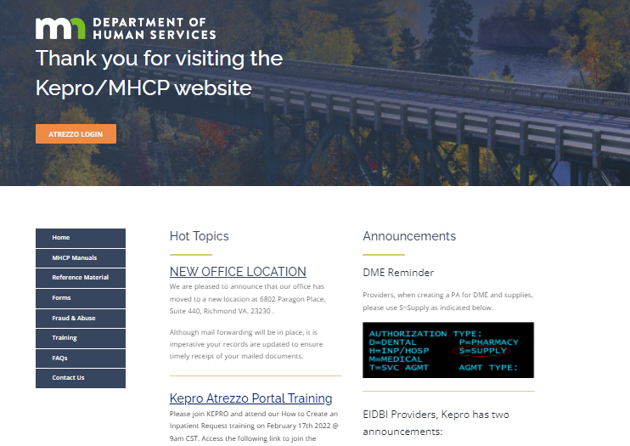
Atrezzo Provider Portal: To get started visit mhcp.kepro.com
Notes:
This is the MHCP Kepro homepage where you can login and or register an account with Kepro’s Atrezzo provider portal.
On the left-hand side are links to the MHCP manual, trainings, Kepro contact information and more.
This page also has provider updates listed under “Hot Topics” and Announcements

Slide 11
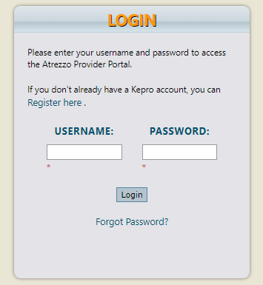
Atrezzo Provider Portal: Login / Registration
Enter the username and password. Then select login or for new users click on the “Register here” option. Successful completion of setup/login takes you to the Home Page

Slide 12
Atrezzo Provider Portal New Case Creation
Provider Pointers:
CMDE and EIDBI requires two separate case creations. Kepro does not recommend submitting both on the same day.
Effective Feb. 1, 2022, EIDBI providers are only required to complete a CMDE once every three years for people with autism spectrum disorder (ASD) or related conditions. For more information, visit the full announcement:
Change to EIDBI comprehensive multi-disciplinary evaluation (CMDE) policy.
Notes:
Families still may request a CMDE once per year, if they choose. Providers may complete CMDEs once per year without prior authorizations when clinically appropriate and within service limits listed on the EIDBI billing grid. For more information, visit the full announcement:

Slide 13
Atrezzo Provider Portal New Case Creation
Provider Pointers:
Responding to additional information does not require a new case to be created. A New CMDE/EIDBI case should be created when a request is denied/rejected.
Changes to an existing SA/case do not require a new case to be created. Upload the appropriate forms/documentation to the existing case for review. For example: EIDBI transition and/or discharge summary form (DHS-7109A)
Notes:
Please keep these items in mind when creating/submitting requests.
Changes to an existing SA/case do not require a new case to be created. Upload the appropriate forms/documentation to the existing case for review.
September Newsletter Announcement:
New form for Early Intensive Developmental and Behavioral Intervention (EIDBI) transition and/or discharge summary
Minnesota Department of Human Services created EIDBI transition and/or discharge summary form (DHS-7109A) based on feedback from stakeholders to support EIDBI provider agencies in notifying the medical review agent and other parties of a transition or discharge from EIDBI services.
Providers must follow EIDBI policy and consult with the caregiver or guardian about the transition or discharge plan. The caregiver or guardian must sign the form if they approve of the transition or discharge plan. Review the EIDBI policy manual Rights and responsibilities webpage (including appeal rights) if the caregiver or guardian does not agree with the transition or discharge plan.
Visit the EIDBI policy manual How to complete ITP and Progress Monitoring, DHS-7109 webpage for instructions to complete the form. Visit the Frequently asked questions webpage if you have trouble downloading the form. See the EIDBI policy manual EIDBI services webpage for step-by-step instructions on transferring agencies, and the EIDBI policy manual Medical necessity criteria webpage for termination of EIDBI services information. For additional instructions, see the EIDBI Provider Manual—Service authorization.

Slide 14
Atrezzo Provider Portal New Case Creation
Provider Pointers:
Minnesota Department of Human Services created EIDBI transition and/or discharge summary form (DHS-7109A) based on feedback from stakeholders to support EIDBI provider agencies in notifying the medical review agent and other parties of a transition or discharge from EIDBI services.
Template for location change requests:
“This member moved to our 1234 Street location (NPI # XXXXXXXXXX) from our 5678 Street location (NPI # XXXXXXXXXX) on 04-29-21. Please see attached ITP (page 2) showing the allocation from XX-XX-XXXX to XX-XX-XXXX for old location and the allocation from XX-XX-XXXX for new location.”
Adjustments should be made to an existing case if additional codes or unit modifications are being requested during the same authorization period. Place a note in the Clinical information section on the Request overview page citing the additional codes, requested/adjusted units and the affected date span.
Notes:
** To clarify for providers the EIDBI transition and/or discharge summary form (DHS-7109A) is not required. If your agency has a discharge form that can be submitted. The main objective is to ensure that Kepro is notified of the DC or transition to that the necessary adjustments can be made to the Service agreements and there is not a delay in care for the member.
Please keep these items in mind when creating/submitting requests.
Changes to an existing SA/case do not require a new case to be created. Upload the appropriate forms/documentation to the existing case for review.
https://www.dhs.state.mn.us/main/idcplg?IdcService=GET_DYNAMIC_CONVERSION&RevisionSelectionMethod=LatestReleased&dDocName=dhs-292814#signature
September Newsletter Announcement:
New form for Early Intensive Developmental and Behavioral Intervention (EIDBI) transition and/or discharge summary
Minnesota Department of Human Services created EIDBI transition and/or discharge summary form (DHS-7109A) based on feedback from stakeholders to support EIDBI provider agencies in notifying the medical review agent and other parties of a transition or discharge from EIDBI services.
Providers must follow EIDBI policy and consult with the caregiver or guardian about the transition or discharge plan. The caregiver or guardian must sign the form if they approve of the transition or discharge plan. Review the EIDBI policy manual Rights and responsibilities webpage (including appeal rights) if the caregiver or guardian does not agree with the transition or discharge plan.
Visit the EIDBI policy manual How to complete ITP and Progress Monitoring, DHS-7109 webpage for instructions to complete the form. Visit the Frequently asked questions webpage if you have trouble downloading the form. See the EIDBI policy manual EIDBI services webpage for step-by-step instructions on transferring agencies, and the EIDBI policy manual Medical necessity criteria webpage for termination of EIDBI services information. For additional instructions, see the EIDBI Provider Manual—Service authorization.

Slide 15
Atrezzo Provider Portal To get started visit mhcp.kepro.com
Notes:
These checklists have been created to assist providers with submitting EIDBI ITP and CMDE authorizations. Each case will be reviewed to ensure all necessary documentation has been provided and services requested meet medical necessity criteria outlined in EIDBI policy.
Effective Feb. 1, 2022, EIDBI providers are only required to complete a CMDE once every three years for people with autism spectrum disorder (ASD) or related conditions.
Families still may request a CMDE once per year, if they choose. Providers may complete CMDEs once per year without prior authorizations when clinically appropriate and within service limits listed on the EIDBI billing grid. For more information, visit the full announcement:

Slide 16
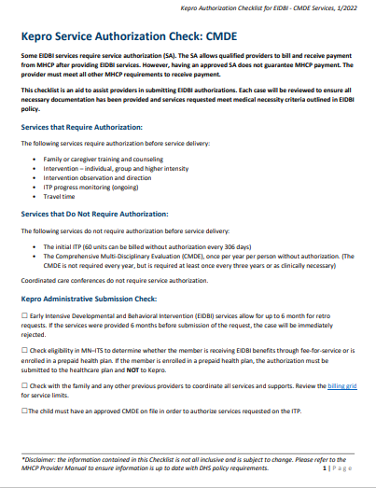
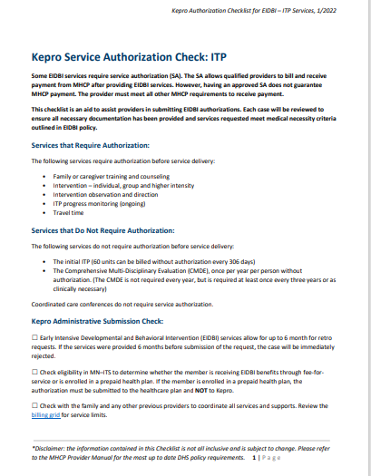
Atrezzo Provider Portal New Case Creation: To get started visit mhcp.kepro.com
Notes:
These checklists have been created to assist providers with submitting EIDBI ITP and CMDE authorizations. Each case will be reviewed to ensure all necessary documentation has been provided and services requested meet medical necessity criteria outlined in EIDBI policy.
CMDE Checklist: https://fs.hubspotusercontent00.net/hubfs/5627605/Kepro%20Administrative%20Submission%20Checklist_CMDE_Final_.pdf
ITP Checklist: https://fs.hubspotusercontent00.net/hubfs/5627605/Kepro%20Service%20Authorization%20Check_ITP_Final.pdf
Website for Atrezzo Provider Portal Training PPT: https://fs.hubspotusercontent00.net/hubfs/5627605/CMDE_EIDBI%20Atrezzo%20Portal%20Powerpoint_03012022.pdf

Slide 17
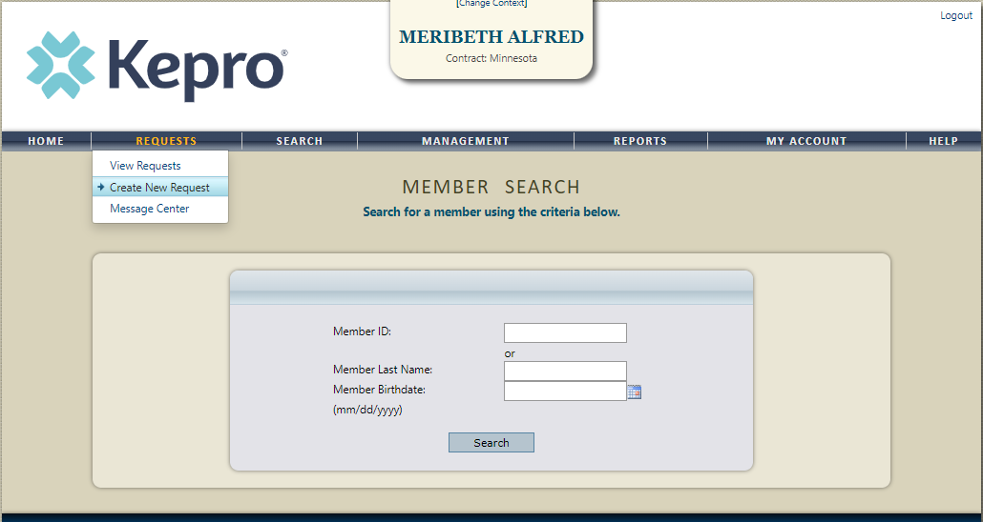
Atrezzo Provider Portal New Case Creation
Successful completion of setup/login takes you to the Home Page
Click “New Request” to start your case creation

Slide 18
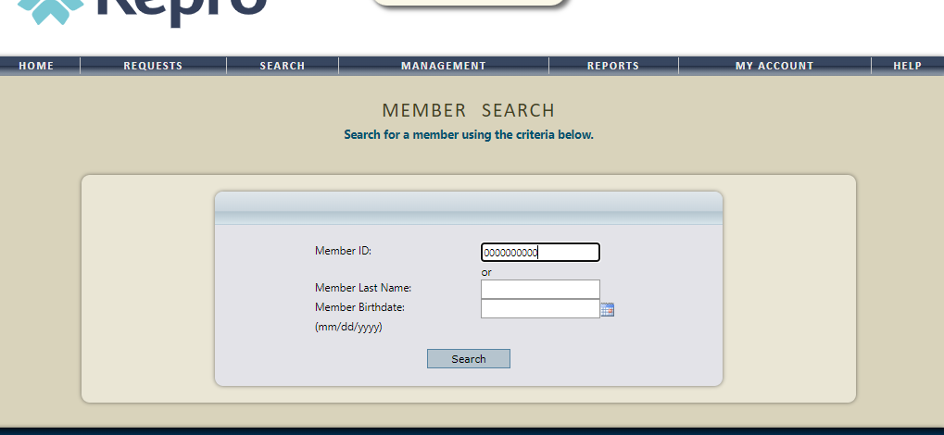
Atrezzo Provider Portal New Case Creation
Complete member search utilizing the Members Minnesota Medicaid ID # or Last name and Birthdate

Slide 19
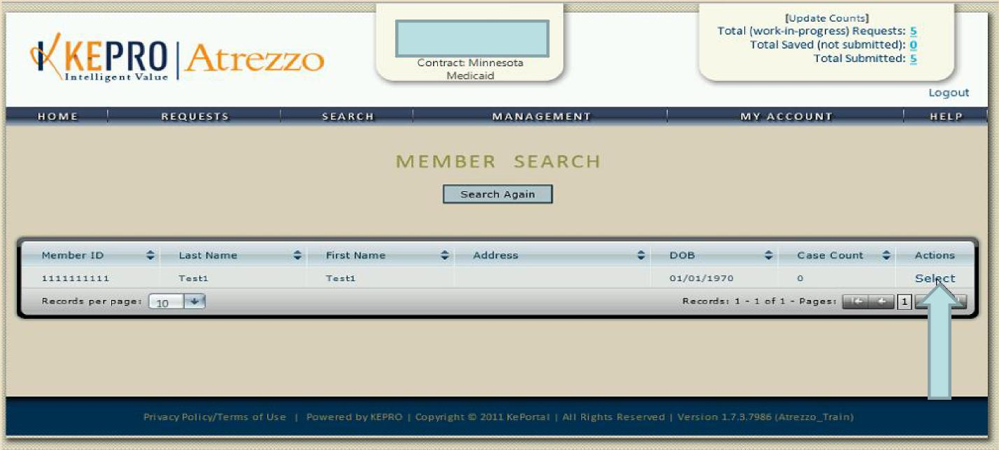
Atrezzo Provider Portal New Case Creation
Upon verification of the members First Name, Last name and Date of Birth, Click “ Select” under the ACTIONS column

Slide 20
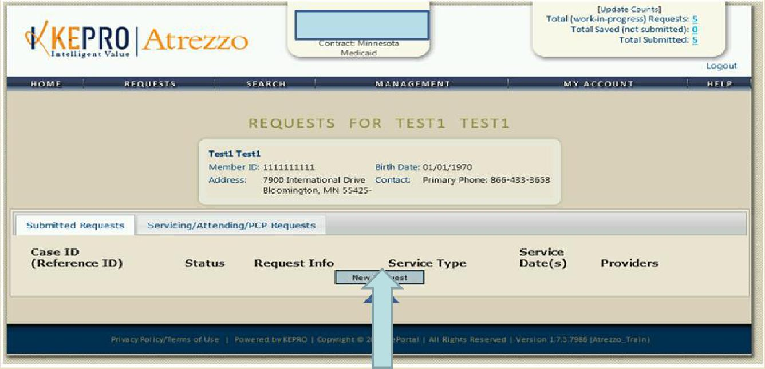
Atrezzo Provider Portal New Case Creation
Click “New Request”

Slide 21
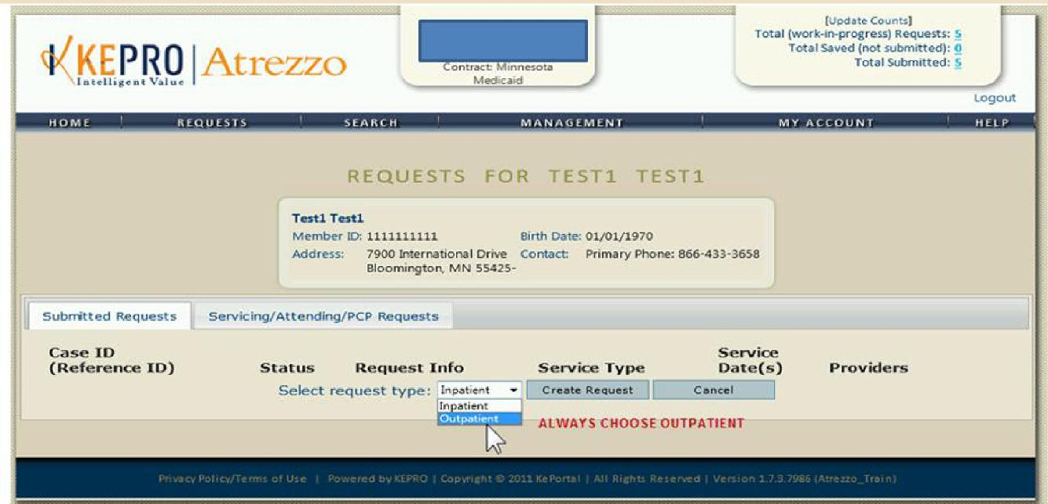
Atrezzo Provider Portal New Case Creation
Request type must reflect “OUTPATIENT”

Slide 22
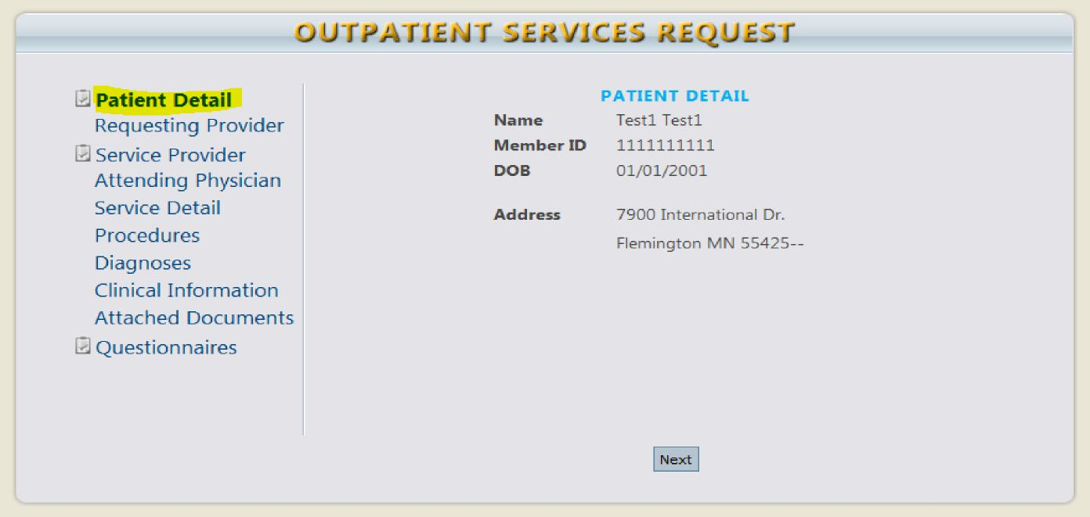
Atrezzo Provider Portal New Case Creation
Member Detail Information will display.
Ensure accuracy of the Member’s Name & Medicaid ID prior to proceeding.
Once verification is complete, click “Next” to continue.
Notes:
It is important to first check eligibility in MN–ITS to determine whether the member is receiving EIDBI benefits through fee-for-service or is enrolled in a prepaid health plan

Slide 23
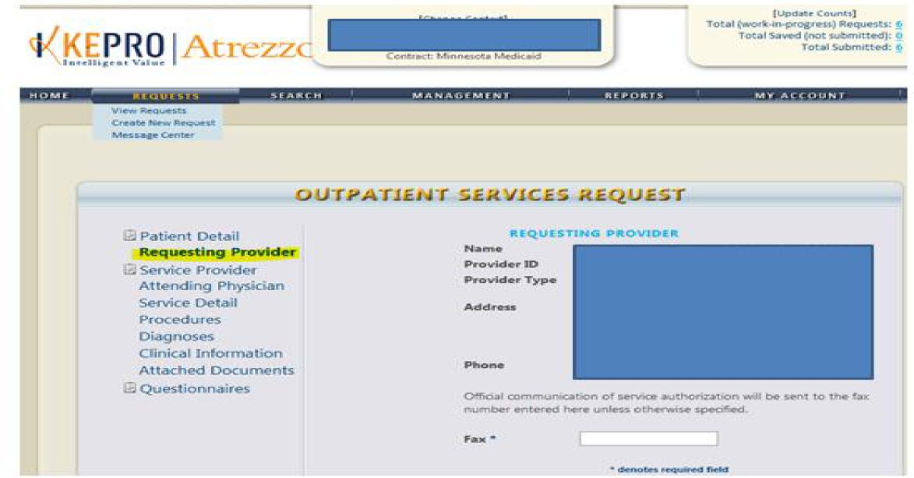
Atrezzo Provider Portal New Case Creation
Requesting Provider information will automatically default to the provider listed in the change context section (Top center of your screen). The requesting provider information can only be changed if you have more than 1 NPI number registered to your Atrezzo Provider portal account.
Notes:
To change the requesting Provider, you must cancel your existing case creation and select the applicable Provider from the change context section.

Slide 24
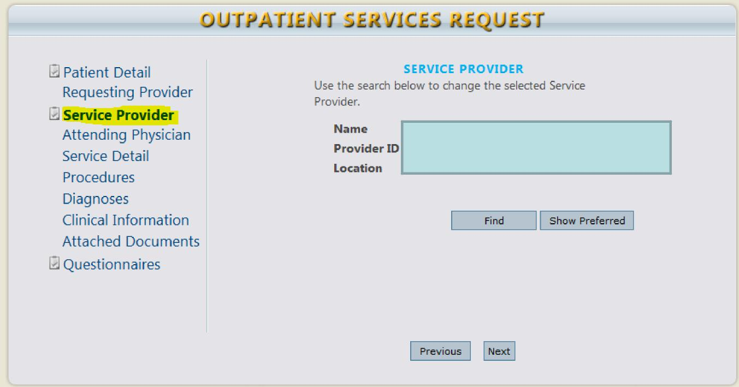
Atrezzo Provider Portal New Case Creation
The Servicing provider information will automatically default to reflect the providers name listed in the change context section (Top Center of your screen). If the listed provider is not applicable to the requested authorization click “Find” to complete a provider search.

Slide 25
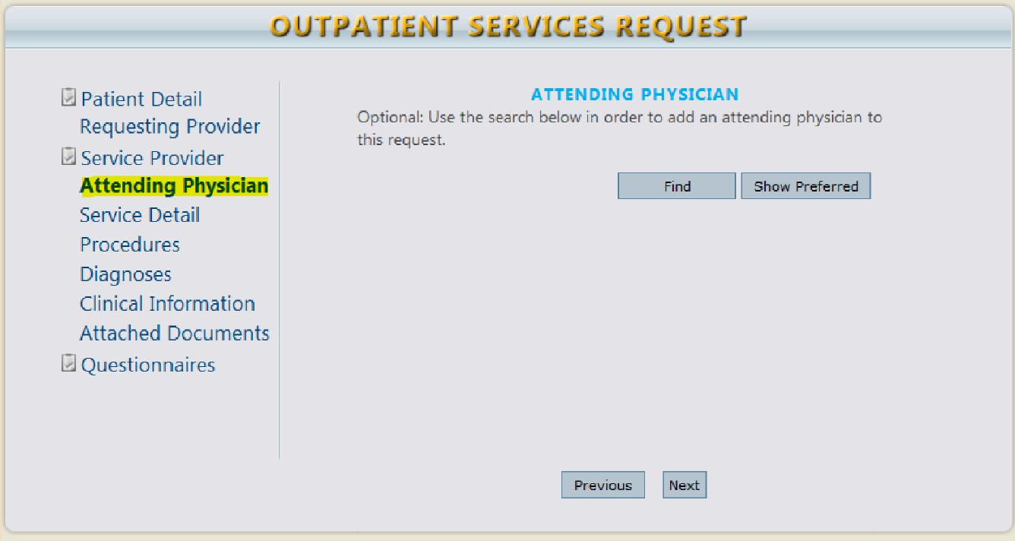
Atrezzo Provider Portal New Case Creation
**Attending Physician Section is optional**

Slide 26
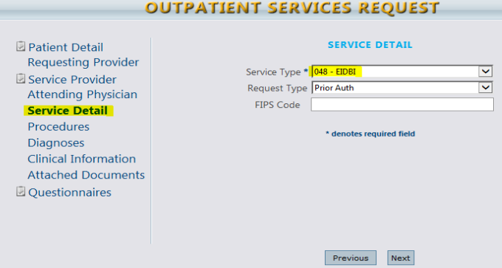
Atrezzo Provider Portal New Case Creation
Select the applicable service type from the drop-down listing (Selection of the incorrect service type may adversely affect case review)
EIDBI= 048-EIDBI & CMDE= 048a-CMDE
Request Type= Prior Auth
FIPS Code= Does not apply (Leave option blank)
Notes:
Add screen shot of dropdown menu to consolidate slides for EIDBI and CMDE Service Type Options

Slide 27
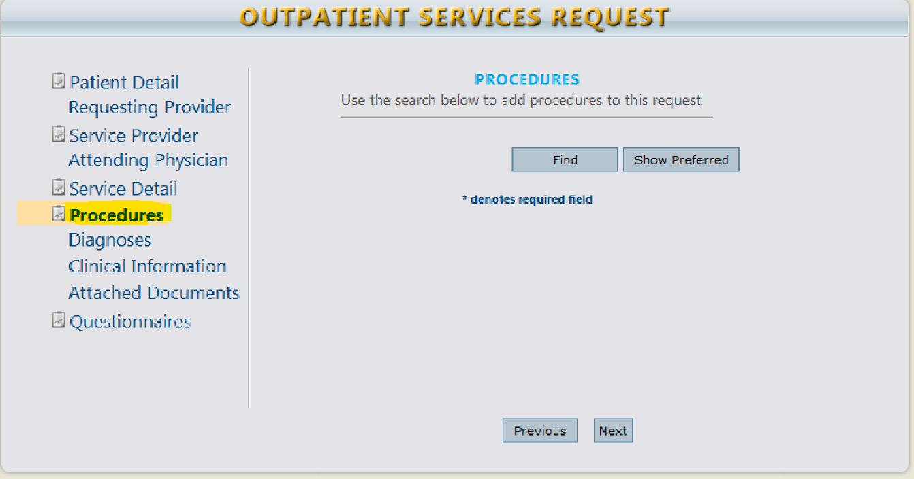
Atrezzo Provider Portal New Case Creation
Click “ Find” to complete Procedure code search.
11

Slide 28
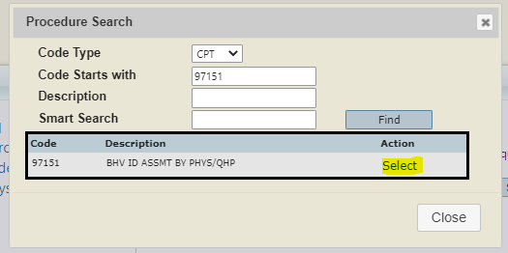
Atrezzo Provider Portal New Case Creation
Procedure codes:
CMDE Procedure code: 97151 only
ITP/EIDBI Procedure codes: 97153, 97154, 97155, 97156, 97157, H0032 and H0046
Click “Select” under the Actions column which places the preferred code on the case entry.
Code usage should be specific to what is being requested on the treatment plan.
12
Notes:
Click “Select” under the Actions column which places the preferred code on the case entry. Code usage should be specific to what is being requested on the treatment plan.
CMDE Procedure code: 97151 only
ITP/EIDBI Procedure codes: 97153, 97154, 97155, 97156, 97157, H0032 and H0046
Modifier: UB.
Recommendation: Complete CPT code search utilizing the CPT code versus the code description to reduce search results

Slide 29
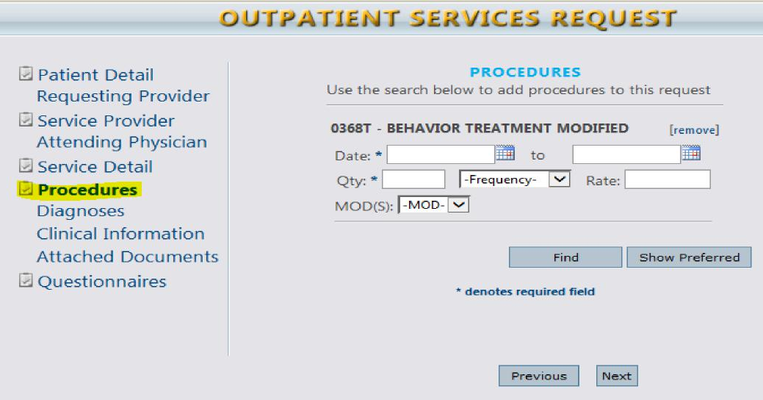
Atrezzo Provider Portal New Case Creation
Enter the requested date span utilizing the calendar dropdowns
Effective 10/1/2020: EIDBI requested dates of services cannot exceed 180 days
Enter the quantity (Frequency = Units). Please enter the total units requested for that date range.
Select the applicable modifier from the drop-down listing (UB Modifier)
Request containing more than 1 procedure code requires you to repeat the above steps
13
Notes:
One of the most common reasons Kepro is unable to process a SA is because of an issue with the signature page. For example. the start date of the request is for a date prior to the last signature date.
The ITP should also be signed before or on the same day as the requested start date.
CMDE, encourage providers to use the start date as the signature date for a year time frame as indicated below.

Slide 30
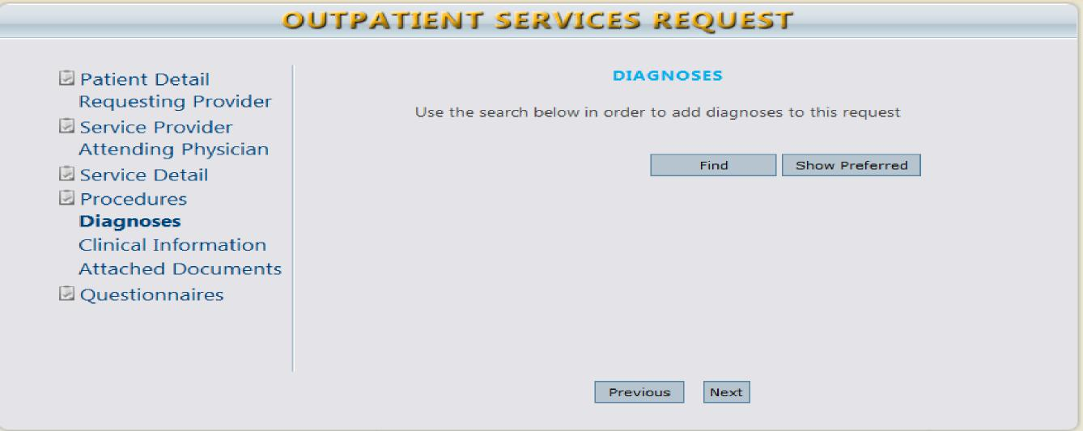
Atrezzo Provider Portal New Case Creation
Enter the Diagnosis code by clicking “Find”
Recommendation: Complete Diagnosis Code Search utilizing the Diagnosis Code versus the code description to reduce search results
14

Slide 31
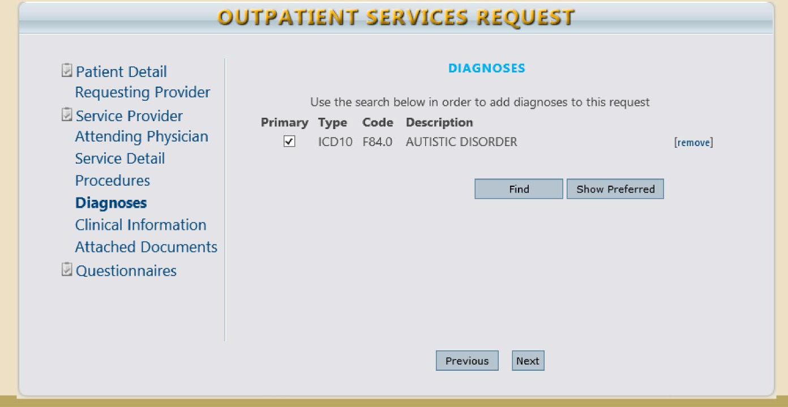
Atrezzo Provider Portal New Case Creation
The first diagnosis code entered is automatically deemed as the primary diagnosis.
Entering more than 1 diagnosis code requires repeating the above steps
15

Slide 32
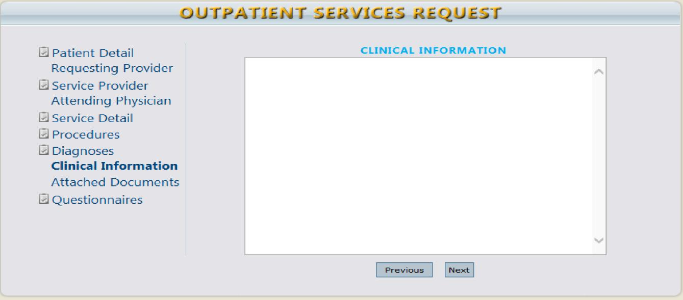
Atrezzo Provider Portal New Case Creation
Insert case specific details into this area for reviewers' attention (i.e., change requests, noting documents uploaded, etc.)
Please note this is a medical record and subject to audit. Please be mindful of this fact when entering communications.
Please do not use this area to submit inquiries as to the case status, instead refer to the case overview for status details
16
Notes:
**Medical Necessity information needs to be documented in the physical record and not just a note in this screen.
Clinical documentation must support the requested services
** If addl info has been requested

Slide 33
Atrezzo Provider Portal: Attaching Documents
Provider Pointers:
Any one document must be less than 4 MB. There is no limit to the total size of all the documents, so long as each individual document is less than 4 MB.
If the document size exceeds 4 MB, compress the file
Instructional information regarding file compression depends on your individual program settings. Consult your IT representative within your facility for assistance. OR
Split your document into two separate files to meet the maximum size limit.
Atrezzo accepts files with the following extensions: PDF, DOCX, XLS, GIF, TIF, TXT, XLSX, JPG, DOC, RTF, BMP, JPEG

Slide 34
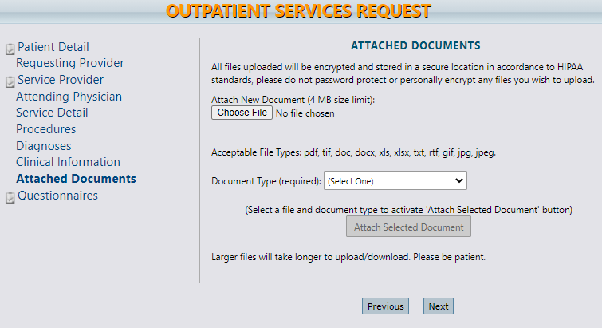
Select “Choose file” to locate the file and click open to attach. The file Name will appear when it is successfully uploaded (refer to steps 2-4).
Providers must submit the required DHS forms for CMDE and EIDBI requested services.
Clinical Documentation must support the requested services.
Notes:
**PHI – Ensure the record, naming configuration and any other means of communication/documentation does not include another recipient’s information. The case will have to voided if it contains information for another recipient.

Slide 35
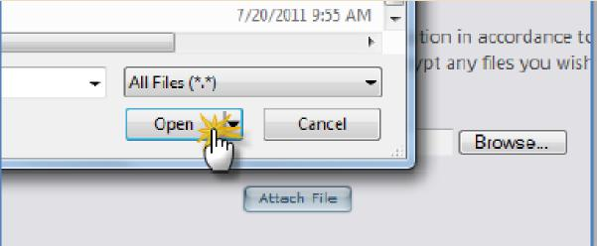
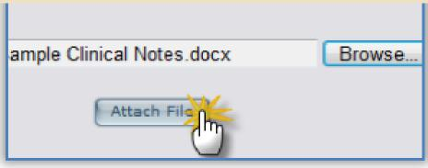
Step 2
Step 3
Step 4

Slide 36
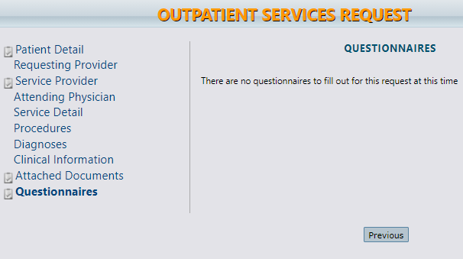
Atrezzo Provider Portal New Case Creation
The Questionnaire is not applicable to CMDE/EIDBI, please skip this step.
17

Slide 37
Atrezzo Provider Portal New Case Creation
Click the check box on the case entry page acknowledging the below statement.
You are now ready to submit your Atrezzo Provider Portal Case
Click “ Submit”. Request overview page will now display your case entry and KEPRO case ID number.
18
If you are unable to complete your case submission, you have the option of Selecting “Save for Later”. Selecting this option saves the data entered up to the current completion point. The case will display on the Atrezzo Provider Portal home page awaiting final submission.
Note: Case Submittal is confirmed by receipt of KEPRO case ID on the Request Overview page.

Slide 38
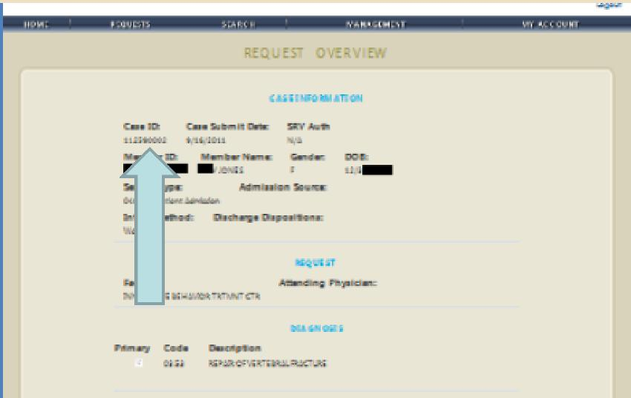
Atrezzo Provider Portal New Case Creation
YOUR ATREZZO PROVIDER PORTAL CASE ENTRY IS NOW COMPLETE KEPRO case ID number is in the upper left corner of your screen
19

Slide 39
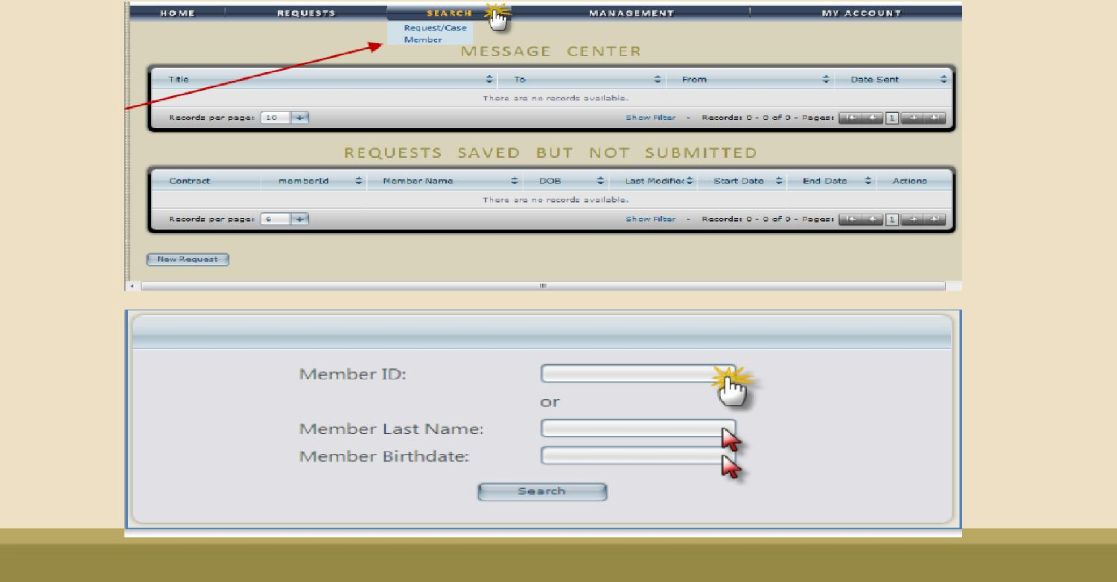
Atrezzo Provider Portal: Submitted Case Inquiry
Complete Member Search
Search by Member ID or Last Name and Date of Birth

Slide 40
Atrezzo Provider Portal : Submitted Case Inquiry
1. Select the Member from the search results by clicking on the SELECT Link ( Located under the Actions Column)
2. Always Select the Minnesota Medicaid Contract

Slide 41
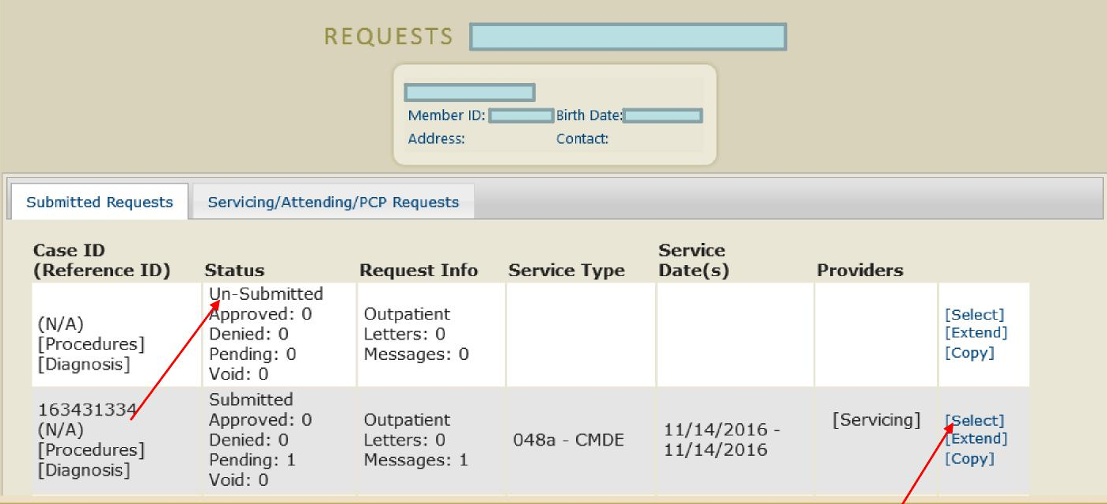
Atrezzo Provider Portal: Submitted Case Inquiry
1. Verify the member’s information and click Select next to the applicable request
Note: Un-Submitted Status indicates your request has not been submitted to KEPRO. View all Un-Submitted request on your home page

Slide 42
Atrezzo Provider Portal: Submitted Case Inquiry
Request Overview page will display all case information:
Member Information
Requested and Certified CPT codes
Requested and Certified Quantity
Current Status (Pending- Add information, Submitted, Approved or Denied)
All Case Messages
Ability to send a new messages
Attached Documents ( All clinical information previously attached for KEPRO Review )
Ability to attach additional documentation
Clinical Information- View all Clinical notes submitted by KEPRO internal staff members and Providers via the Atrezzo Provider Portal System
Ability to add Additional Clinical Information

Slide 43
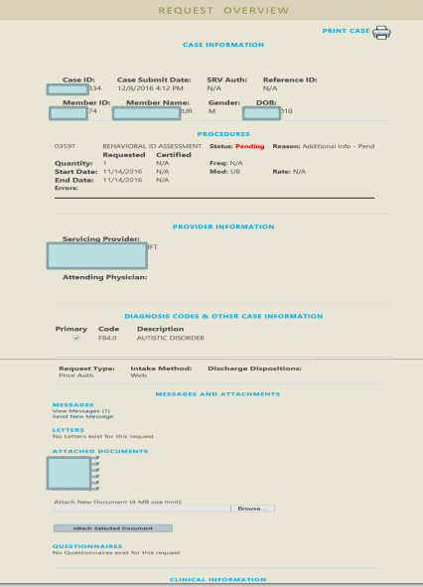
Atrezzo Provider Portal: Submitted Case Inquiry

Slide 44
Receiving Provider Notification
Upon review of the submitted clinical documentation Kepro will make a medical necessity determination. Provider notification regarding Approvals, Denials and request for additional documentation or corrections is viewable via the Atrezzo Provider Portal Message Center.
The purpose of the messaging center is to communicate requests for additional information and Provider responses, and determination outcome.
To READ a message sent, go to the Home Screen and click on the message located in the Message Center.

Slide 45
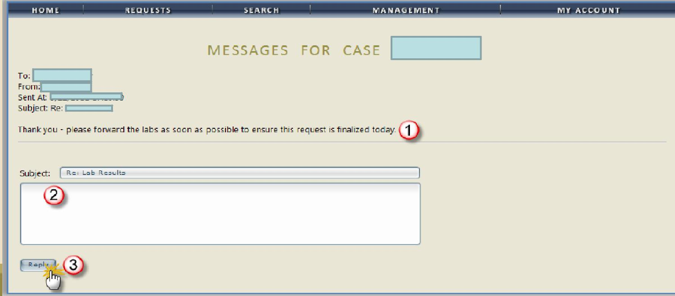
Receiving Provider Notification
The message appears
To REPLY to the message, type the reply in the space provided
Click the REPLY button

Slide 46
Frequently Asked Questions
1. How do I request additional units for service codes to an already approved ITP?
Update Section D of the ITP indicating the increase in units for the needed service code (s).
Provide rationale for the need for additional units in Section E of the ITP under the rationale paragraph.
Obtain QSP and guardian approval through a revised signature page.
Locate the already approved case in Atrezzo portal for the time frame needed and attach the updated documents.
Leave a note for the reviewer regarding what the attachments include and generally what is being requested.

Slide 47
Frequently Asked Questions
2. When and how should the provider contact the Kepro reviewer for a pended case?
When to contact a clinical reviewer:
Questions about a pended case (clinical questions should be asked by QSP, not admin)
Error on case submission or attachments
How to contact a clinical reviewer:
Leave a written message or clinical note within the specific case being referenced in the Atrezzo portal
Call Kepro Provider Call Center at (866) 433-3658 and reference the case in question
To inquire about the status of a pended case, please call the Kepro Provider Call Center
Most questions can generally be answered via the Atrezzo portal.
Please call DHS with billing questions.

Slide 48
Frequently Asked Questions
3. When does a provider submit a CMDE for medical necessity review only?
Active PPHP during the CMDE completion timeframe (including the signature date)
Another provider completed a CMDE but was not submitted to Kepro for review
Indicate in notes
Leave a note for reviewer indicating that this review is for medical necessity only.

Slide 49
Frequently Asked Questions
4. When and how does a provider submit a discharge summary?
A discharge summary should be completed when:
A recipient has been discharged from your agency and is no longer receiving EIDBI services
A recipient discharges to another EIDBI provider to continue services with the new provider
Providers are strongly encouraged to complete the DHS Discharge/Transition Form (7109A) to avoid billing discrepancies between providers
Attach discharge summary or 7109A form to the approved/applicable Atrezzo case (please ensure QSP at minimum has signed the summary)

Slide 50
Frequently Asked Questions
5. What should a provider do when the recipient switches in the middle of an authorization period from an MCO to Fee For Service (MA)?
Verify recipient’s MA eligibility to determine start date
Ensure that there is an approved CMDE on file for that recipient (may need to be approved for medical necessity)
Create a case for review in the Kepro portal and select the dates of service in which MA became primary coverage
May also require prorating total units needed for each service code (i.e. if the authorization timeframe is 90 days then the service codes should be adjusted to reflect 90 days of service)
Please note: submitting the prior authorization information does not guarantee an automatic approval through Kepro

Slide 51
DHS MHCP MANUAL
To access the above material and obtain full access to the MHCP Manual, please visit:
Early Intensive Developmental and Behavioral Intervention (EIDBI) Benefit (state.mn.us)

Slide 52
Atrezzo Provider Portal
For additional assistance, please contact KEPRO Customer Service Department at (866) 433-3658
Refer to the Atrezzo Provider Portal User Guide located
under the Help tab on the Home page in the Atrezzo
Provider Portal.
https://atrezzo.kepro.com/HelpDocs/Minnesota/Atrezzo%20Connect%20User%20Guide.pdf
https://atrezzo.kepro.com/HelpDocs/Minnesota/AtrezzoFAQ.pdf
Notes:
Kepro Atrezzo Portal Training
Please join KEPRO and attend our How to Create an Inpatient Request training on March 23, 2022 @ 9am CST.

Slide 53
Question & Answers

Slide 54
Thank you for your attendance and participation.

