Slide 1

EXTENDED PSYCHIATRIC INPATIENT TREATMENT SERVICES
Provider Training
Atrezzo Provider Portal and DHS Review Process

Slide 2



Extended Psychiatric
Inpatient Treatment

Slide 3
Extended Inpatient Psychiatric
When is the patient eligible?
What is the provider facility responsibility?
When to submit prior authorization request to Kepro?
DHS contracts with county and private hospitals throughout Minnesota to provide extended inpatient hospital psychiatric treatment for MA fee-for-service eligible adults and children. The members are court committed or voluntarily admitted in lieu of commitment and are most often hospitalized on an acute psychiatric unit before admission to the contracted services.
Contracting hospitals should refer to the Extended Inpatient Psychiatric Services contract for limited medical services that MHCP considers outside the contract per diem rate and hospitals can submit separately for outpatient payment.

Slide 4

DHS Extended Psychiatric Inpatient Forms (5)
Links included
Extended Psychiatric Inpatient Treatment Review Procedures https://edocs.dhs.state.mn.us/lfserver/DHS-4905A-ENG
Weekly Review Guidelines Continued Stay in Psychiatric Inpatient Bed
https://edocs.dhs.state.mn.us/lfserver/DHS-4905B-ENG
DHS 4905C Initial Review Form
https://edocs.dhs.state.mn.us/lfserver/DHS-4905C-ENG
DHS 4905D Weekly Bed Review Form
https://edocs.dhs.state.mn.us/lfserver/DHS-4905D-ENG
DHS 4905F Discharge Summary Review Form
https://edocs.dhs.state.mn.us/lfserver/DHS-4905F-ENG

Slide 5
DHS4905A form – what is here?
Extended Psychiatric Inpatient Treatment Review Procedures
The following information can be found on this document:
Forms and Instructions
Eligibility Requirements
Weekly Reporting
Care Longer Than 45 Days
Discharge
The Medical Assistance (MA) contract bed program has several requirements for both voluntary and committed patients in psychiatric inpatient treatment.
Key points to remember are:
Providers must submit the information needed to determine medical necessity for continued stay
The medical review agent or contractor may review inpatient medical records to determine validity of information provided
Hospital days are counted from the first day the patient is eligible under contract funding, not from the day of admission to the hospital. (date of transfer)
https://edocs.dhs.state.mn.us/lfserver/DHS-4905A-ENG

Slide 6
DHS4905B form - what is here?
Weekly Review Guidelines: Psychiatric Inpatient Bed
The following information can be found on this form:
Information To Submit
Follow-up Forms and Documentation Requirements
Milestones
Discharge
The inpatient provider who is most clinically familiar with the patient must submit the following forms and documentation on days 14, 21, 28, 35 and 42 to receive continued authorization.
Send the documentation listed by secure fax, or directly upload documents via your Atrezzo Provider Portal, to the medical review agent Kepro.
The list of documentation listed to the side numbered 1-11 will need to be submitted with each Weekly Review submission. This need to be current updated clinical documentation from the last covered day.
https://edocs.dhs.state.mn.us/lfserver/DHS-4905B-ENG

Slide 7

MAJOR MILESTONES
The following are the major milestones of Extended Psychiatric Inpatient Treatment :
Admission
Identification of preliminary discharge options, including documentation of collaboration with MH-TCM or ACT teams, if the patient is connected with these providers
Completion of a formal, well-defined discharge plan (including provisional discharge criteria) that is possible to achieve within 45 days. If it appears that despite aggressive treatment efforts, longer term stabilization is needed, continued care options (including extension of 45-day limit) are considered
Patient is ready for discharge and the discharge plan (including the provisional discharge) is implemented. Passes may be granted, and a definitive discharge date is set
Patient is discharged or, if necessary, care is transferred to another facility
If treatment is not expected to be completed in 45 days, the medical review agent needs to determine eligibility for extension of services. The hospital must call the medical review agent (Kepro Provider Services 866.433.3658) and fax/upload medical documentation to them by day 35 for an extension of the 45-day period and provide the agent the Weekly Bed Review (DHS-4905D). The information must also be faxed to the patient’s MH-TCM or ACT team, if applicable.
*Additional documentation may be requested

Slide 8
Now that we have reviewed the Extended Psychiatric Inpatient Treatment Eligibility and Documentation Requirements…
Let's move on to the actual review process.

Slide 9

PART ONE
Review process: A step by step guide

Slide 10
Three-Fold Process
INITIAL REVIEW
WEEKLY CONCURRENT REVIEW
DISCHARGE
Form DHS-4905C
Form DHS-4905D
Form DHS-4905F
Request prior authorization on first day County determines patient meets the MA benefit criteria and the treatment team determines medical necessity for extended inpatient stay – submit supporting documentation
Submit form with the REQUIRED documents (treatment plan, assessments, discharge updates, etc.) prior to days 14, 21, 28, 35 and 42
Upon discharge, submit form to Kepro along with the formal discharge summary with course of treatment noted with discharge disposition

Slide 11
DHS-4905C
Initial Review Procedure
Approval days 1-14
At transfer to Extended bed from an acute IP hospitalization OR Emergency Room, the provider submits completed form DHS-4905C form with supporting documentation as required by DHS:
Previous treatment history and problems related to reason for admission to an extended stay bed (including substance abuse) to support the need for the extended stay admission (See the Kepro Provider Support Sheet)
All pertinent records (admission assessments, MAR, H&P, Treatment Plan, etc.) from day one of the acute bed stay through the date of transfer to the contract bed status including documentation noting medical necessity for transfer to Extended Inpatient status
https://edocs.dhs.state.mn.us/lfserver/DHS-4905C-ENG
Completed DHS-4905C form
Clinical Documentation
Creates New Atrezzo Case
Creates New Prior Authorization (IHA) *The PA remains in Pended status until Discharge notification

Slide 12
DHS-4905D
Continued Stay Review Procedure
Approval 7-day increments
Submit this form with the treatment plan, assessments and progress notes as indicated on the form for days 14, 21, 28, 35 PRIOR to the last covered day
*The PA remains in Pended status until Discharge notification
To meet MHCP continued stay criteria, documentation must address all of the following:
Demonstrated immediate or ongoing risk to self or others
Description of the medication management being done, including information such as reactions to medication, symptoms or behavioral responses to medications, and continued plan for medication treatment
What symptoms continue to be present, how they compare to the patient’s non-acute level of functioning, and what impact the symptoms are having on current functioning
Treatment plan and treatment plan progress, including clear documentation on how the patient’s strengths have been assessed and incorporated into the treatment and discharge planning
Progress in arranging a discharge destination
Other factors to consider, such as amount of daily medical observation needed and why; psychiatric or emergent evaluations; whether the multi-disciplinary team involved provides the plan; other interventions designated as important to discharge; specific barriers identified, and strategies employed to overcome.
The MMIS PA remains in a Pended status until Discharge notification
https://edocs.dhs.state.mn.us/lfserver/DHS-4905D-ENG

Slide 13

Discharge
Arrange discharge, if at any time during hospitalization, the patient meets all of the following criteria:
The patient has no suicidal or homicidal ideations or intent.
Treatment goals have been met and psychiatric symptoms have decreased to a degree where less acute level of care is indicated.
There are no further plans for medication adjustment and medication can be monitored safely in a less acute setting.
Symptoms no longer interfere with activities of daily living (ADLs) or the patient can be monitored or assisted in completing ADLs.
A definitive living situation and outpatient treatment plan has been established (including scheduled appointments and aftercare for chemical dependency).
The patient is reasonably willing to comply with the discharge plan.

Slide 14
DHS-4905F
Discharge Review Procedure
Upon discharge, fax (secure) this form to medical review agent, or directly upload completed form via the Atrezzo Provider Portal.
Make sure to include the formal discharge summary with course of treatment and discharge disposition noted
https://edocs.dhs.state.mn.us/lfserver/DHS-4905F-ENG
Submit this form within 2 days of discharge with the documents
*The PA receives an Approved status with successful Discharge review

Slide 15
PART two
Provider Portal Registration

Slide 16
STOP!
Do not use this process if you have already created a Username and Password as a MN Mental Health provider.
Contact ACENTRA @ MNProviderIssues@KEPRO.COM
to have the new location(s) added to your existing account.
Atrezzo Login

Slide 17

Atrezzo Login Location
Contact MNProviderIssues@kepro.com to obtain your registration code.
1
Have your NPI on hand
2
Go to: http://mhcp.Kepro.com
3
Click on “Atrezzo Login”
4

Slide 18
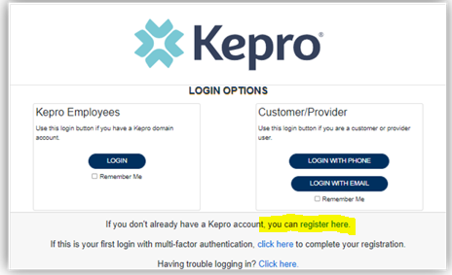
Click on “Register Here”
Enter your NPI
Enter your “Provider Registration Code”
Enter your Organizational Information
  Username, password, First and Last names, email address, and fax numbers are required
  If you do not have a fax number, use 111-111-1111
Successful completion will take you to the homepage
Atrezzo Login Process

Slide 19
PART three
Submitting an Initial Case

Slide 20


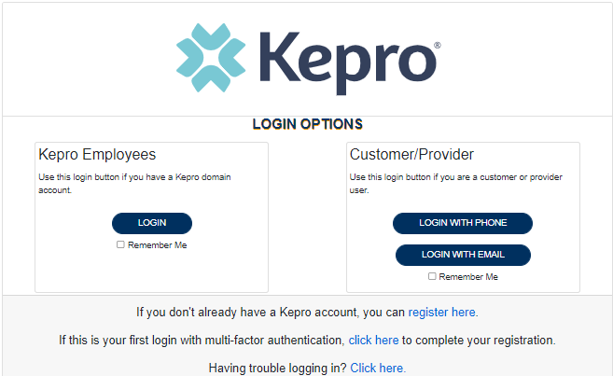

ANG Provider Portal
Training Website:
For in-depth training on the new ANG Platform, please visit:
mhcp.Kepro.com/training
> ANG Provider Portal
Training Video Link:
MHCP ANG Provider Portal Create Case Wizard Training Video
ANG Provider Portal allows for:
Secure access to ANG Connect (Provider Portal)
Provider will be able to access letters by Case/Request, Respond/Send messages To/From KEPRO
Receipt of a Kepro Case ID# to confirm Kepro has successfully received your submission.

Slide 21

Accessing ANG (Atrezzo)
Provider Portal
Any Concerns Please Email MNProviderIssues@kepro.com
Select Atrezzo Login
Website: https://portal.Kepro.com
Registered Provider:
Complete Registration and create username

Slide 22


Submission Steps for Case Creation Wizard
The following slides present step by step instruction on how to submit a case through the ANG Case Creation Wizard. Please notice each slide has a corresponding step 1 through 23 with instructions on the left and highlighted boxes to guide the process.

Slide 23

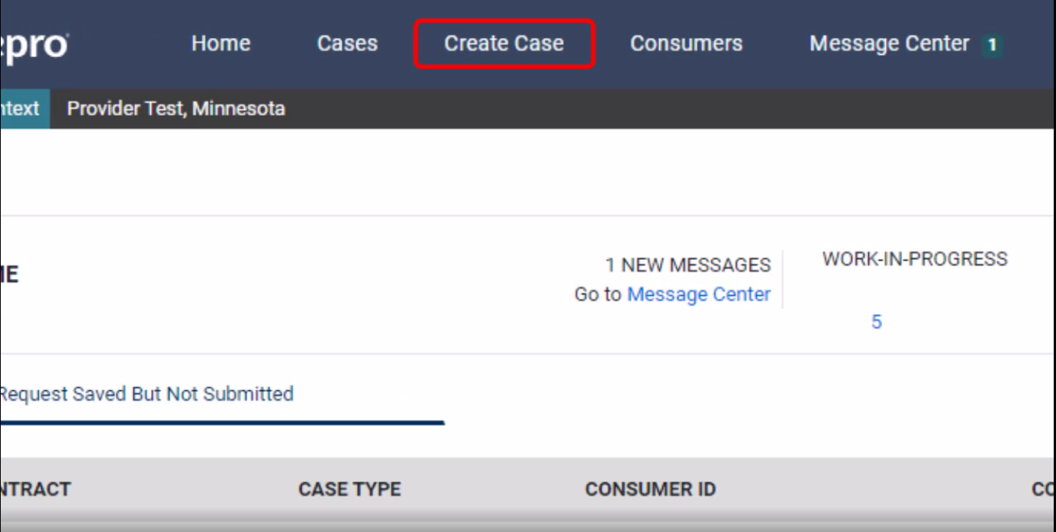
ANG Provider Portal
Successful Completion of setup/login directs user to the Home Page
After logging in from the home screen, click on “Create Case”.

Slide 24

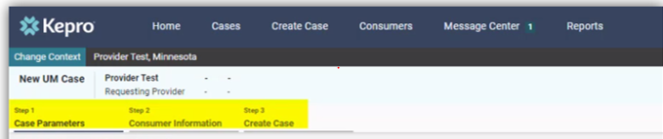
ANG Provider Portal
The Create a Case Wizard shows each section as a Step. The required information will be indicated by a red asterisk (*).
“Create Case Wizard” screen view

Slide 25

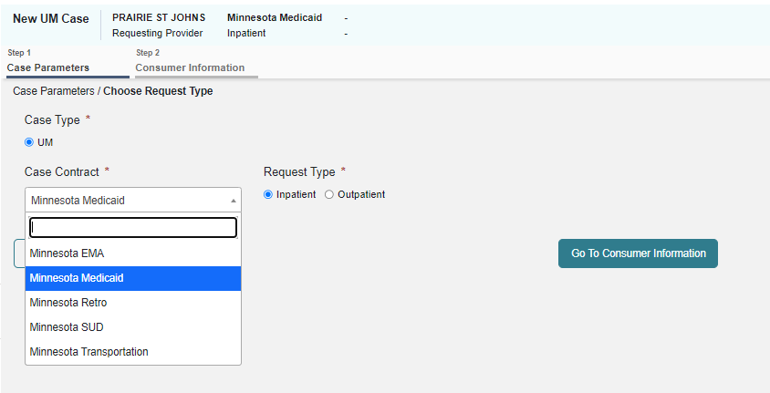
ANG Provider Portal
Case Parameters
Choose:
Case Type: “UM”
Case Contract: “Minnesota Medicaid”
Request Type:
  “Inpatient”
Click “Go To Consumer Information” to continue

Slide 26

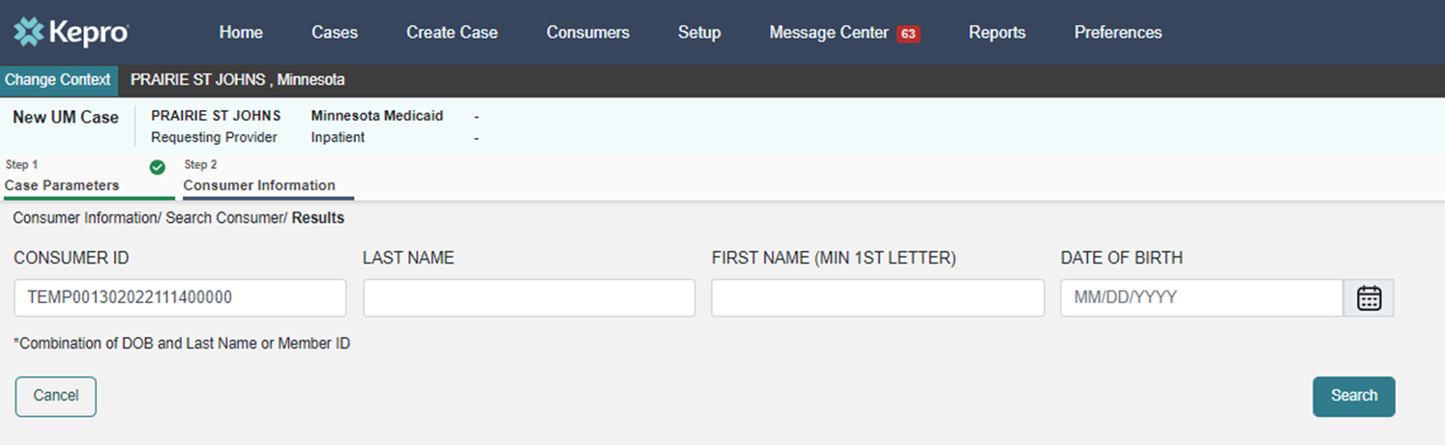
ANG Provider Portal
Consumer information
Search members by:
MN Member ID
Last Name & DOB
Click “Search” to continue

Slide 27

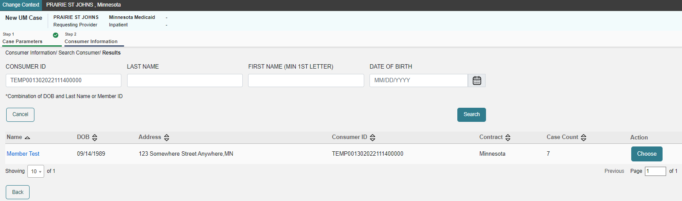
ANG Provider Portal
The members demographic information will display.
Consumer information
Verify member information.
Click “Choose” to continue.

Slide 28

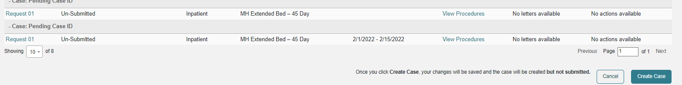
ANG Provider Portal
Consumer information
Previous cases submitted for this member will be displayed.
Click on “Create Case” to continue.

Slide 29

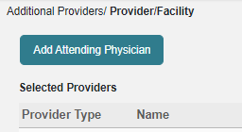
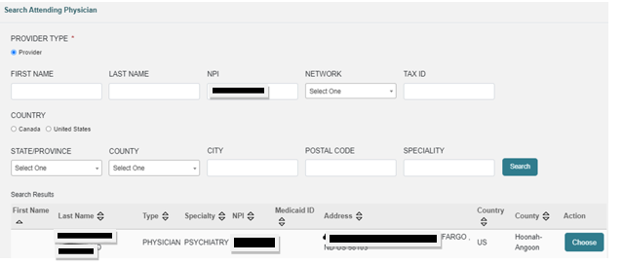
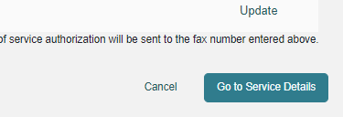
ANG Provider Portal
CREATE CASE
Notification prompt displays:
Add Attending Physician
Enter NPI
Select Choose
Go to Service Details tab will appear - click

Slide 30

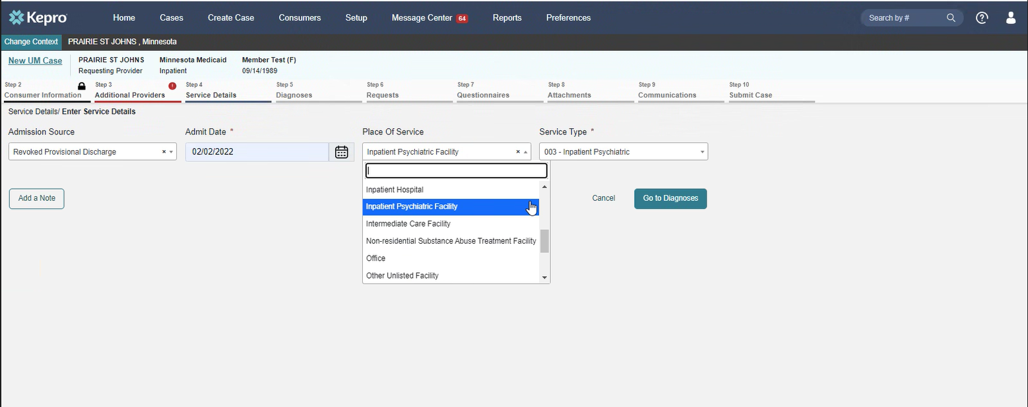
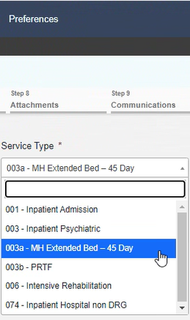
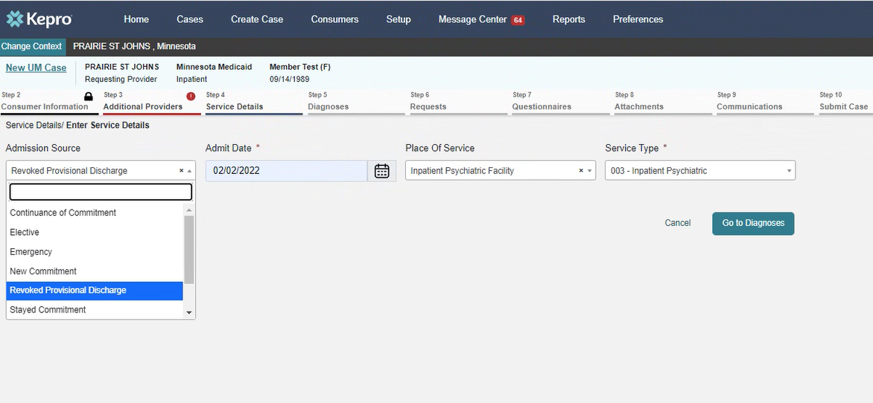
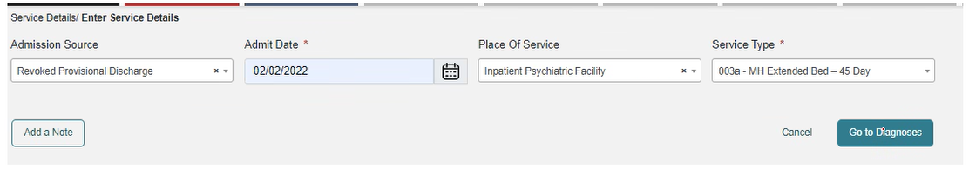
ANG Provider Portal
Requesting Provider and Facility
Select Admission Source from dropdown menu
Enter Admit/Transfer date
Select Place of Service as INPATIENT PSYCHIATRIC FACILITY
Select Service type as 003a MH Extended Bed – 45 day
Then Select “Go to Diagnosis”
Example of completed entries

Slide 31

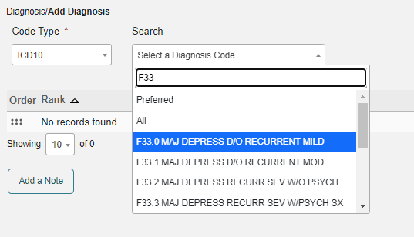
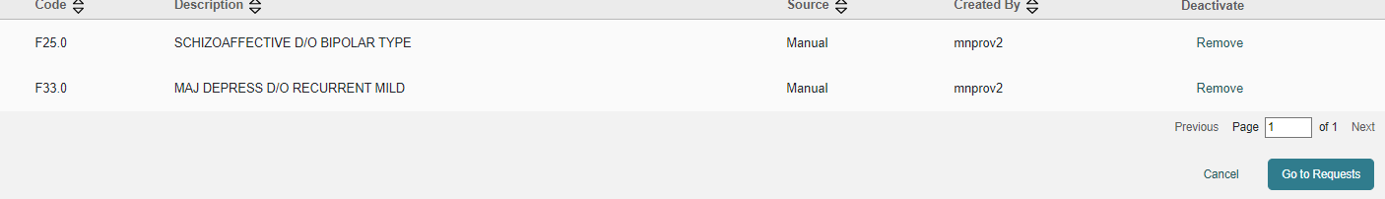
ANG Provider Portal
9
diagnosis
Choose:
Code Type: “ICD 10” from the drop down,
Enter the diagnosis code to search
Select the correct code from the drop down,
Click “Go to Requests” to continue

Slide 32
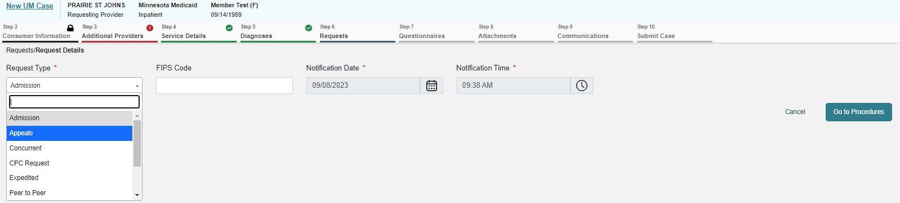
ANG Provider Portal
10
ADDITIONAL PROVIDERS
  Admission: beginning treatment
  Complete the Request Type by selecting ADMISSION* from the drop-down menu
  Click on “Go to Procedures” to continue.
**PROVIDER: ANG is currently experiencing challenges with this Request Type and may produce an error in the next few steps. IF you encounter this error, please make the necessary adjustment to “Retro” when prompted and the clinical review staff will amend your Request Type upon receipt. We apologize in advance for this workaround while ANG updates the internal rules for individual service types.

Slide 33
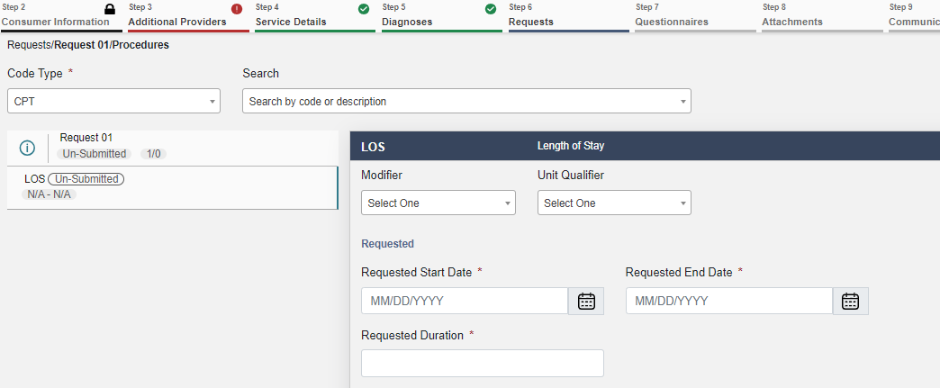

ANG Provider Portal
11
In the LOS – Length of Stay fields, enter the Requested Start Date and Requested End Date. ANG will calculate the “Requested Duration” when you tab out of this field.
Select the “Go to Questionnaires” box

Slide 34
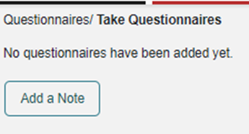

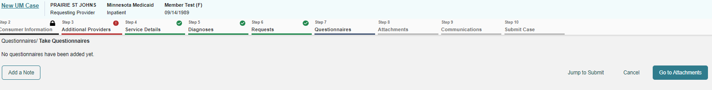
ANG Provider Portal
12
requests
There are NO questionnaires for this review type
You can now move to the next screen to Upload Required Documentation
Select “Go to Attachments”

Slide 35
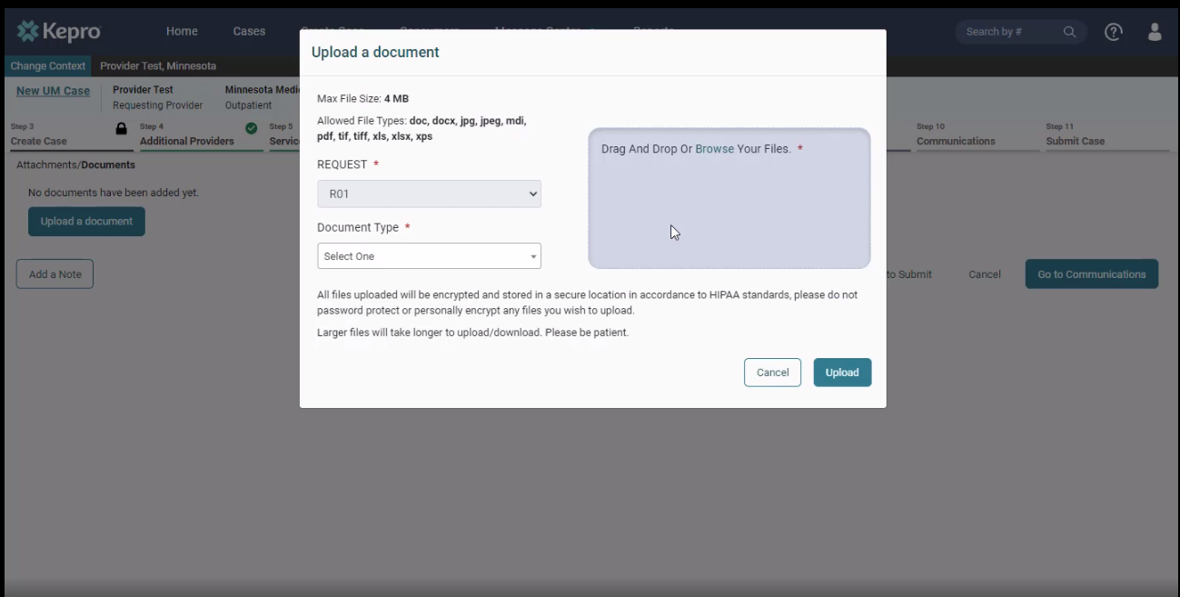
ANG Provider Portal
13
attachments
Click on “Upload documents.”
*You can drag and drop your documents, or you can browse your files.
Choose the appropriate document types
  PDF is the preferred file type for uploads
Once the documents are chosen, click on “Upload.”

Slide 36
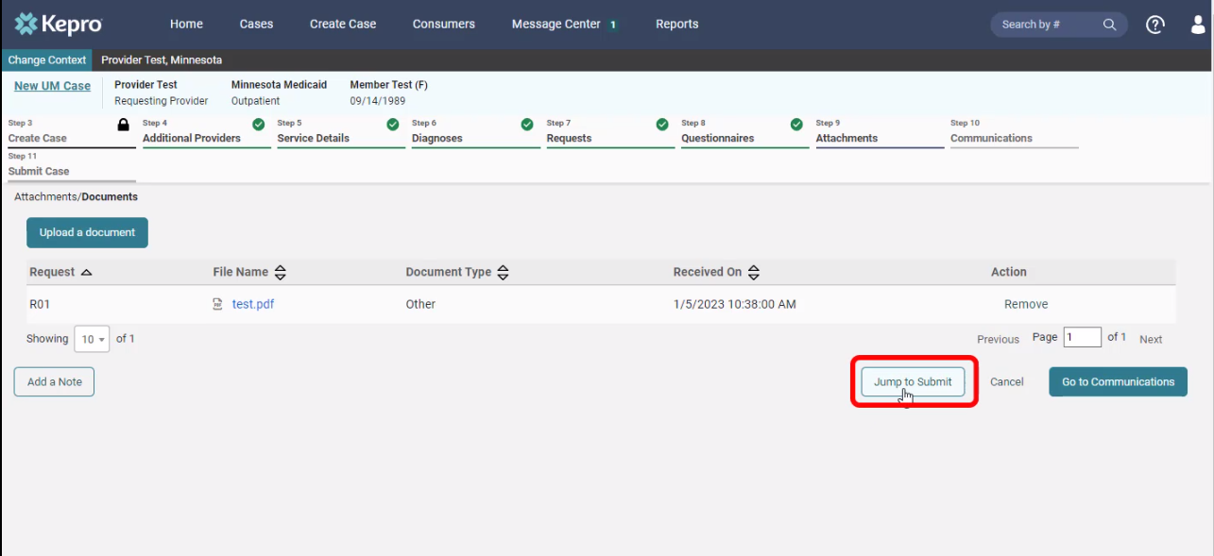
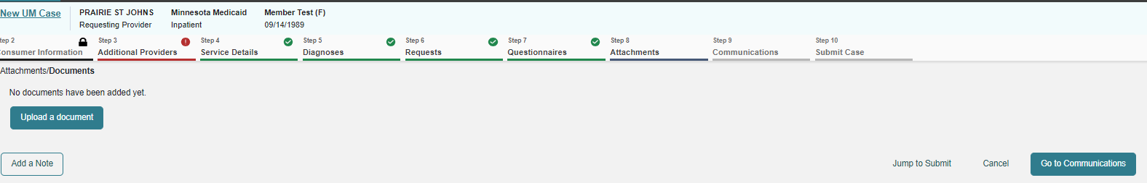
ANG Provider Portal
14
attachments
When all the required clinical documentation has been uploaded, you are ready to SUBMIT your created case
Click on “Jump to Submit” when all the steps are completed, and a case note has been entered (if necessary).

Slide 37
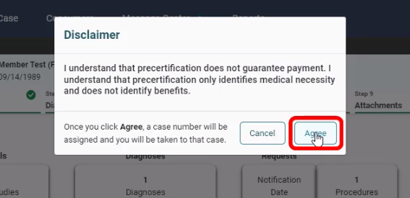
ANG Provider Portal
15
disclaimer
Click “Agree” on the disclaimer

Slide 38
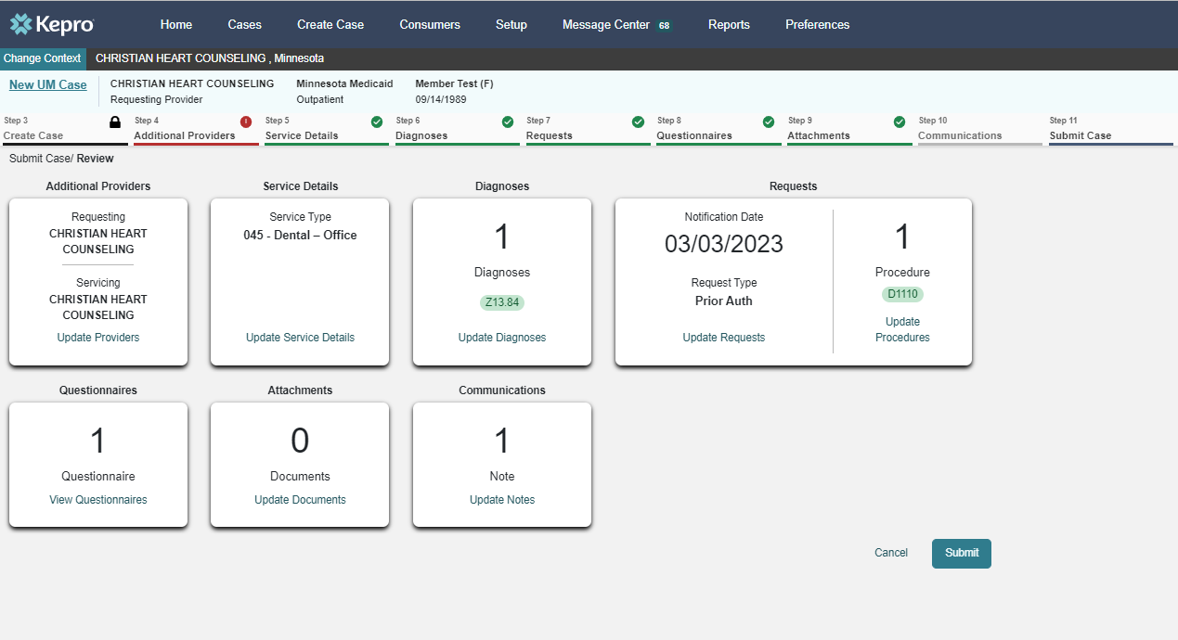
ANG Provider Portal
16
communications
Review the details of your request
If any changes need to be made, click on “Update” in any section
When everything is correct, click on “Submit”
SUD
F15
97153

Slide 39
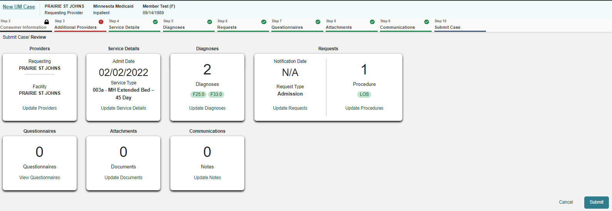
ANG Provider Portal
17
SUCCESS!
A case created and completed ready for clinical review by Kepro-Acentra
Suggestion to Provider: If you print or record this new Case ID number at this point, it will save you time tracking case status, monitoring for pended information or to enter questions/concerns to the Message system. You are able to search for submitted cases using this Case ID number via the Provider portal when required to EXTEND service lines to existing reviews.

Slide 40
Part four
Extending Service Lines for Continued Stay

Slide 41

Selecting an Existing Case
18
If patient will remain admitted to your facility by Day 15, DHS requires additional clinical review of this continued stay
When signed into ANG provider portal, enter Case ID to the ‘Search by #’ field
When the Case opens, select “Extend” and follow the previous Slides 33 to 38 (steps 14 to 19)

Slide 42
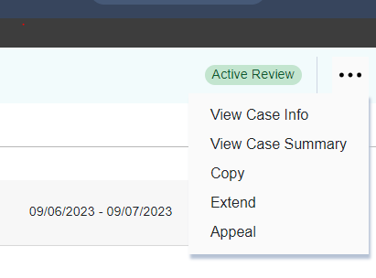
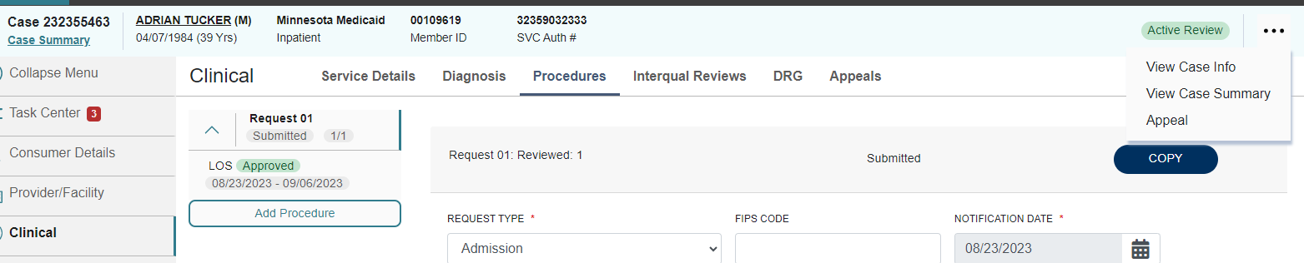
ANG Provider Portal
19
If client is still in services and a case needs extended
  Select 3 dots (…) in right corner
  Select Extend
From here you will additional dates for continued stay and upload the required DHS clinical documentation following the previous steps
When completed, click Submit Case. A new case is not generated.
Continued stay requests

Slide 43
TROUBLE SHOOTING/ PROBLEM SOLVING
Tips and Tricks

Slide 44
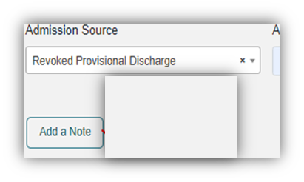
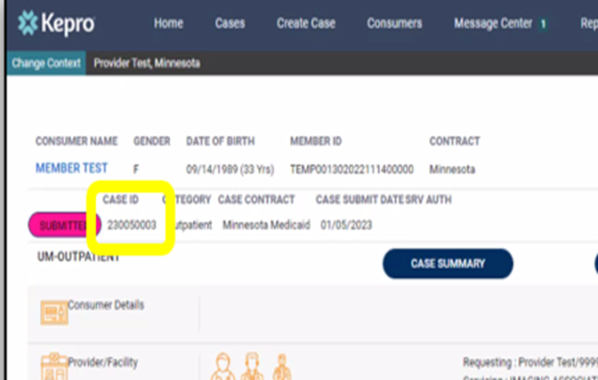

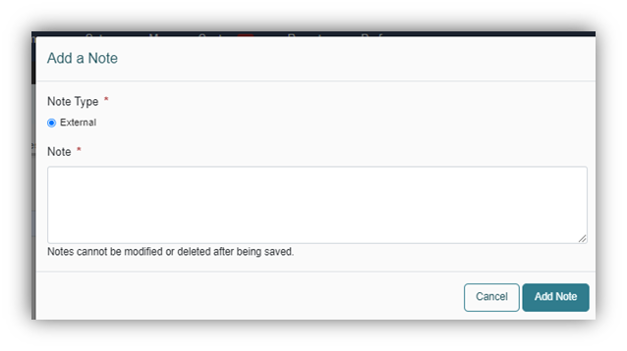

ANG Provider Portal
QUICK TIPS –
Adding a note
Tracking Case ID numbers
20
1. Adding a note is a useful tool that sends your entry to the review team
~ Click on "Add a Note“
~ Type Note
~ Select the blue "Add Note"
2. Tracking submitted Cases
Time Saver: Print or record the new Case ID as seen in the screenshot below.
Having your Case ID numbers readily available outside of ANG helps you easily track review status, monitor for pended information and enter questions/concerns during the review process.

Slide 45
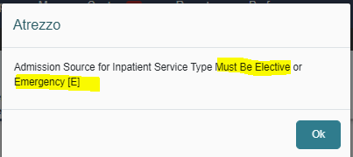
ANG Provider Portal
21
POTENTIAL ERROR CODES/ WARNINGS**
**PROVIDER: ANG is currently experiencing challenges with this Request Type and may produce errors. IF you encounter any of these errors, please make the necessary/requested adjustment when prompted and the clinical review staff will amend your Case upon receipt.
Please include a NOTE of you encounter and the ACTUAL information to ensure accuracy.
We apologize in advance for this workaround while ANG updates the internal rules for individual service types.
Notes:
****This is the “lying slide”: ERROR message is inaccurate / Becky will need to address (do we even need to include this slide??) The reality is if Admission Source is Elective or Emergency, the case is incorrect. This is currently being amended by the MH reviewer upon receipt.****

Slide 46
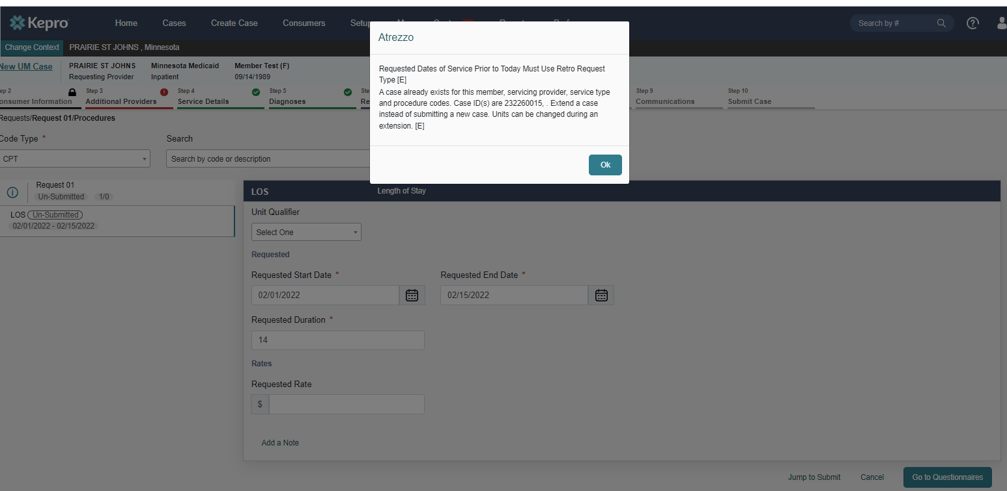
ANG Provider Portal
22
21
We continue to update ANG for this service type and some rules are conflicting. You may potentially encounter this error message. IF you encounter this error, please make the requested change and enter a NOTE of the occurrence for the clinical review staff to amend. This will help us track its appearance.
Thank you in advance for your patience while we work through these challenges.

Slide 47
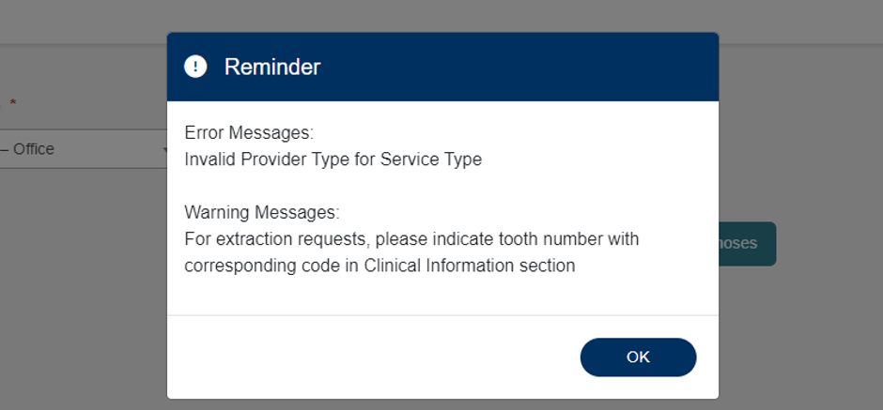
ANG Provider Portal
23
MANAGING POSSIBLE Error messages
If applicable, error messages will appear, prohibiting requested submission.
Errors will disappear as information is added or corrected.
Please make the corrections or additions. Please include a note of the Error and your actions taken. The clinical reviewer will make your updates.
If “Invalid Provider Type” error message appears, an incorrect provider type was selected.

Slide 48



Questions
Feel free to reach out to the below contacts with any concerns or questions.
DHS email:
MN_DHS_Inpatient.ExtendedBed@state.mn.us
Additional Contact Information
Kepro Provider Services: 866-433-3658
DHS Provider Services: 651-431-2700
MH.SUD.ProviderQuestions@kepro.com
Notes:
25

