Slide 1
EMERGENCY MEDICAL ASSISTANCE REQUESTS: ATREZZO PROVIDER PORTAL TRAINING
Utilizing the Create a Case Wizard
Portal Submission Requirements

Slide 2
Objectives
Acentra Health’s role as the MRA
Registration & Submissions
Certification Outcomes/FAQ
MHCP’s current medical review agent is Acentra health (formerly known as Kepro).
Review the registration and submission process for EMA requests via the Atrezzo Provider Portal
To increase efficiency and certification outcomes for these requests.

Slide 3


Atrezzo Provider Portal
Training Website:
For in-depth training on the new Atrezzo Platform, please visit:
mhcp.Kepro.com/training
> Atrezzo Provider Portal
Training Video Link:
MHCP Atrezzo Portal Create Case Wizard Training Video
Atrezzo Provider Portal allows for:
Secure access to Atrezzo Provider Portal
Provider will be able to access letters by Case/Request, Respond/Send messages To/From ACENTRA
Receipt of a Atrezzo Case ID# to confirm Acentra has successfully received your submission.

Slide 4
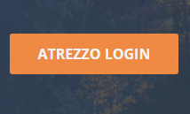
Accessing Atrezzo
Provider Portal
Select “Atrezzo Login”
To Register for Atrezzo Provider Portal :
Enter your 10 digit National Provider Identifier (NPI) number and Provider Registration Code (Provider to call Acentra Customer Service (866) 433-3658 to obtain registration code)
Website: https://portal.Kepro.com
Registered Provider:
Enter your unique username and password

Slide 5

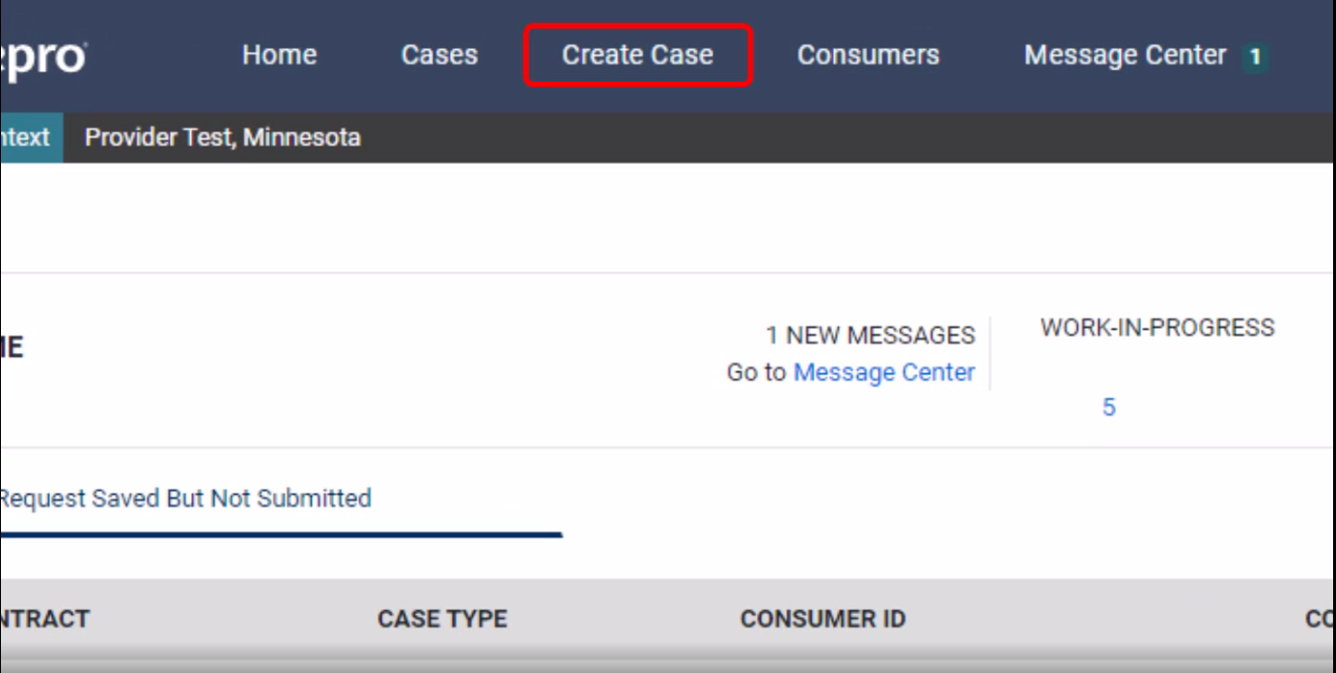
Atrezzo Provider Portal
Successful Completion of setup/login directs user to the Home Page
After logging in from the home screen, click on “Create Case”.

Slide 6

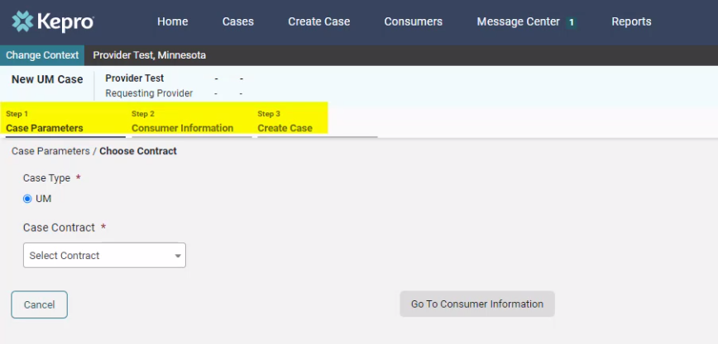
Atrezzo Provider Portal
The Create a Case Wizard shows each section as a Step. The required information will be indicated by a red asterisk (*).
CREATE CASE WIZARD

Slide 7

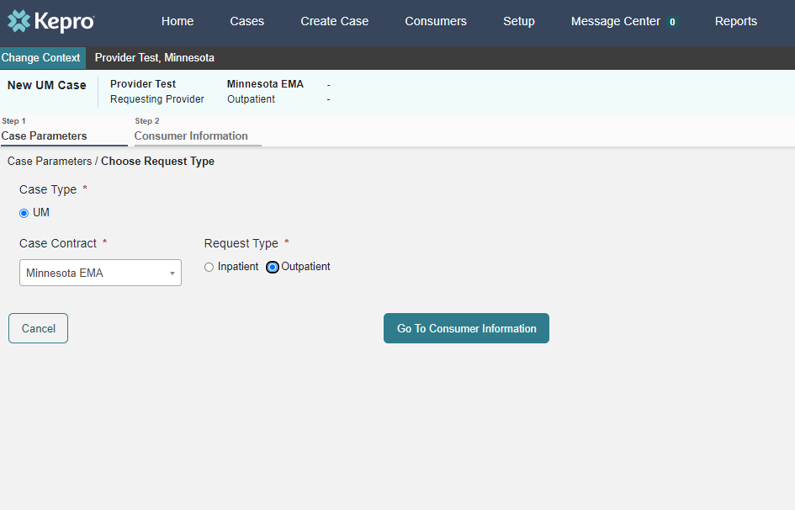
Atrezzo Provider Portal
The Create a Case Wizard shows each section as a Step. The required information will be indicated by a red asterisk (*).
CASE PARAMETERS
Choose:
Case Type: “UM”
Case Contract: “Minnesota EMA”
Request Type: “Outpatient”.
Click “Go To Consumer Information” to continue.

Slide 8

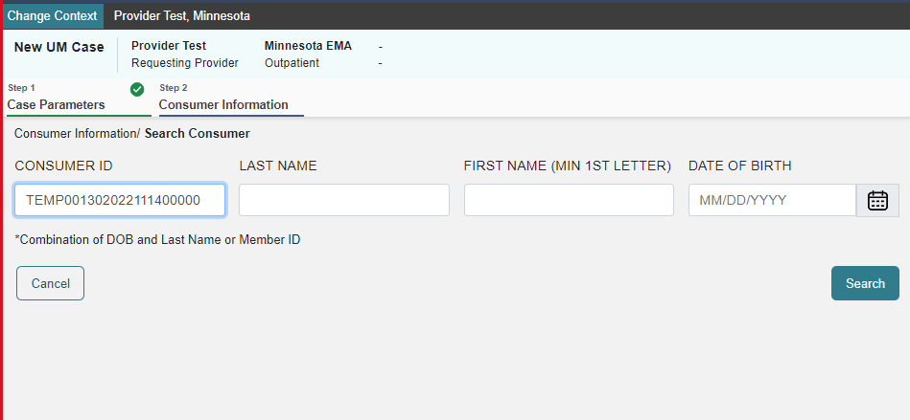
Atrezzo Provider Portal
CONSUMER INFORMATION
Search members by:
MN Member ID
Last Name & DOB
Click “Search to continue”

Slide 9

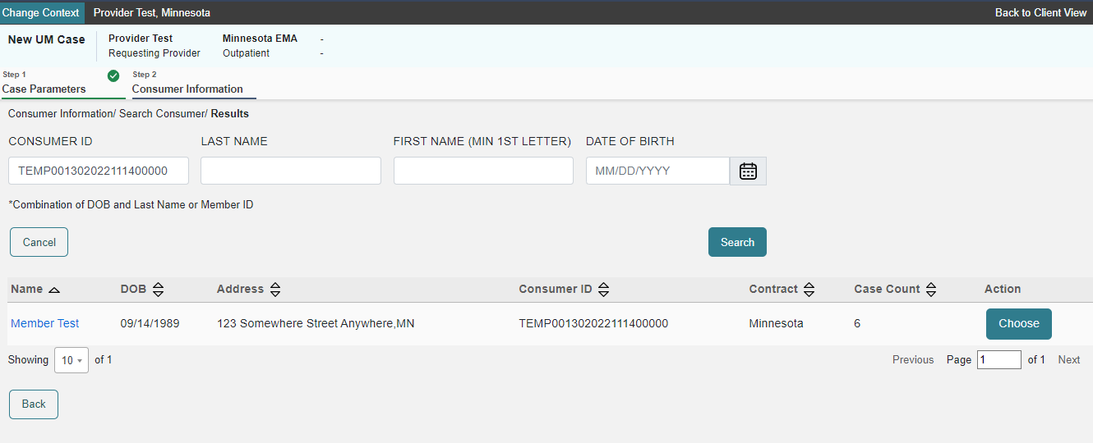
Atrezzo Provider Portal
CONSUMER INFORMATION
Choose:
Verify member information.
Click “Choose” to continue.

Slide 10

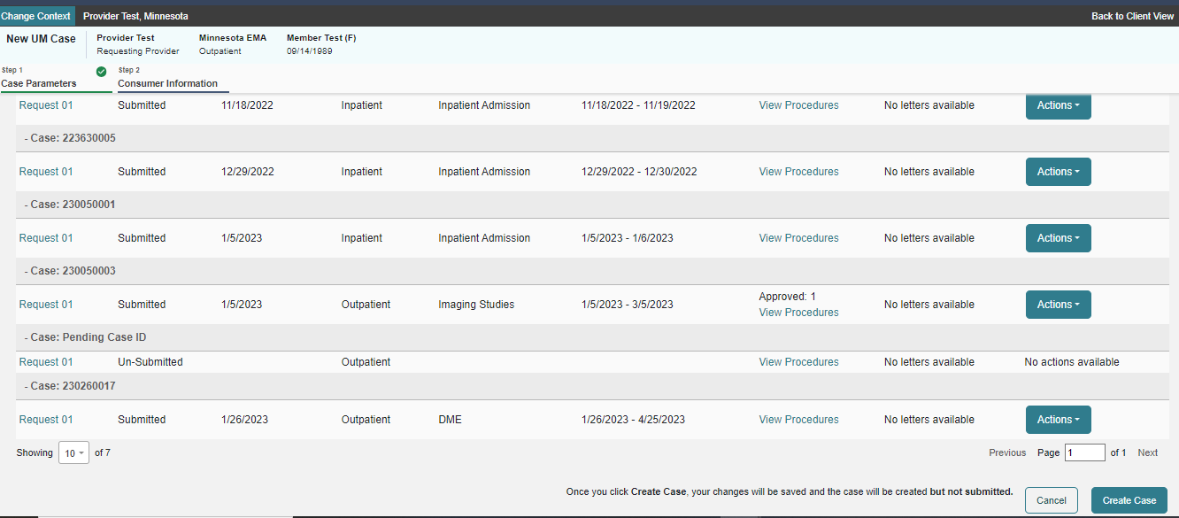
Atrezzo Provider Portal
CONSUMER INFORMATION
Previous cases submitted for this member will be displayed.
Click on “Create Case” to continue.

Slide 11

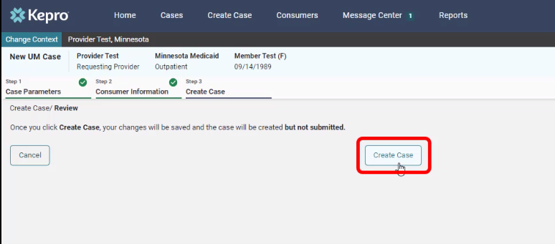
Atrezzo Provider Portal
CREATE CASE
Notification prompt displays:
Once you click Create Case, your changes will be saved and the case will be created; BUT
Case WILL NOT be submitted

Slide 12

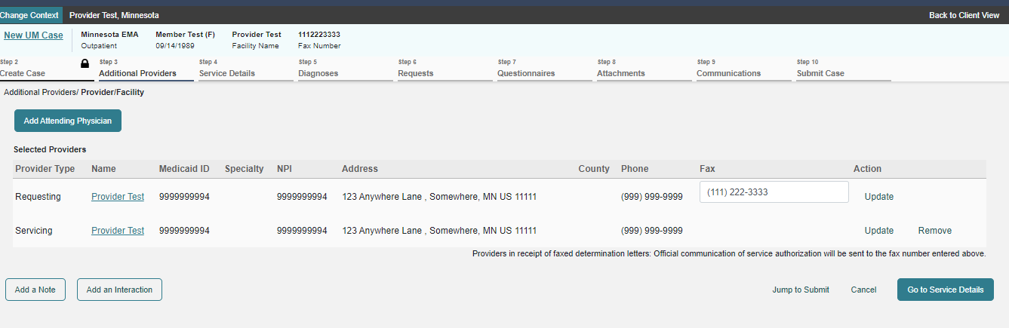
Atrezzo Provider Portal
ADDITIONAL PROVIDERS
This screen shows the requesting and servicing provider, which should be the same for EMA.
Click “Go to Service Details” to continue

Slide 13

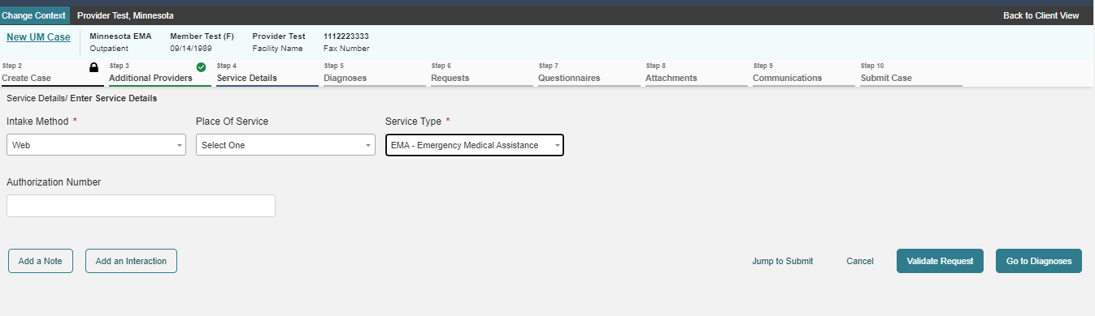
Atrezzo Provider Portal
SERVICE DETAILS
Choose:
Intake Method
Place of Service
Service Type
Choose “Go to Diagnosis”

Slide 14

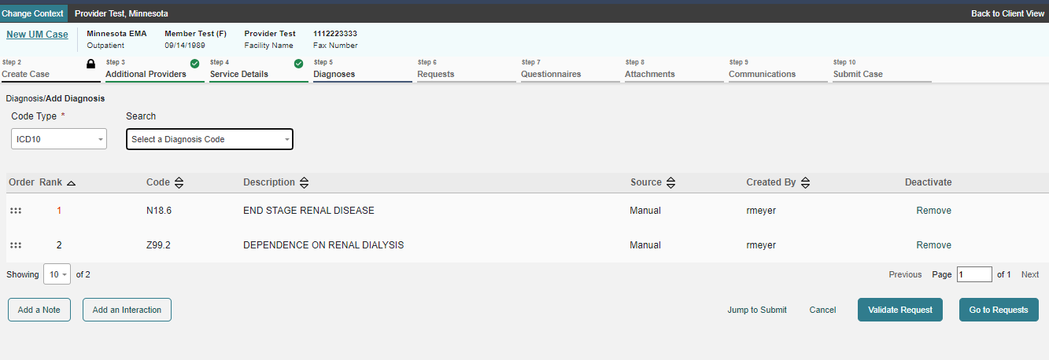
Atrezzo Provider Portal
DIAGNOSIS CODES
Insert Diagnosis Codes
Click “Go to Requests” to continue

Slide 15
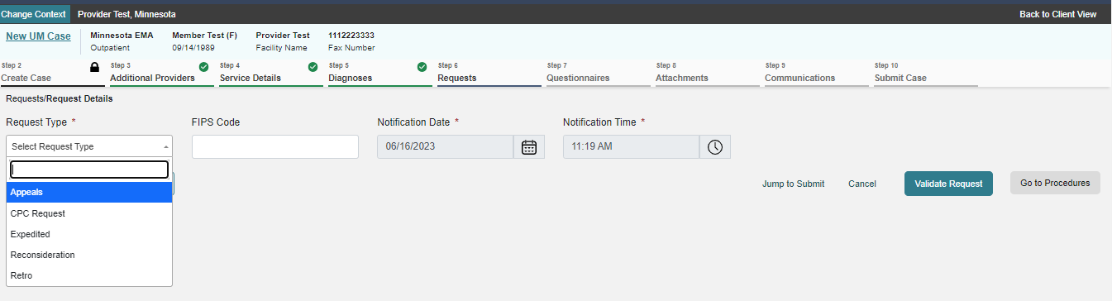
11
Atrezzo Provider Portal
REQUEST DETAILS
Choose:
Request Type
Click “Go to Procedures”

Slide 16
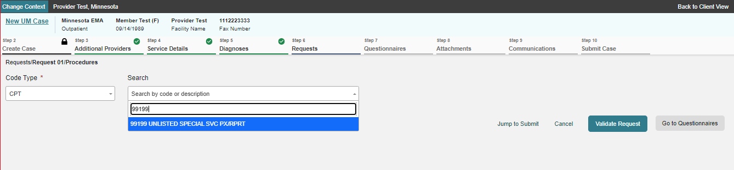
12
Atrezzo Provider Portal
REQUEST DETAILS
Choose:
Code Type
Search CPT Codes (Always use 99199)

Slide 17
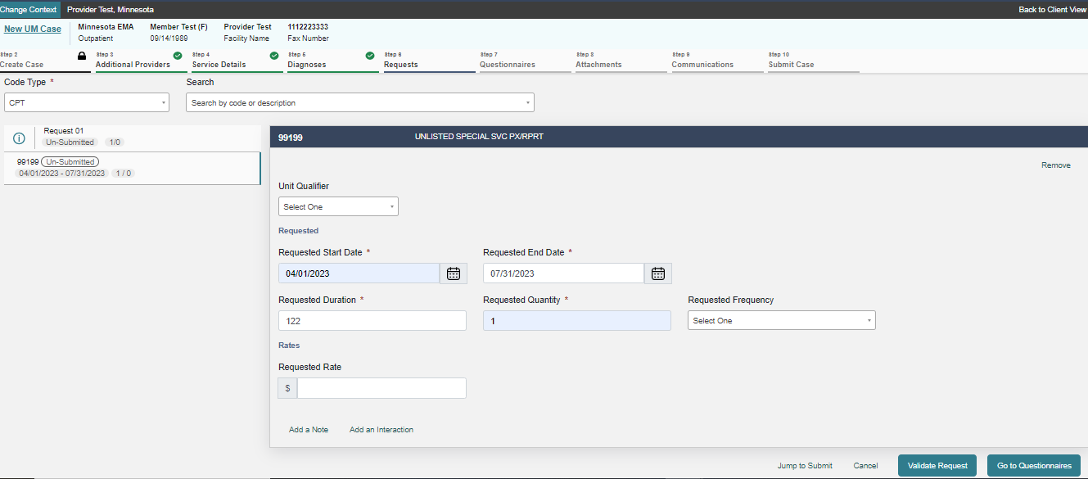
13
Atrezzo Provider Portal
CPT CODE DETAILS
Choose:
Requested Start Date
Requested End Date
Quantity (Should always be 1)
Click “Go to Questionnaire” to continue

Slide 18
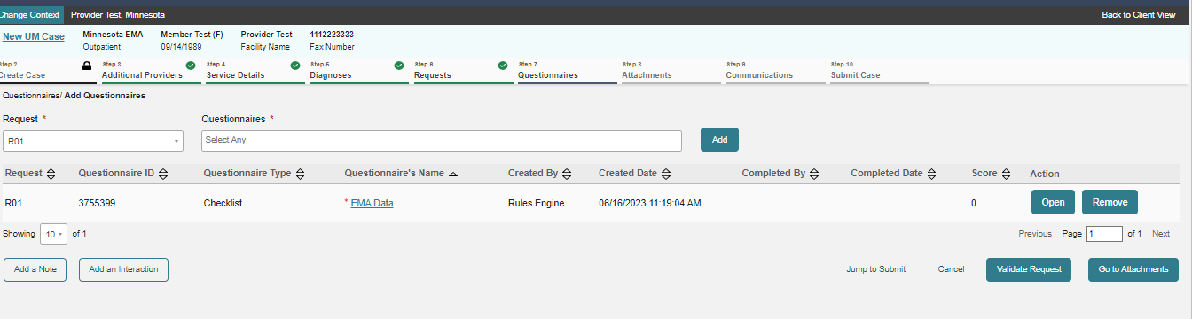
14
Atrezzo Provider Portal
CPT CODE DETAILS
Choose:
Request
Questionnaire
Click “Add”
Open added Questionnaire
Click “Go to Attachments” to continue

Slide 19
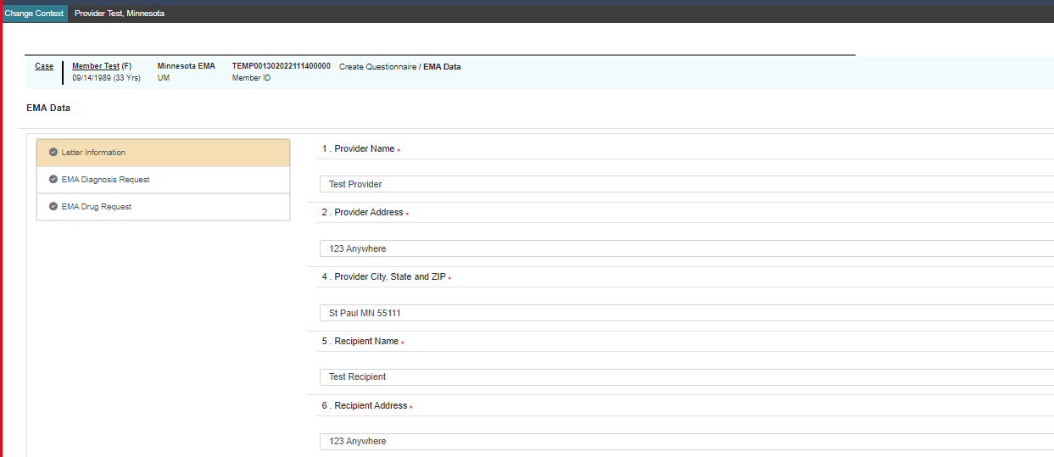
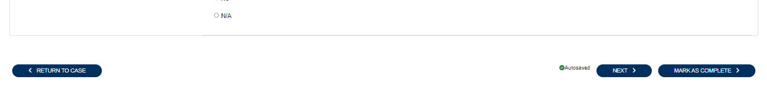
15
Atrezzo Provider Portal
QUESTIONNAIRE
Fill out questionnaire accordingly.
Choose “Next” to move to the next page
Choose “Return to Case” upon completion
NOTE: Please DO NOT click the “Mark as Completed, instead choose “Return to Case”

Slide 20
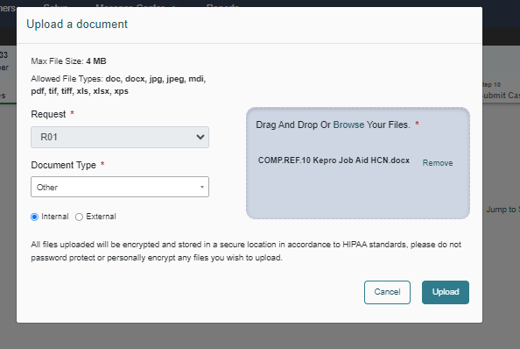
16
Atrezzo Provider Portal
ATTACHMENTS
Click on “Upload documents.”
*You can drag and drop your documents, or you can browse your files.
Once the documents are chosen, click on “Upload.”

Slide 21
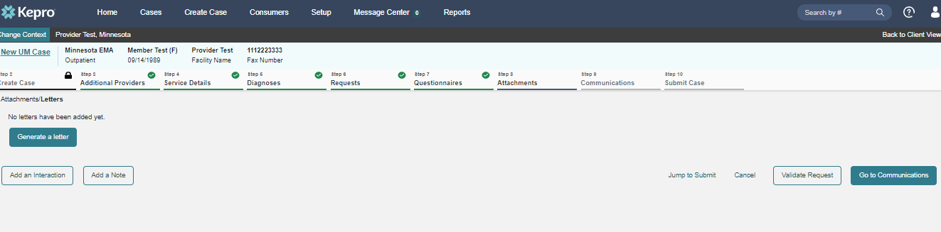
17
Atrezzo Provider Portal
LETTERS
Click “Go to Communications” to continue

Slide 22
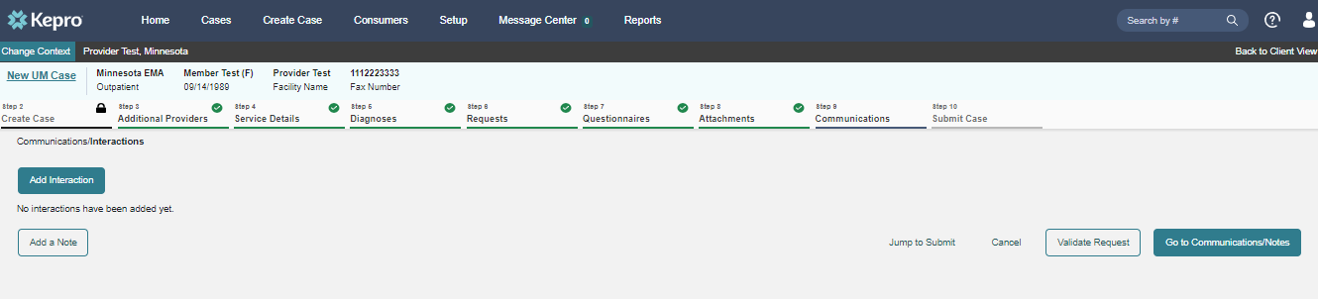
18
Atrezzo Provider Portal
COMMUNICATIONS
Optional: Click “Add Interaction” to insert note for the Reviewer

Slide 23
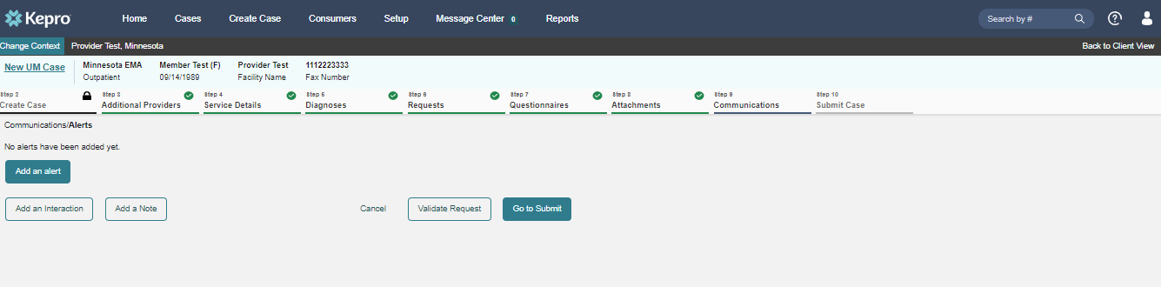
19
Atrezzo Provider Portal
COMMUNICATIONS
Optional: Click “Add an Alert” to insert case alerts
Click “Go to Submit” to finalize

Slide 24
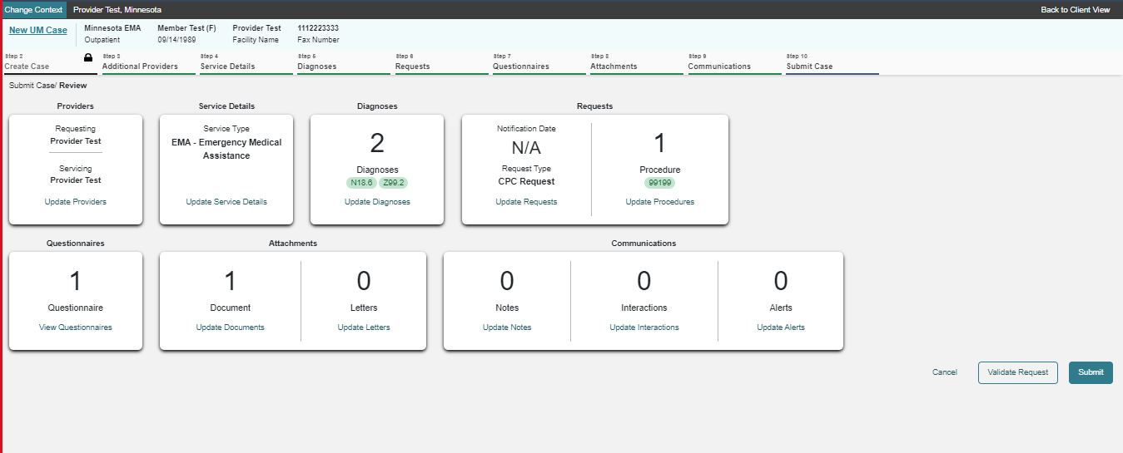
20
Atrezzo Provider Portal
REVIEW CASE
Click “Submit” upon review on submission status

Slide 25
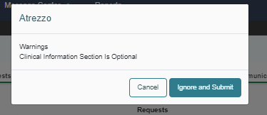
21
Atrezzo Provider Portal
WARNINGS
Click “Ignore and Submit”

Slide 26

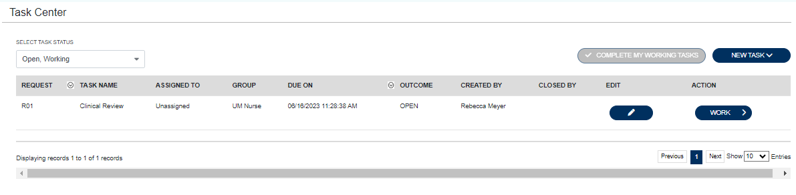
22
Atrezzo Provider Portal
CASE SUBMISSION
When a case ID is populated, the case has been successfully submitted for review.

Slide 27
23
Atrezzo Provider Portal
CPC Requirements
[EMA] DHS MANUAL:
https://www.dhs.state.mn.us/main/idcplg?IdcService=GET_DYNAMIC_CONVERSION&RevisionSelectionMethod=LatestReleased&dDocName=DHS16_157743
CPC FORM DHS 3642:
https://edocs.dhs.state.mn.us/lfserver/Public/DHS-3642-ENG
Please follow instructions on the last page of the CPC Form
Only one date of service per CPC
Clinical documentation to support CPC must be included
Notes:
The CPC form duplicates a lot of information that is built into the portal. So if they submit electronically, do they need to submit the CPC Form?

Slide 28
CASE DENIAL REASONS
MOST COMMOM REASONS FOR A REJECTED CASE/ADMINISTRATIVE DENIAL
  Incomplete CPC Form
  Any incomplete box may be a cause for rejection
  No supporting documentation
  No medical professional signature
  Inactive diagnosis codes
  Listing more than 15 diagnosis codes
  Ineligible for EH
  Multiple dates of service
  Emergency room visits

Slide 29


Question & Answer

Slide 30




Thank you for attending!
Please reach out with any questions you may have.
Contact Info
1 (844) 810-1472
EMAMNMedicaid@kepro.com
https://mhcp.kepro.com/

